Slide 1
HPC usage and software packages
Vladimir Slavnić
Research Assistant
Institute of Physics Belgrade

Slide 2
Agenda
VI-SEEM HPC resources
PARADOX Cluster
Access to PARADOX Cluster
PARADOX Cluster software stack
Environment modules
Job management with examples

Slide 3
VI-SEEM HPC Resources
High Performance Computing
HPC vs HTC
VI-SEEM HPC (High Performance Computing) service
Provides access to clusters with low-latency interconnection or supercomputers
15 HPC systems
Most of them based on CPUs with x86_64 instruction set and equipped with accelerator cards
Some BlueGene/P systems, and one based on the Cell processors.
Delivers 18.8 CPU, 371.6 GPU, 16.0 Xeon Phi, and 5.3 IBM Cell millions of hours per year
Ability to perform complex simulations on the state-of-the-art computing hardware

Slide 4
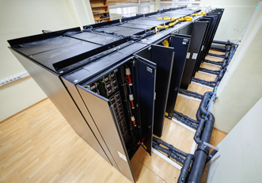
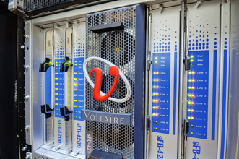
PARADOX Cluster
Water-cooled racks
106 nodes, 1696 CPU cores
2x8-core Intel Sandy Bridge E5-2670 @ 2.6 GHz
32 GB of RAM
106 GPU NVIDIA Tesla M2090
96 TB storage space
Lustre parallel file system
QDR Infiniband 40 Gbps

Slide 5
Access to PARADOX Cluster
From local machine within IPB computer network:
$ ssh username@paradox.ipb.ac.rs
Example:
$ ssh demo001@paradox.ipb.ac.rs
If a graphical environment is needed use the -X option:
$ ssh username@paradox.ipb.ac.rs -X
Login node paradox.ipb.ac.rs is used for:
- Preparing jobs - Submitting jobs to the batch system
- Some very lightweight testing - But not for the long running computations!
File systems
/home # Shared between worker nodes and used both for long term storage and job submission
/scratch # Local file system available on each worker node
Secure copy (scp) can be used to transfer data to or from paradox.ipb.ac.rs
To logout use the Ctrl-d command, or exit
From outside of IPB computer network, first log in to the user interface machine ui.ipb.ac.rs, and then to login node paradox.ipb.ac.rs
http://www.scl.rs/PARADOXClusterUserGuide/

Slide 6
PARADOX Cluster software stack [1]
Compilers
GNU Compiler Collection
Intel Compilers
Portland Group Compilers
Performance tools
Profilers
Scalasca
TAU
Cube
gprof
PGI pgprof
Intel Vtune
Valgrind
Debuggers
TotalView Debugger
GDB
PGI pgdbg
Intel Debugger

Slide 7
PARADOX Cluster software stack [2]
Libraries
LAPACK
BLAS
FFTW
Intel MKL
NumPy & SciPy
Boost
gsl
HDF5
Application software
CP2K
NAMD
Netcdf
Parallel libraries
CUDA
OpenMPI
Gromacs
VMD

Slide 8
Environment modules [1]
Tool to help users to manage Linux environment
Dynamic modification of a user's environment variables
Used by HPC centers to provide different versions of software to users
Check available modules
$ module avail
The modules on PARADOX are divided into:
Applications, environment, compilers, libraries and tools categories

Slide 9
Environment modules [2]
Module can be loaded by executing:
$ module load module_name
Example:
$ module load intel
$ which icc
$ env
The list of currently loaded modules can be shown by tying:
$ module list
Specific modules can be unloaded by calling:
$ module unload module_name
Example:
$ module unload intel
$ module list
All modules can be unloaded by executing:
$ module purge

Slide 10
Job management [1]
Batch system (torque+maui scheduler) on paradox.ipb.ac.rs is managing:
Job submissions
Resources allocations
Jobs launching over the cluster
To submit a batch job, user needs to write a shell script which contains:
A set of directives which describe needed resources for job (lines beginning with #PBS)
Lines necessary to execute user’s code
After that job can be launched by submitting the script to batch system using qsub command
Job will enter into a batch queue
When resources are available, job will be launched over allocated nodes
Batch system provides monitoring of all submitted jobs
Queue standard is available for user’s job submission.

Slide 11
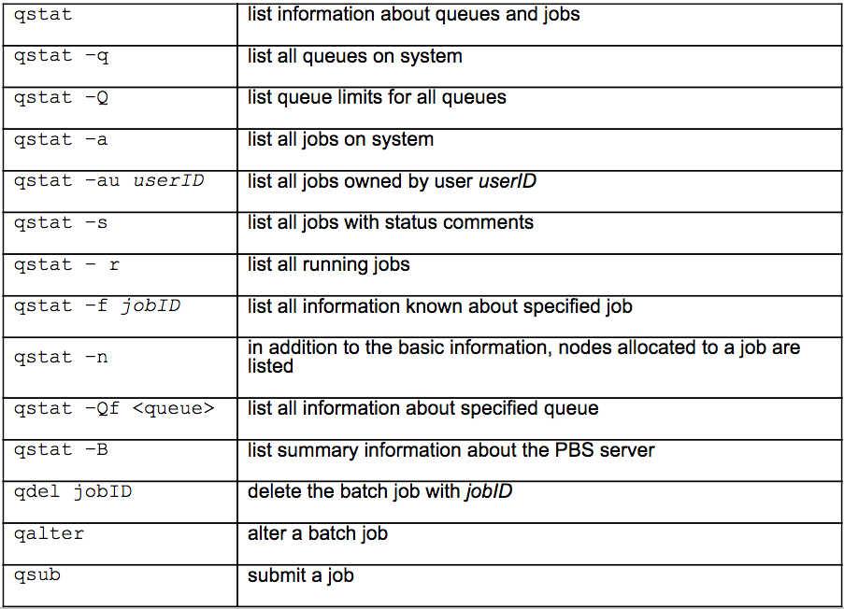
Job management [2]
Frequently used PBS commands

Slide 12
Serial job example [1]
Sample sequential job PBS script:
#!/bin/bash
#PBS -q standard
#PBS -l nodes=1:ppn=1
#PBS -l walltime=00:10:00
#PBS -e ${PBS_JOBID}.err
#PBS -o ${PBS_JOBID}.out
cd $PBS_O_WORKDIR
chmod +x job.sh
./job.sh
Simple job bash script
#!/bin/bash
/bin/date
/bin/hostname
pwd
sleep 30
/usr/bin/whoami
This example can be downloaded from:
http://wiki.ipb.ac.rs/images/d/db/Serial.tgz
Download tgz archive with example files, extract archive and enter serial folder
:

Slide 13
Serial job example [2]
Submit job to execution by issuing following command:
$ qsub job.pbs
The qsub command will return а result:
<JOB_ID>.paradox.ipb.ac.rs
Where <JOB_ID> is а unique integer used to identify the job
To check the status of your job use the following command:
$ qstat <JOB_ID>
Alternatively user can check the status of all submitted jobs using the following syntax of the qstat command:
$ qstat -u <user_name>
To get detailed information about a job user can use the following command:
$ qstat -f <JOB_ID>

Slide 14
Serial job example [3]
When job is finished, files to which standard output and standard error of a job was redirected will appear in user’s work directory
To cancel a running job following command should be executed:
$ qdel <JOB_ID>

Slide 15
NAMD job example
Go to:
http://wiki.vi-seem.eu/index.php/PARADOX-IV_NAMD_and_VMD_usage
Download apoa1 benchmark input
Download and prepare PBS job script
http://wiki.ipb.ac.rs/images/6/60/Example_namd_job_scripts.tgz
Submit NAMD job:
CUDA with InfiniBand
$ qsub example_gpu.pbs
InfiniBand via OpenFabrics OFED
$ qsub example_non_gpu.pbs

