Slide 1




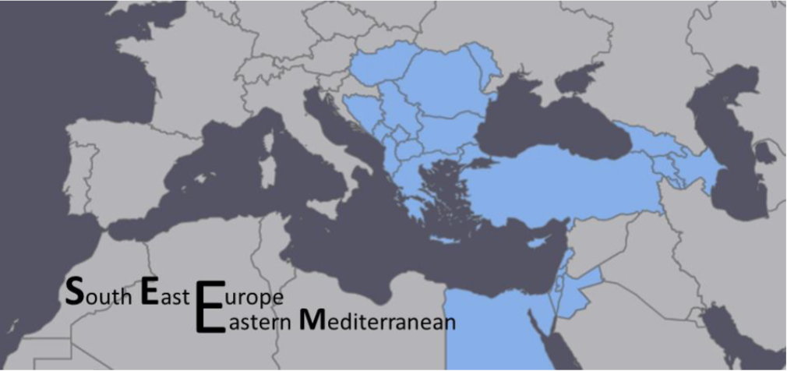
VI-SEEM Project and its Synergy with National Initiative Supported by the Agency for Innovation and Technology Transfer
Dr. Petru Bogatencov
Local project coordinator
IMI ASM, RENAM
bogatencov@renam.md

Slide 2
Scopul Proiectului DICOM Network
Proiectul are drept obiectiv principal formarea unui sistem informaţional integrat, bazat pe tehnologii de calcul distribuit GRID, Cloud pentru evidenţă şi schimb de informaţii în format DICOM, orientat să sporească considerabil calitatea serviciilor prestate, micşorând totodată sinicostul lor. Conceptul de dezvoltare a sistemului informaţional include colectarea, stocarea, prelucrarea şi difuzarea de informaţii medicale în format DICOM într-o instituţie aparte, grup de instituţii şi toate instituțiile din țara. Sectorul TIC fiind aplicat în realizarea acestui obiectiv permite prelucrarea şi vehicularea informaţiei în cadrul unui sistem informaţional unic intr-o manieră specifică, de natură să producă schimbări profunde in activitatea sistemului de sănătate. Sistemul permite colectarea datelor imagistice pentru o analiza mai profundă a accidentelor neurologice si traumatologice, la fel şi incidenţa lor in sănătatea populaţiei.

Slide 3
DICOM format
DICOM (Digital Imaging and Communications in Medicine) is a standard for handling, storing, printing, and transmitting information in medical imaging. It includes a file format definition and a network communications protocol.
The communication protocol is an application protocol that uses TCP/IP to communicate between systems. DICOM files can be exchanged between two entities that are capable of receiving image and patient data in DICOM format.
DICOM enables the integration of scanners, servers, workstations, printers, and network hardware from multiple manufacturers into a picture archiving and communication system (PACS).
The National Electrical Manufacturers Association (NEMA) holds the copyright to this standard. It was developed by the DICOM Standards Committee, whose members are also partly members of NEMA. DICOM is known as NEMA standard PS3, and as ISO standard 12052:2006 "Health informatics -- Digital imaging and communication in medicine including workflow and data management".

Slide 4
DICOM data
A DICOM data object consists of a number of attributes, including items such as name, ID, etc., and also one special attribute containing the image pixel data
Logically, the main object has no "header" as such, being merely a list of attributes, including the pixel data. A single DICOM object can have only one attribute containing pixel data. For many modalities, this corresponds to a single image.
Another example is supplement to the DICOM Standard for Nuclear Medicine (NM) data, where an NM image, by definition, is a multi-dimensional multi-frame image. In these cases, three- or four-dimensional data can be encapsulated in a single DICOM object.
Data Set is that portion of a DICOM Message that conveys information about real world objects being managed over the network.
DICOM uses three different Data Element encoding schemes. With Explicit Value Representation (VR) Data Elements, for VRs the format for each Data Element is: GROUP (2 bytes) ELEMENT (2 bytes) VR (2 bytes) LengthInByte (2 bytes) Data (variable length). There are two other schemes of Explicit Data Elements or Implicit Data Elements encoding in the DICOM standard.
DICOM standard has problems related to data entry. "A major disadvantage of the DICOM Standard is the possibility for entering probably too many optional fields. This disadvantage is mostly showing in inconsistency of filling all the fields with the data. Some image objects are often incomplete because some fields are left blank and some are filled with incorrect data.“ [Mustra, Mario; Delac, Kresimir; Grgic, Mislav (September 2008). Overview of the DICOM Standard. ELMAR, 2008]

Slide 5
Background of medical images data collecting and processing system creation
During last years IT sector and eHealth made a big progress in Moldova:
Hospitals and other medical Institutions acquire modern digitized equipment.
Medical institutions are connected to the Internet and high speed connections available not only in the cities but in the country regions too.
Many medical institutions are developing and implementing different information systems.
One of the directions of eHealth developing is implementation of instruments for processing and systematization of various images produced as a result of medical examinations. E.g. only limited number of medical institutions in Moldova possesses modern tomography equipment that can be used for complex images processing. It often happens that tomographic examinations’ images are needed to be transferred from one hospital to another for their analyzing and future use.
At present images transmission technologies mainly based on writing data on photo films, CD and DVD, but a few installations are equipped by DICOM Viewers for qualitative information visualization.
Creation of integrated system of DICOM images collection, systematization and visualization in unified form is a very actual task.

Slide 6
Background of medical images data collecting and processing system creation (2)
Currently even in framework of one medical institution the exchange of imagistic investigations typically is performing only by printing the images on the paper that is not comfortable for medical personal because they are limited in number of copies and quality. As a result at the surgery are presented only the pictures printed by the doctor specialist in imagistic but not the doctor who care of the patient. It is often happens in practice that physicians are waiting in operating room for images to be printed from existing investigation.
For transferring investigations to other medical institution, when patient is transferred or addressed to another medical entity or to another specialist, is also used printed version of investigation, because it is not always exist properly compatible DICOM Viewer with target investigation format. As a result, a part of investigation is not printed and the treating specialist does not have all necessary information; usually it causes making again expensive investigation. If there appears a need to transfer the investigation to the other country, for obtaining recommendations from foreign specialist in nowadays-medical institutions need to transfer these images via paper mail and it causes inexplicable delays.
As a result, medical institutions have to spend many extra expenses for buying the needed materials for print and archive the results of investigations in non-convenient form.

Slide 7
DICOM Network concept
Medical institutions that offer imagistic investigations have a number of problems with saving and distributing the results of investigations:
Sending the results to the patient’s doctor
Creating archive
Consulting with other doctors and scientists
Exchange of information with other medical institutions
Collecting and calculating statistics
DICOM Network offers the possibility to solve in unified manner all these problems and issues. Also it will increase the quality of offered service and reduce the price of medical investigations.
Instrumental support of DICOM Network implementation is based on utilization of the modern technologies of distributing computing.

Slide 8
Specific features of DICOM Network
The main aim of the proposed Distributed Network for Secure Exchanging of DICOM Format Images is creation of united system of exchanging DICOM medical examinations using distributed computing technologies.
Creation of facilities that offers a possibility to realize unified approach for storing, processing and distributing of medical examination in DICOM format for all medical institutions of the country.
The essence of the system can be fully achieved in case the proposed network will integrate all main national institutions and hospitals that offer possibility of medical examinations in DICOM format (tomography, roentgen, photofluorography, ultrasonic, etc.).

Slide 9
Basic approaches for the system realization
There exist different kinds of applications for visualization and processing of the DICOM image files, but these applications and their algorithms are heavily depend on medical equipment and also on its vendor. Thus, access to these data files is restricted to computers that are connected to the specialized devices.
One of the main feature of the proposed by authors approach is elaborating of a unified library for storing, visualizing and processing of DICOM images that will be made available for authorized medical personnel in medical institutions. These unified modules would provide the opportunity for every physician with the necessary access rights to examine results of the actual and precedent patient's investigations;
The system on the other hand would allow students and residents to access the results of the investigations and see conclusions made by specialists

Slide 10
Basic approaches for the system realization (2)
Development of DICOM Network system has to cover three aspects:
high performance, large and reliable storage and high level of data security. Analysis proved that the most suitable solution is to use distributed computing resources.
It implies that all the algorithms and their code would be running on external high-performance computing resources like Grid / Cloud distributed clusters (in the existing infrastructure).
The proposed innovative approach would have a significant impact in the future allowing realization of intellectual algorithms of searching for similar cases in precedent investigations and analysis of prescribed treatment or helping in making decisions to medical specialists.

Slide 11
Basic approaches for the system realization (3)
DICOM Network is working as PaaS and SaaS system for medical institutions connected to the system.
The system will grant secured access to investigations that contains DICOM images and results of data processing.
Current system concept represents only the first step of integrated system elaborating for results of medical investigations collection, storing and results sharing; the final idea is to create a common database of medical investigations and keep the patient medical card in the database hosted in distributed computing infrastructure.

Slide 12
Previous realizations. Existing centralized system of images collection and access

Slide 13
Disadvantages of the previous centralized realization of the system
There is no of unified format DICOM Viewer that is qualitative enough and well adopted to the system needs;
Extremely strong requirements to the storage capacity – centralized data storage system’s capacity is the bottleneck;
Problems with computational resources for large files processing
Restricted number of on-line transactions processing and problems of scalability for new working places connection;
Complicated procedure for results of investigations transmitting/exchange outside the existing centralized system

Slide 14
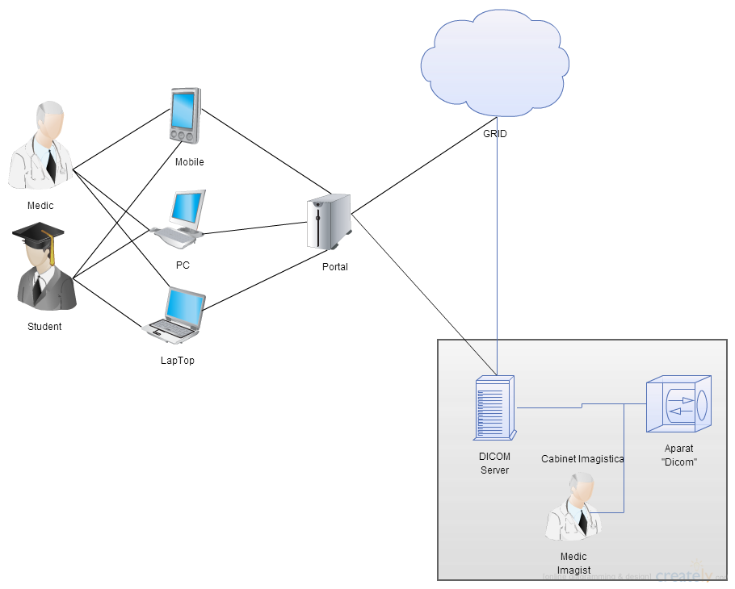
DICOM Network – distributed approach
“Processor” -
processing resources
/ cloud
DICOM Viewer

Slide 15
Компоненты системы DICOM Network
На основе информации на представленной выше схеме можно выделить следующие компоненты распределенной системы:
«DICOM Server» – модуль отвечающий за сбор и локальную обработку изображений, подготовку и отправку их для хранения и обработки на Cloud/Grid компьютерную инфраструктуру.
«Processor» - специальный Job для обработки на распределенной компьютерной инфраструктуре с целью оптимального архивирования изображений
«Portal» - WEB интерфейс, посредством которого зарегистрированные пользователи (врачи и другие категории пользователей) могут найти необходимое обследование
«DICOM Viewer» - Desktop приложение, обеспечивающее возможность визуализации и построения различных моделей на базе DICOM изображений.

Slide 16
Features of DICOM Network software
Ability to visualize various images acquired in DICOM format from different types of medical equipment;
Ability to receive images from various medical installations and storing them in the unified DICOM format;
Providing ability to exchange images in DICOM format among various institutions and working locations;
Ability to systemize and roughly analyze acquired images in DICOM format for finding correlating dependences.

Slide 17
Realization approach base on distributed computing infrastructure
Well scalable and adaptive for special data processing requests, computational and data storage resources;
Possibility of using global computational resources for deep analysis of investigations and complex processing of collecting data;
Ability to share data in a very convenient way among medical establishments at national level and internationally;
Very reliable and unified procedure of users’ identification and authorization.

Slide 18
DICOM Network-distributed solution
Section
Physician Workstation
GRID/cloud
infrastructure
Request for images from archive
Dicom Viewer
Information about
the Patient
Images
CA Autentification
One of the
Tomograf Center
eHealth
Web Portal
Tomograph
Server to
Process
DICOM
Images
Data on medical research
DICOM
Files

Slide 19
Component DICOM server
DICOM Server – данный модуль является сервисом обеспечивающим процесс сбора исследований от оборудования, сохранения архива изображений и передаче информации об обследовании в «DICOM Portal». Данный сервис рассчитан на различные интерфейсы импорта/экспорта данных в зависимости от аппаратуры.
«DICOM Server» может быть использован как обыкновенный PACS, так как в нём реализованы все необходимые команды для протокола DICOM: CSTORE, CMOVE, аутентификация по AETITLE. Таким образом, он может быть использован, в том числе для присоединения к системе сторонних специализированных Viewer.
Основным же преимуществом данного компонента является разработанная в проекте система архивирования и оптимизирования массивов изображений и их последующая интеграция с «DICOM Portal» и «DICOM Viewer». Это позволяет разграничить уровень доступа к исследованию в соответствии с базой данных медперсонала и учитывая изменения во внешней информационной системе документооборота пациентов.

Slide 20
Component DICOM portal - the system WEB interface
Users’ access web interface of the DICOM Network is realized via DICOM Portal that can be integrated and considered as a part of the distributed National e-Health portal. This integrated solution allows to provide service for the following types of users:
Пациентов, которые имеют доступ лишь к своим обследованиям исходя из IDNP.
Врачей больницы, которые имеют доступ лишь к пациентам, которые они ведут на текущий момент.
Врачей специалистов, которые обрабатывают исследования, поступающие от «DICOM Server», вносят заключение, расходные материалы и протокол исследования.
Пользователей с временным доступом, которые получают временный доступ к конкретным пациентам/исследованиям. Это необходимо для обеспечения доступа иностранным специалистам, судам или другим пользователям системы в соответствии с разрешениями, не конфликтующими с концепцией защиты персональных данных.
Администраторов системы, выполняющих мониторинг и конфигурацию системы «DICOM Server» и регулирующим уровень доступа для остальных пользователей системы.
Для администраторов системы была разработана отдельная консоль управления, также доступная ONLINE.

Slide 21
DICOM Network – other system components
DICOM Monitoring – cистема мониторинга работы сконфигурированных «DICOM Servers» . Данная система позволяет определить неисправность или недоступность подключения оборудования, что в свою очередь позволяет решить проблему на ранней стадии и повышает отказоустойчивость всей системы.
DICOM Viewer – для просмотра исследований был разработан специализированный «DICOM Viewer» обеспечивающий все необходимые операции нам медицинским изображением
Autentification Interface – является интерфейсом для интеграции сторонних систем аутентификации и авторизации. Данный модуль существенно расширяет область применения системы и позволяет подключать авторизированные законом trusted источники информации. Одним из примеров использования данного интерфейса является интеграция системы MPASS позволяющая дать доступ пациентам к персональным исследованиям.
Processor Interface – является интерфейсом для обработки DICOM изображений сторонними системами, таким как внешние High Performance Computing, GRID или Cloud инфраструктуры, что открывает возможности для развития системы в будущем.

Slide 22
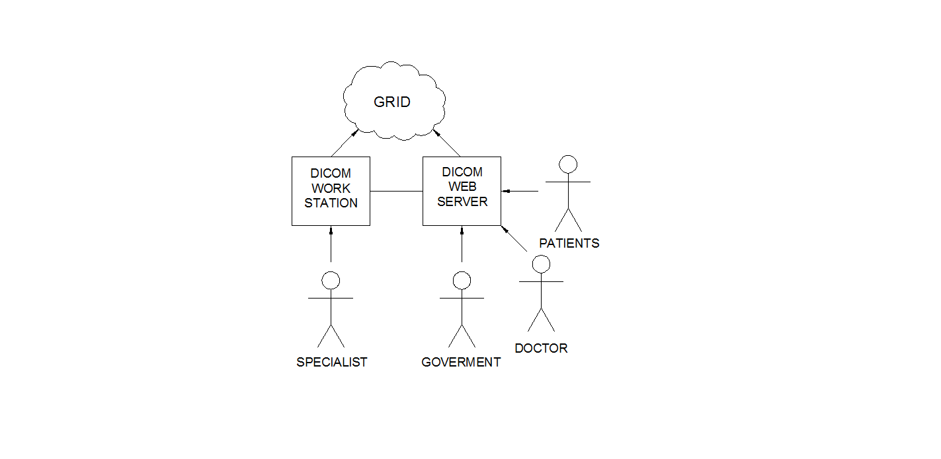
Entities interrelated with DICOM Network information system
Main entities of that use resources and interrelate with creating information system are:
Patients – clients of one of the medical centers.
Doctors – employees in the hospital
Imagistics specialists – doctors specialized on working with DICOM images.
Doctors who use the data results from DICOM Network for practical treatment
Representatives of Government - Statistics Agency and the Ministry of Health

Slide 23
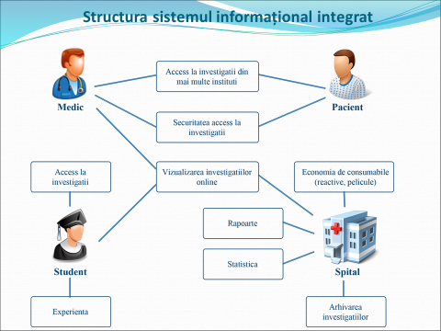
System Data Flows and Users’ Categories

Slide 24
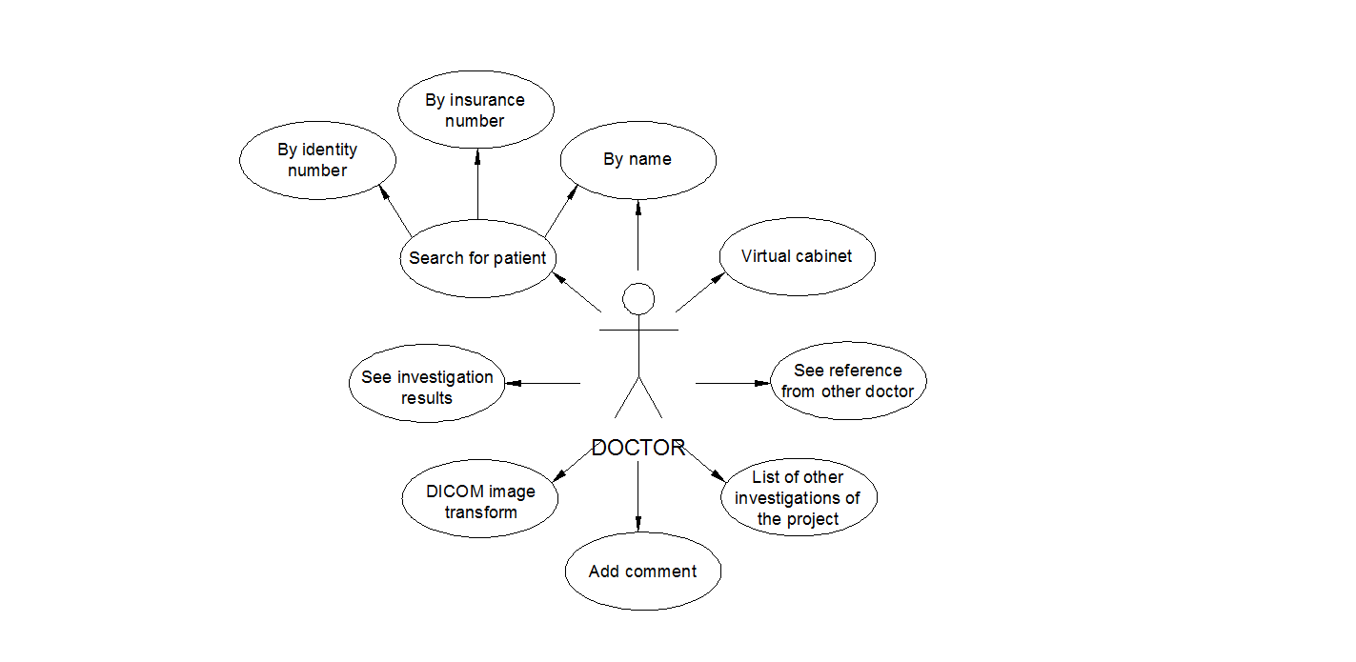
Functionality for medical doctor

Slide 25
Rezultatul implementării SID DICOM Network
Sistema deja implimentată este primul în RM sistem informațional, care efectuează colectarea, analiza și arhivarea imaginilor digitale medicale.
Peste 200 de investigații sunt stocate zilnic prin intermediul sistemului dat
Peste 400 de investigații zilnic sunt preconizate la finele anului curent după conectarea noului aparataj medical
La moment 16 medici imagiști au acces la investigații primite de la dispozitivele medicale digitale pentru analiza și documentarea rezultatelor investigării
Circa 500 medici din cadrul instituției au primit acces la investigațiile pacienților tratați în regim ON LINE nemijlocit la locul lor de muncă în dependență de nivelul de acces configurat pentru fiecare utilizator
2 «DICOM Server» au fost instalate la moment, ceia ce acoperă necesitățile Beneficiarului Sistemul poate fi tirajat și are posibilitate de conectare pentru un număr nelimitat de servere pentru acoperirea necesităților instituțiilor medicale
Sistema permite de a urgenta considerabil accesul medicilor la investigații și rezultate și sporește calitatea acordării serviciilor medicale dând posibilitate medicilor cliniciști de a analiza personal investigațiile

Slide 26
Atragerea investiţiilor suplimentar pentru dezvoltarea
Au fost întreprinse negocieri cu potenţiali parteneri din instituţiile medicale private şi statale cu prezentarea conceptului sistemului şi obiectivelor de realizare:
Clinica Galaxia
Centrul German de diagnostic
Centrul Diagnostic
Spitalul Republican
Sistemul a fost evaluat pozitiv şi colaborarea va continua pe parcursul finisării sistemului şi ajustării lui la necesităţile Beneficiarului.

Slide 27
System Development perspectives
The DICOM Network as integrated application proposed for future development within H2020 VI-SEEM (VRE for regional Interdisciplinary communities) project. Main areas of future development are:
Processing image sets from extended types of medical devices in common format;
Store large amounts of data in safety distributed storage provided by regional cloud storage infrastructure;
Effective management of stored medical research data;
Participate in creation and use of regional distributed medical images data processing system;
Realization of Instruments for providing strictly limited access to personal patient data.
Together with the project partners we are negotiating possible extension of the initial set of DICOM Network system components.

Slide 28
Joint AITT DICOM Network and Hirizon2020 VI-SEEM projects event

Slide 29
VI-SEEM
Contract n°: 675121
Start date: 01/10/2015
Duration: 36months
Total budget: 3 500 000 €
Total funded effort, PMs: 715
Web site: www.vi-seem.eu

Slide 30
Partners
Participant no. | Participant organisation name | Part. short name | Country
1 (Coord) | GREEK RESEARCH AND TECHNOLOGY NETWORK S.A. | GRNET | Greece
2 | THE CYPRUS INSTITUTE | CyI | Cyprus
3 | INSTITUTE OF INFORMATION AND COMMUNICATION TECHNOLOGIES – BULGARIAN ACADEMY OF SCIENCES | IICT-BAS | Bulgaria
4 | INSTITUT ZA FIZIKU | IPB | Serbia
5 | NEMZETI INFORMACIOS INFRASTRUKTURA FEJLESZTESI IRODA | NIIF | Hungary
6 | UNIVERSITATEA DE VEST DIN TIMISOARA | UVT | Romania
7 | UNIVERSITETI POLITEKNIK I TIRANES | UPT | Albania
8 | UNIVERZITET U BANJOJ LUCI | UNI BL | Bosnia and Herzegovina
9 | SS CYRIL AND METHODIUS UNIVERSITY OF SKOPJE | UKIM | FYR of Macedonia
10 | JAVNA USTANOVA UNIVERZITET CRNE GORE PODGORICA | UOM | Montenegro
11 | RESEARCH AND EDUCATIONAL NETWORKING ASSOCIATION OF MOLDOVA | RENAM | Moldova
12 | INSTITUTE FOR INFORMATICS AND AUTOMATION PROBLEMS OF THE NATIONAL ACADEMY OF SCIENCES OF THE REPUBLIC OF ARMENIA | IIAP-NAS-RA | Armenia
13 | GEORGIAN RESEARCH AND EDUCATIONAL NETWORKING ASSOCIATION | GRENA | Georgia
14 | BIBLIOTHECA ALEXANDRINA | BA | Egypt
15 | INTER UNIVERSITY COMPUTATION CENTER | IUCC | Israel
16 | SYNCHROTRON-LIGHT FOR EXPERIMENTAL SCIENCE AND APPLICATION IN THE MIDDLE EAST | SESAME | Jordan

Slide 31
VI-SEEM Vision
Achieve leadership in science
Enable e-Infrastructure based research and innovation
Regional dimension with high levels of collaboration
Focus on 3 strategic regional user communities
  Trying to produce multidisciplinary tools and practices
  Improve and Produce advanced research
  Bridge the development gap with the rest of Europe

Slide 32
Overall Objectives
Provide user-friendly integrated e-Infrastructure platform
Scientific Communities:
  Climatology
  Life Sciences
  Cultural Heritage
Focus on SEE Region
Resources, services, tools
  Compute
  Data
  Visualization resources
  Services
  Software and Tools

Slide 33
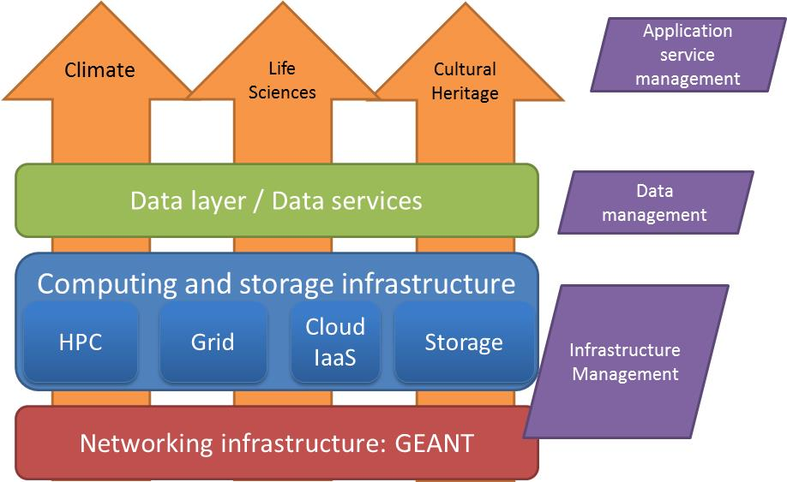
VI-SEEM In a figure

Slide 34
Objectives (1)
Provide scientists with access to state of the art e-Infrastructure - computing, storage and connectivity resources - available in the region; and promote additional resources across the region.
Integrate the underlying e-Infrastructure layers with generic/standardised as well as domain-specific services for the region.
Promote capacity building in the region and foster interdisciplinary approaches
  Metrics: minimum of 39 distinct applications and 45 research teams using the VRE

Slide 35
Objectives (2)
Provide functions allowing for data management for the selected and supported Scientific Communities
Provide adequate user support and training programmes
  Metrics: 18 dissemination events organized by the project with total of 1000 persons targeted, 12 training events organized by the project with 300 persons targeted
enable research activities of international standing in the selected fields of Climatology, Life Sciences and Cultural Heritage

Slide 36
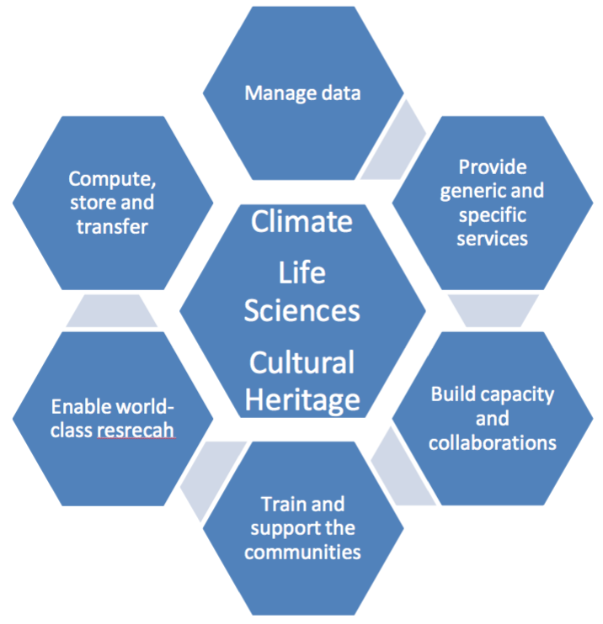
Objectives

Slide 37
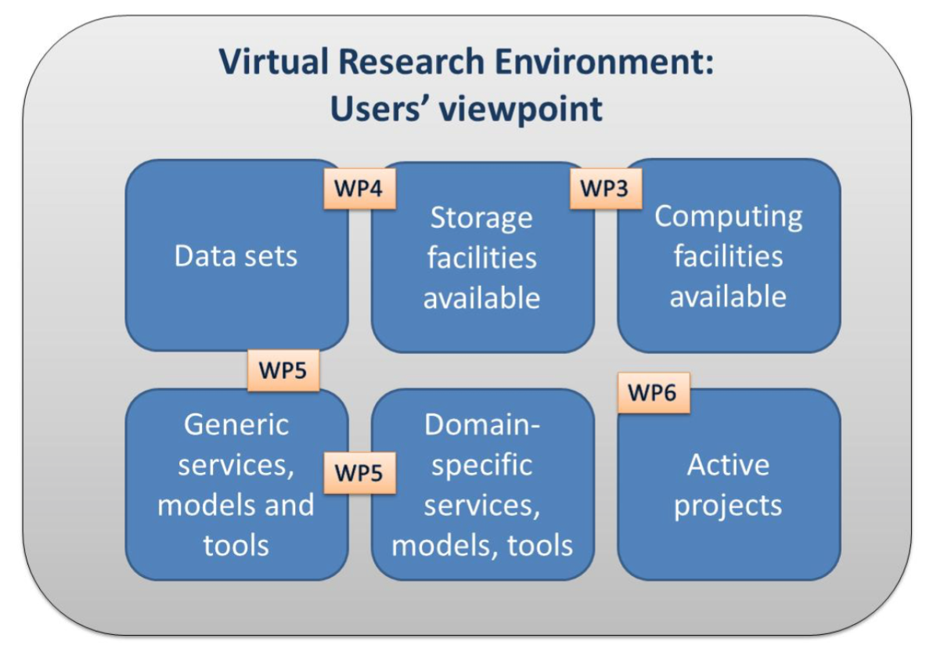

Slide 38
Work Organization

Slide 39
WP2 Communication, Marketing, Training and Innovation
Develop content rich communication platform (not just for the project, but for the relevant communities as a whole.
  Web site, promotional material, agenda system, document sharing, social media
Communication, dissemination and marketing
  Marketing strategy and plan
  Communication strategy
  Dissemination events
Training
  National and international training workshops / events
  Discipline specific
  Cross discipline
  Training repository
Support innovation management
  Develop Strategy
  Monitor the development of innovation
  Manage IPR

Slide 40
WP3 e-Infrastructures and services
Provide scientists with state of the art networking, computing and storage infrastructures and help increase the resource pool in the region
  HPC, Cloud, Grid, Storage
Support the VRE by operating stable resources, services and APIs across various resource provider countries (most of the partners provide resources)
Provide end-to-end VRE resource monitoring and management
Support service-driven approach

Slide 41

WP3 Tasks
Service Registry and Service Level Definitions
Define and implement Service portfolio / catalogue
    Initial Definition and processes
    To be used by all WPs to maintain and publish their services
  SLAs / OLAs for selected services, Initial Definition and processes
Implementation of resource and service provisioning
  Manage relations with infrastructure providers, increase capacity when needed
    List of resource provides, resources types and offering (resources catalogue)

Slide 42
WP3 Tasks
Operations and resource management of the e-Infrastructure for Scientific Communities
  Operations, management, monitoring, accounting
    Tools for:
      Monitoring
      Resource Registries
      Accounting
Authentication, authorization and access management
AAI in a diverse (multiple resource types / multiple APIs / multiple providers) and distributed environment
    State of the art (AARC project)
    Options for AAI
    Initial Solution, Intermediate solution, ifnal aim

Slide 43
WP4 Data Management Lifecycle
Full Data management lifecycle, provide data interoperability across disciplines
Select and integrate data management services tailored to the project’s Scientific Communities
Collect the actual VRE-specific data sets and make them available via common interfaces and services
Provide technical user documentation for all services and tools and contribute to the development of training materials

Slide 44


WP4 Tasks
  Design data services
    tailored to the project’s Scientific Communities
    Facilitating the full data lifecycle (creation, processing, analysis, preservation, access, re-use) – list of options and particular tools for the following scenarios.
      Simple storage (Pythos, B2Drop, ?)
      Publication and re-use
      Sharing (Pythos, B2SHARE, ?)
      Preservation (B2SAFE)
    Identify Vi-SEEM needs, study EUDAT work
  Data access, preservation and re-use
    Implementation of the above mentioned service and provision of resources
      Meta data services (iRODS)
      PIDs
      Register
      Discovery services

Slide 45


WP4 Tasks
  Data collection and provisioning
    Collection of data sets from project’s communities and make them available
    Direct relation with selected applications and main data providers (to be identified in WP5)
    Define Initial set of applications (data provisioning)
    Regional data availability
    Global data availability
    Privacy requirements
  Data analysis
    Hadoop, other big data analysis services
  Discuss status of RDA proposal

Slide 46
WP5 Domain-specific services and support
Integrate generic/standardised as well as domain-specific services
Promote capacity building in the region and foster interdisciplinary approaches
implement user needs for tools and services and translate into an integration plan
Provide the VRE platform for the multidisciplinary scientific community
Provide scientific application support and application training material

Slide 47
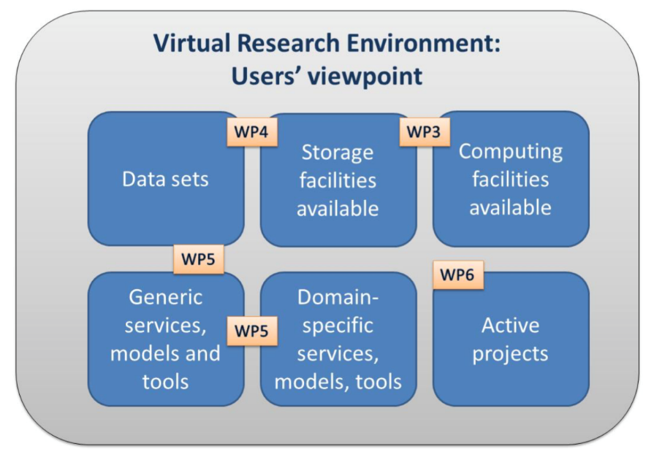

WP 5 Tasks
  Refinement of service requirements and technical assessment for integration
  Identification of service areas, services based on community needs
  Detailed implementation plan including timelines
  Data management plans
  Data sets, descriptions, origin, nature, scale, users, standards, metadata etc.
  In collaboration with WP4
  Development VRE platform
  VRE portal
    What it is
    Technical Information
    Documentation
    Access to data sets
    Tools
    Software repositories
    Access to resources and services

Slide 48
WP5 Tasks (cont)
  Overall integration of services
  Identify and give examples of such services
  Integration of common services
  Scientific support
  Support and enabling of applications using services and infrastructure of the project
  Define process

Slide 49
WP6 Capacity building, open calls and sustainability
Promote capacity building in the region and foster interdisciplinary approaches
Open up the Established Virtual Research Environment to the widest possible regional communities
Enforce a fair, transparent and trusted mechanism for allocation of VRE resources
Facilitate access and deployment of new applications in the VRE infrastructure
Establish and test a viable sustainability and business model

Slide 50
WP6 Tasks
  Framework for VRE resource and service provision
  Access methodology, access policies
Implementation of open calls for access to VRE resources
  Open, monitor and finalize calls for access to resrouces
Integration of the new applications to the VRE environment
  Facilitate use if the services from selected projects
Sustainability and business model
  Organizational models study
  Usage models
  Business models (i.e. pay per use etc.)

Slide 51
Scientific Computing Infrastructure
Computing resources are mainly requested and intensively developing components of the modern e-Infrastructures. Organization of the efficient development, operation and convenient access to e-Infrastructure components for research teams from various institutions at present is one the priority activities for RENAM.
Computing facilities that forming e-Infrastructure based on Parallel Architectures and used for running complex applications:
HPC - Clusters’ systems;
HPC - Supercomputers;
Distributed computing – Grids;
Scientific Clouds…
Parallel Algorithms Design and Programming
Complex Computing Applications Development
Scientific Computing architecture is a bridge for building modern virtualized computing systems – scientific clouds

Slide 52
MD-Grid NGI Aims and Tasks
NREN in Moldova is coordinator of National Grid Initiative and
MD-Grid NGI participates in strategic European Programs for the development of transnational grids and in initiatives for the completion of regional eInfrastructures. The operation of the MD-Grid NGI implements the general EU policy on the development of national initiatives for the coordination of actions related to eInfrastructures and distributed computing.
The integration of distributed computing actions (infrastructures, middleware and applications) with the broadband research and technology network into a standard e-Infrastructures system. Optimization of exploitation of advanced network resources and services, which can serve the new e-Science generation and will attract the greater users community of the Information Society to the mass adoption of advanced services provided by Grid architectures.
Permanent development and administration of the distributed computing infrastructure in Moldova
Organization access for national R&E community to the regional and European computational resources (HPC, Grid, scientific clouds, etc.)
Preparing (educational, training events organization) and support of national users’ communities

Slide 53
MD-Grid NGI supplementary Activities
Engaging of national research and academic institutes and scientific communities via multi-disciplinary VRC in the deployment and development of a range of complex applications.
The development and approval of MD-Grid NGI Policy documents. The elaborated MD-Grid NGI Policy documents stipulate basic principles of NGI Consortium behavior and requirements for NGI supported services:
NGI membership rules for main categories of NGI member organizations: research, academia, industry and government.
The selection of and negotiation of participation with potential new MD-Grid NGI members;
Preparation and signing the agreements about intentions and MoU with MD-Grid NGI new members;
Planning computing infrastructure enlargement, creation and support in setting up new Grid and cloud sites in research and higher educational institutions of Moldova;
Elaboration and negotiation of documents that determine:
Accessible Use Policies and Services Level Agreements for resources and services;
National Grid Certification (Registration) Authority policy and behavior;
Core services structure and functions.

Slide 54
Scientific cloud development
Development of scientific clouds is perspective direction of computational technologies for e-Science. From Moldova RENAM engaged in the following initiatives related to cloud computing:
For SEE region needs cloud technologies were analyzed within SEERA-EI project (EC ERA-NET Programme). The analysis produced had shown strong interest of the regional research communities in scientific clouds technologies deployment. As a resulting outcome of SEERA-EI project was recommendation to launch regional Pilot Call for projects in the area of scientific cloud computing.
Another important initiative is the regional project “Experimental Deployment of an Integrated Grid and Cloud Enabled Environment in BSEC Countries on the Base of g-Eclipse (BSEC gEclipseGrid)” supported by Black Sea Economical Cooperation Programme (http://www.blacksea-cloud.net). The aim of this project is implementation of computing architecture that provide a collaborative, network-based model that enables the sharing of computing resources: data, applications, storage and computing cycles. The project introduces a federated Cloud infrastructure, which can provide different solutions for universities, scientific and research communities and more.

Slide 55
Scientific cloud development (continue)
Development of regional cloud computing resources for Mediterranean and SEE regions supported by VI-SEEM (VRE for regional Interdisciplinary communities in Southeast Europe and the Eastern Mediterranean) European project. VI-SEEM project computational infrastructure includes Cloud Computing and Cloud Data Storage resources.
Moldova is providing resources of MD-Cloud sites for the project. The national cloud computing infrastructure based on OpenStack cloud middleware. RENAMstor data storage resources provided for the project realized using ownCloud platform. Cloud computing infrastructure of the project is available for various research teams from Moldova.
The perspective approach for the mentioned initiatives realization is to combine the Grid and Cloud resources together as a single enhanced computational power and offer the possibility to use Grid or Cloud resources on demand.

Slide 56
High-Performance Computing Resources Available in VI-SEEM Project
For research teams from Moldova are accessible HPC installations operated in organizations – partners of VI-SEEM Project
VI-SEEM Project Consortium plans to organize a series of Call for HPC resources. To participate in these calls will be invited researchers from all countries involved in the project that need special resources for solving their scientific problems.
The following countries providing their HPC resources to virtual research communities engaged in VI-SEEM project: Albania, Greece, Armenia, Bulgaria, Cyprus, Egypt, FYROM, Hungary, Jordan, Romania and Serbia

Slide 57
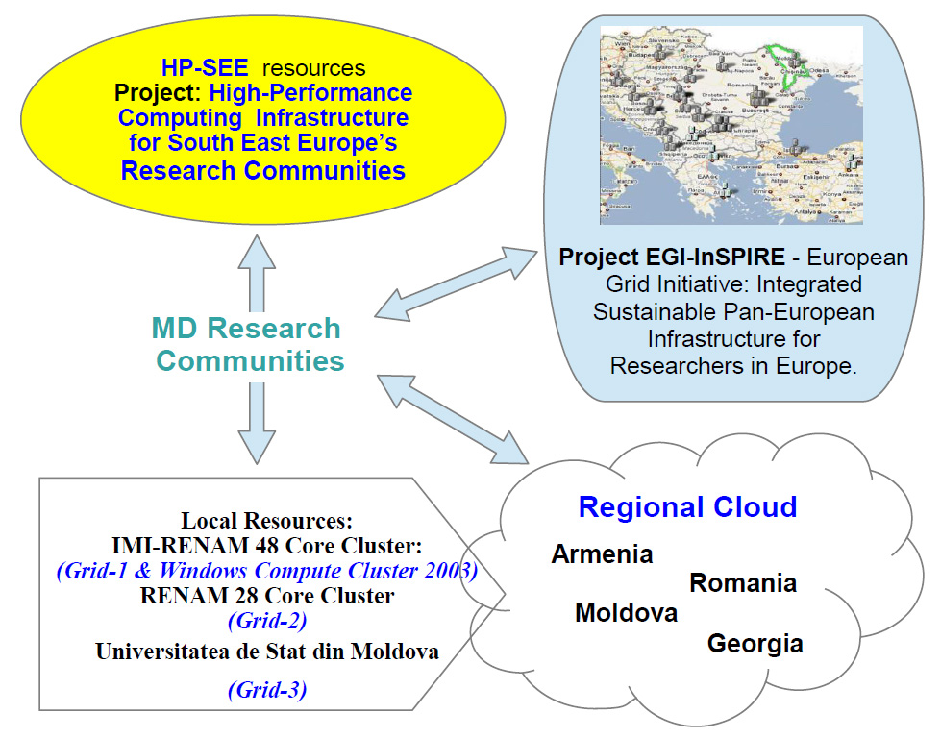
Scientific Computing infrastructure in Moldova

Slide 58

Thank you
Questions?

