Slide 1
Overview of the VI-SEEM services
Anastas Mishev
Associated professor
FCSE-UKIM
Regional training, Belgrade, 11-13 October 2017

Slide 2
Service orientation
Strong recommendation by the EC to have service oriented e-Infrastructures
Introducing the services catalog and the service portfolio
Portfolio – the complete set of services, in production, but also retired services and planned services
Catalog – user facing list of active services
Own implementation of the service catalog/portfolio management system

Slide 3
Service catalog/portfolio
Features
Integration with the VI-SEEM AAI
Read access to the service catalogue, for non-authorizes users
Via RESTful API
Via UI
Read access to the service portfolio, for authorized users
Via RESTful API
Via UI
Write access to the service portfolio, for authorized users
Via customized Django admin module
Via write UI

Slide 4
Service catalog
Service catalogue provides a service discovery and contains all project services
Common services and resources operated by WP3
Storage/data services operated by WP4
Application-level services provided by WP5
Designed to be compatible with the FitSM standards http://fitsm.itemo.org/

Slide 5
Service catalog
Main components of the service catalogue
Web interface (https://services.vi-seem.eu/)
RESTful interface (integration with other components)
Currently in production: 19 services grouped in 5 categories
Fully integrated with project’s AAI

Slide 6
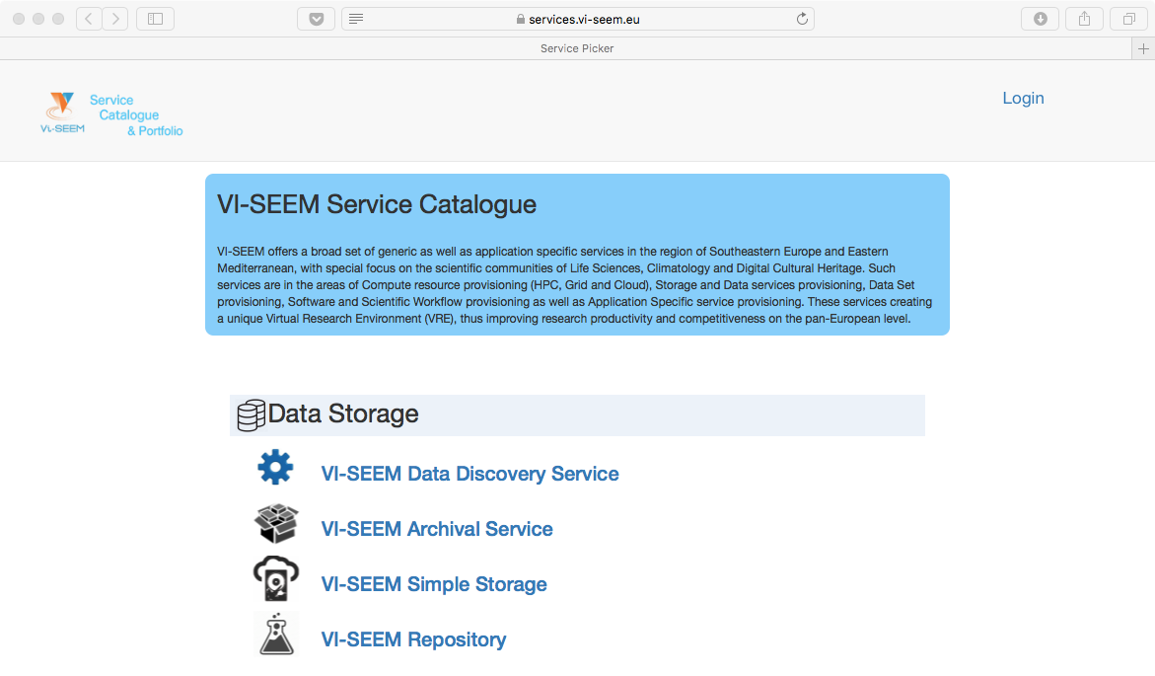
List of services

Slide 7
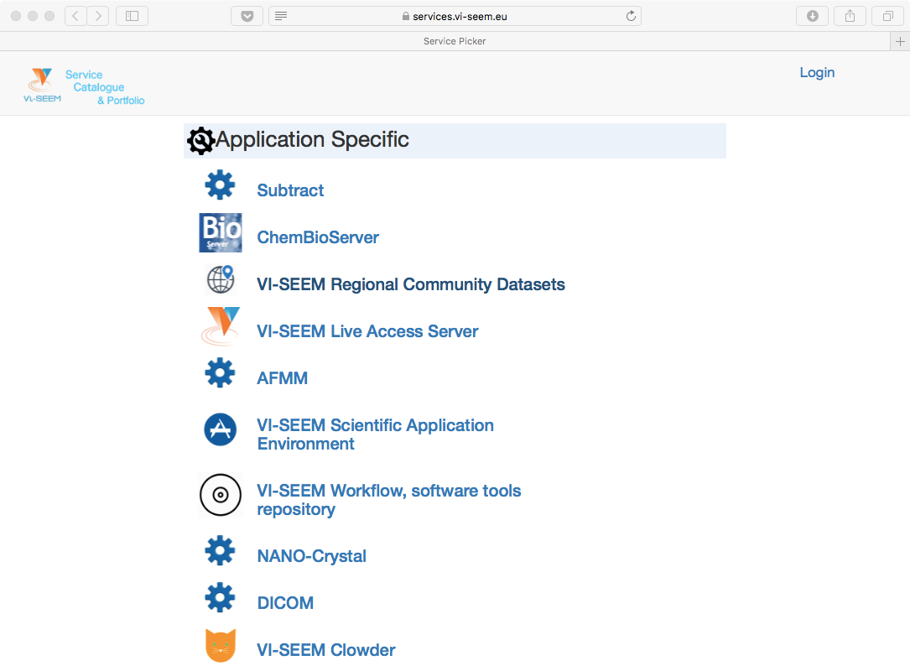
List of services

Slide 8
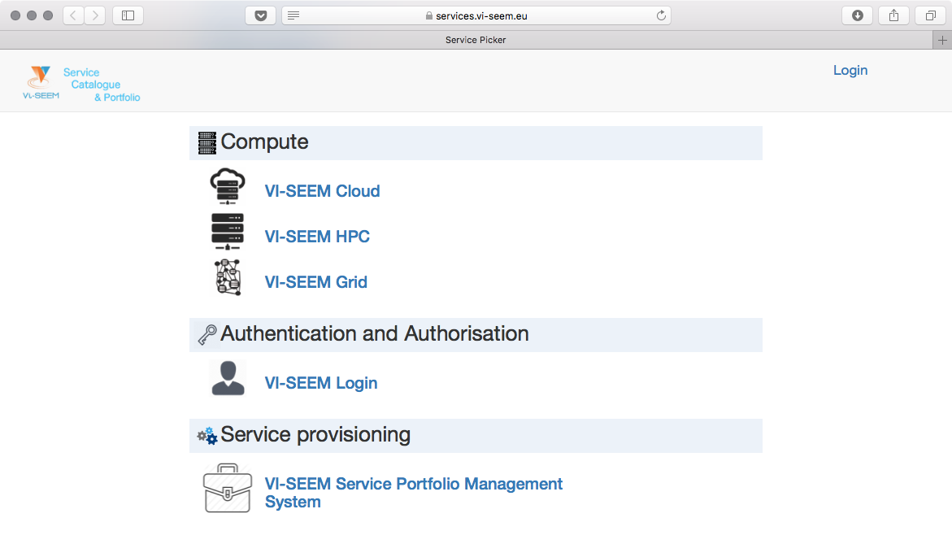
List of services

Slide 9
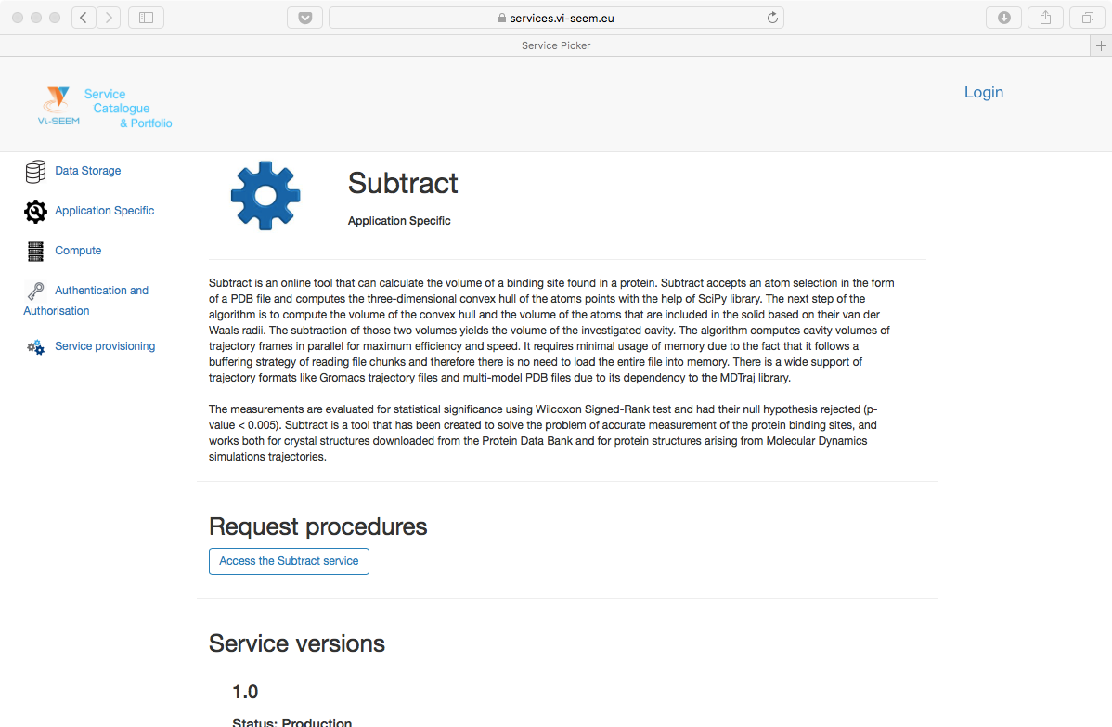
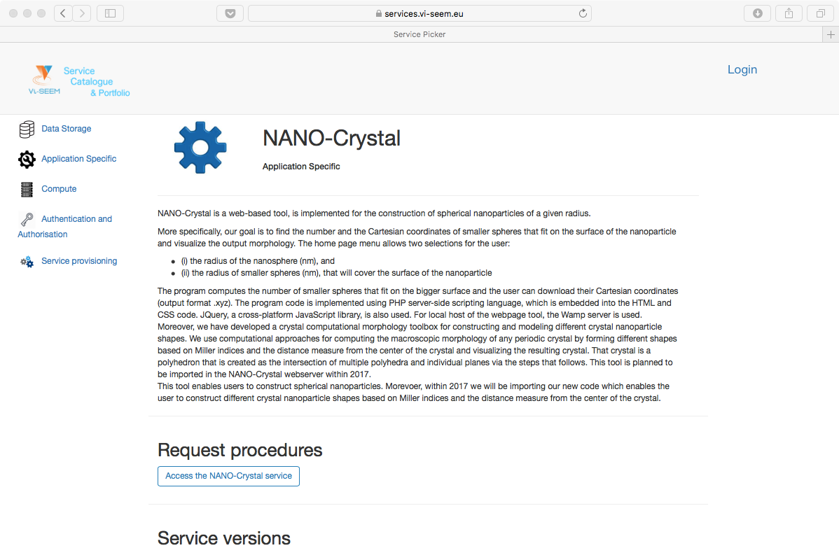
Example services: application specific

Slide 10
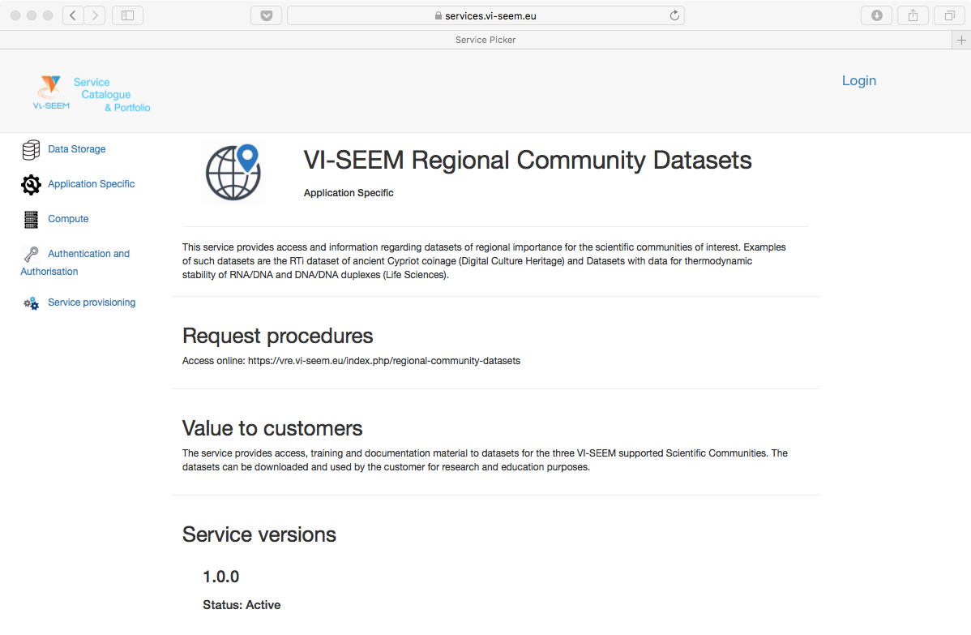
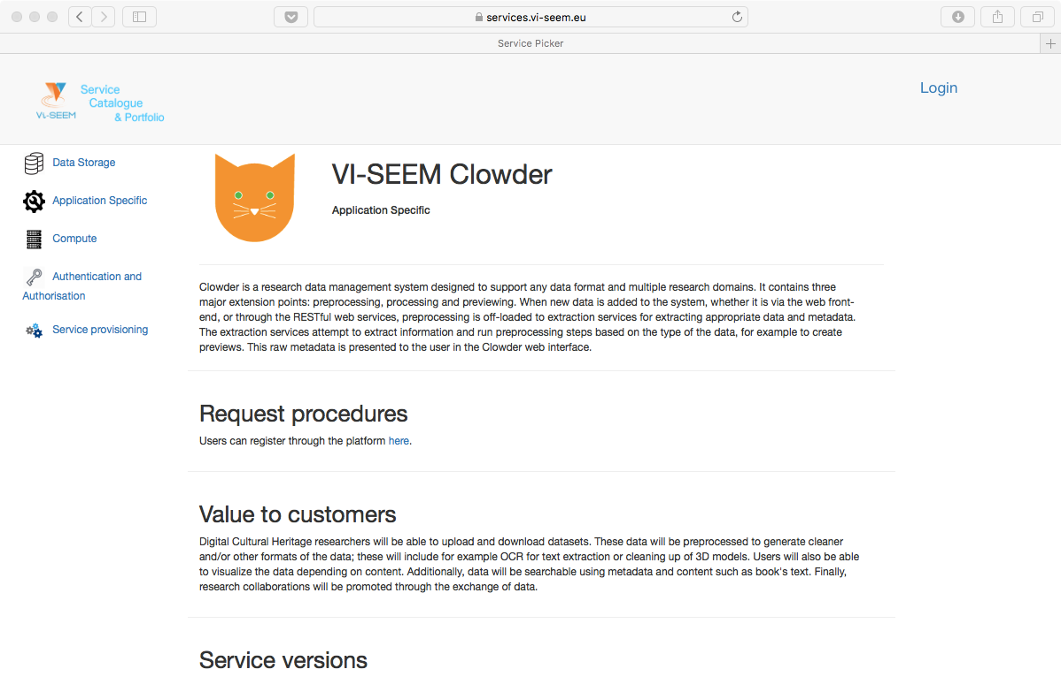
Example services: application specific

Slide 11
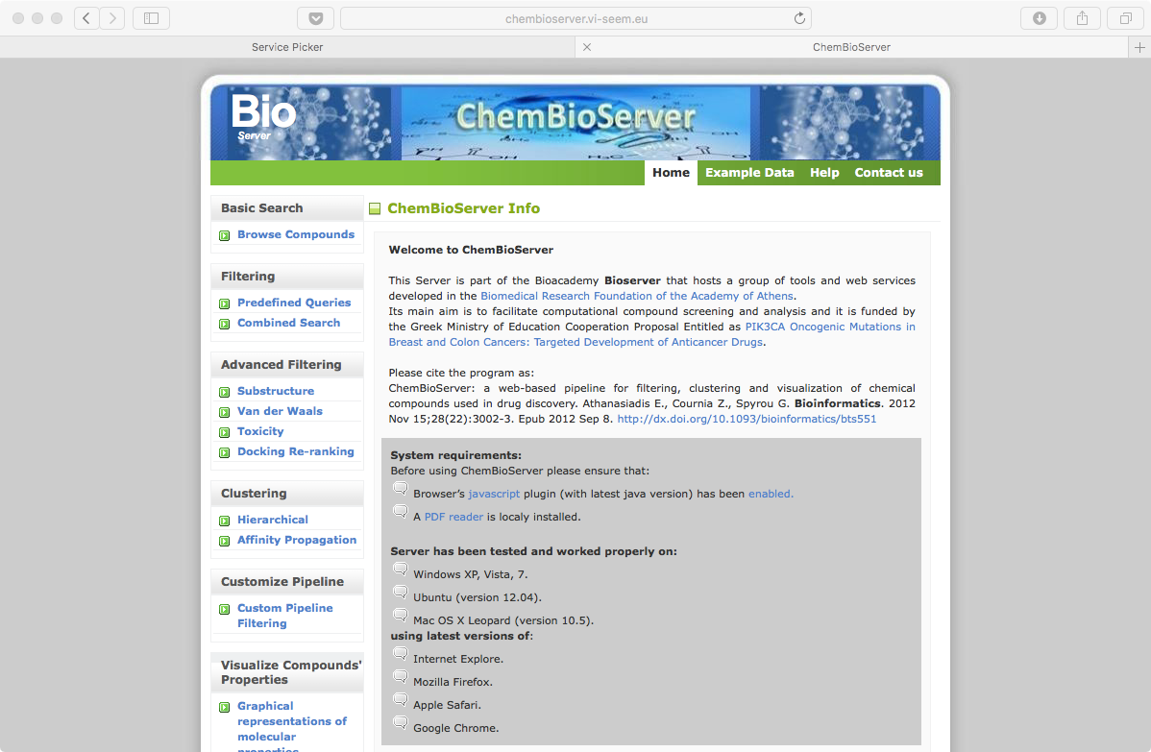
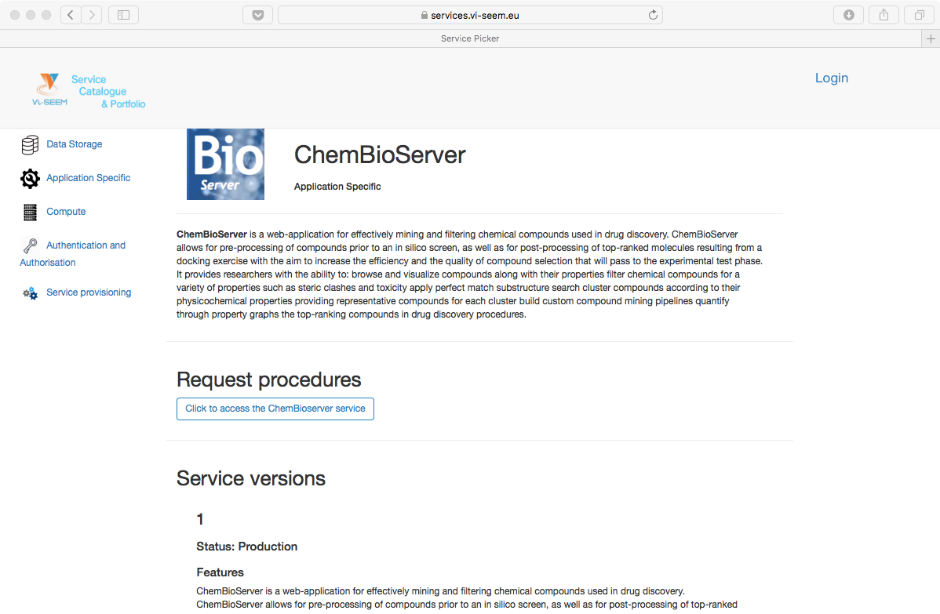
Example services: ChemBioServer

Slide 12
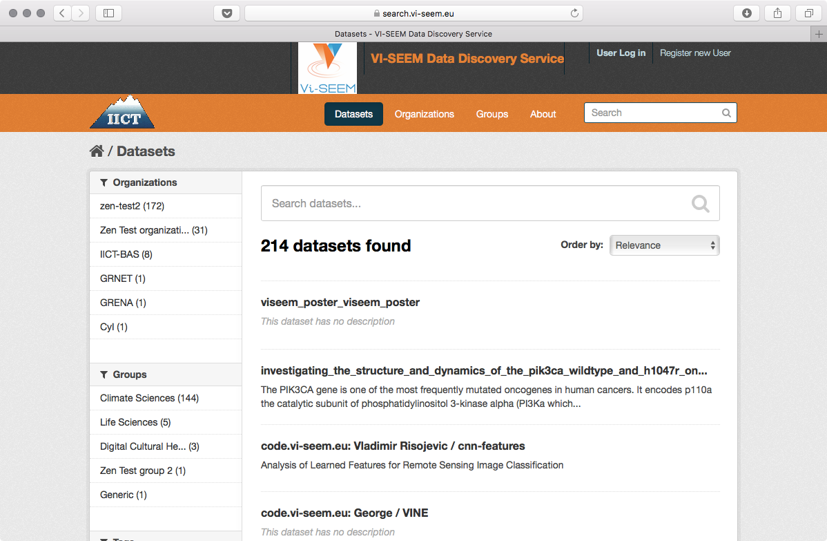
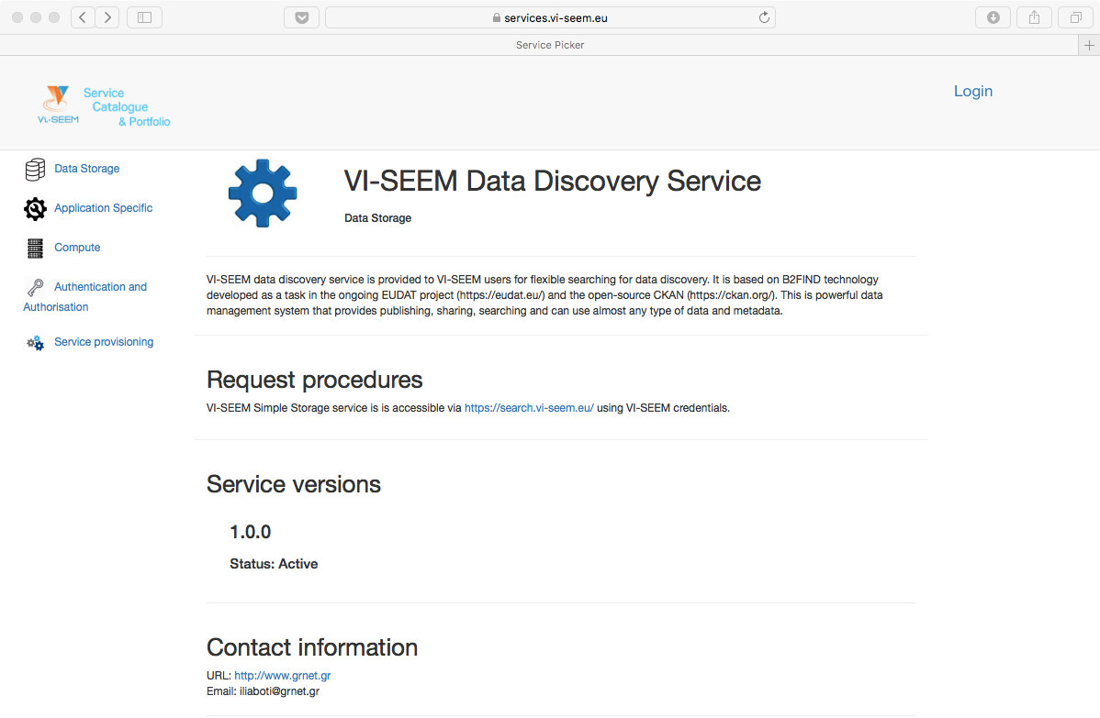
Example services: data discovery

Slide 13
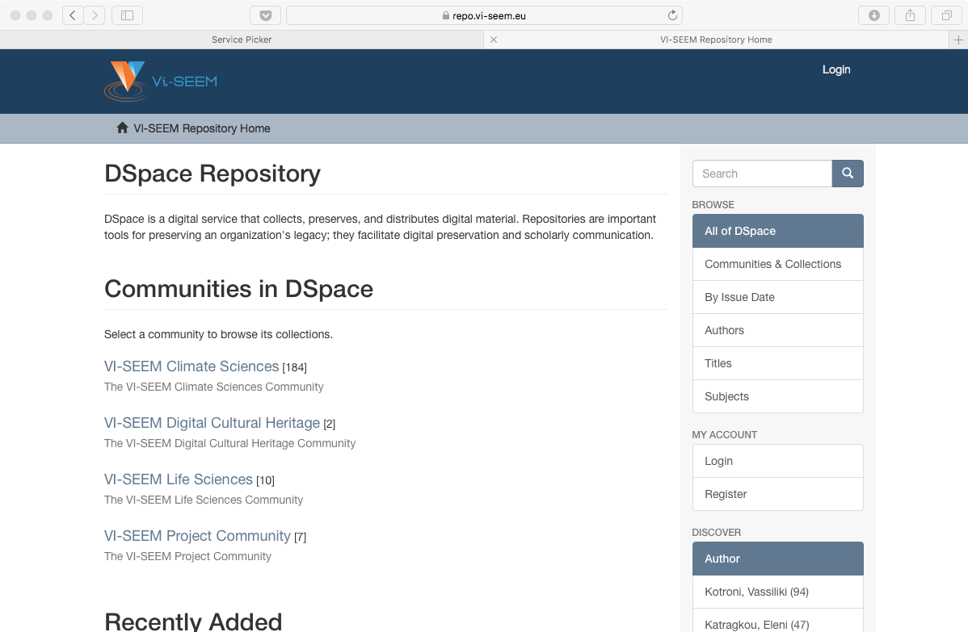
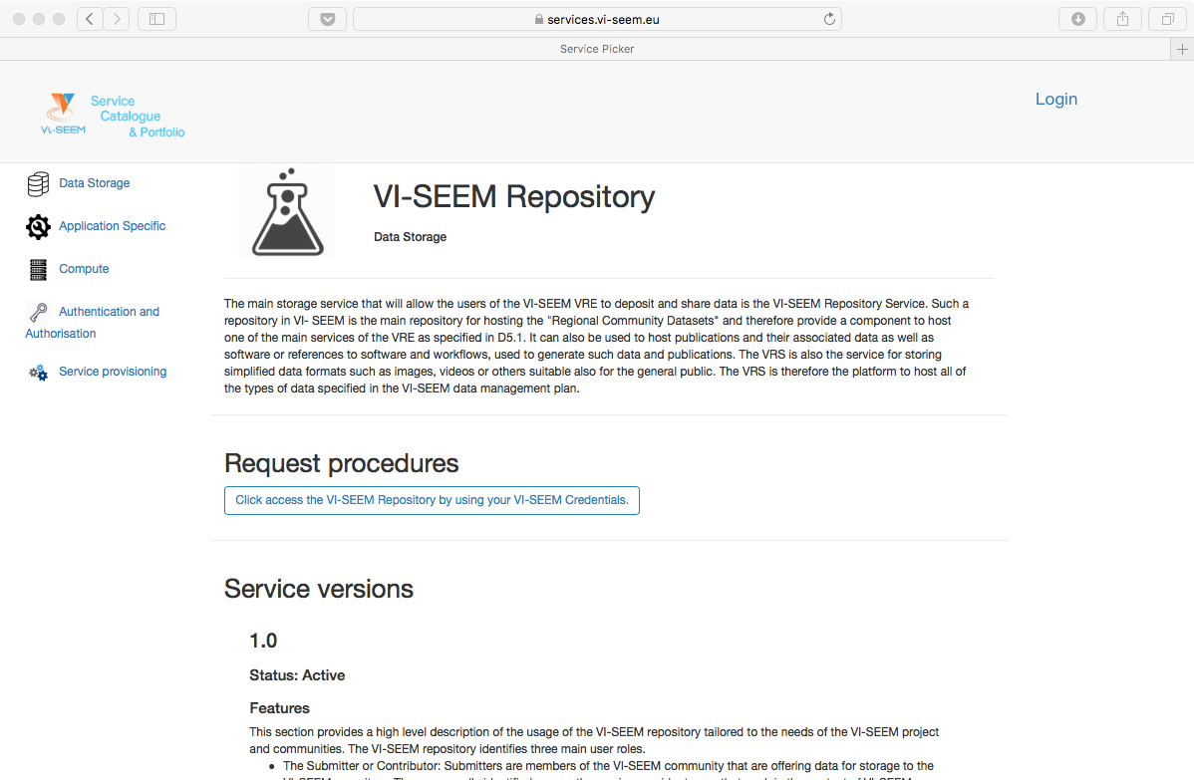
Example services: repository

Slide 14
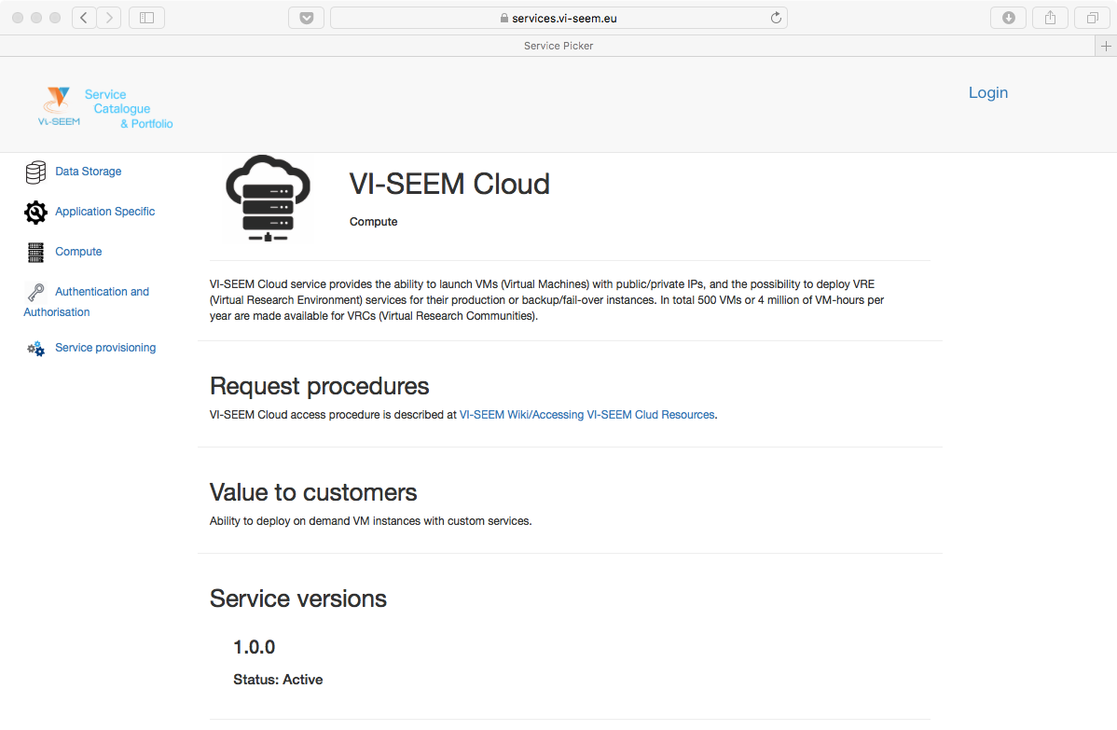
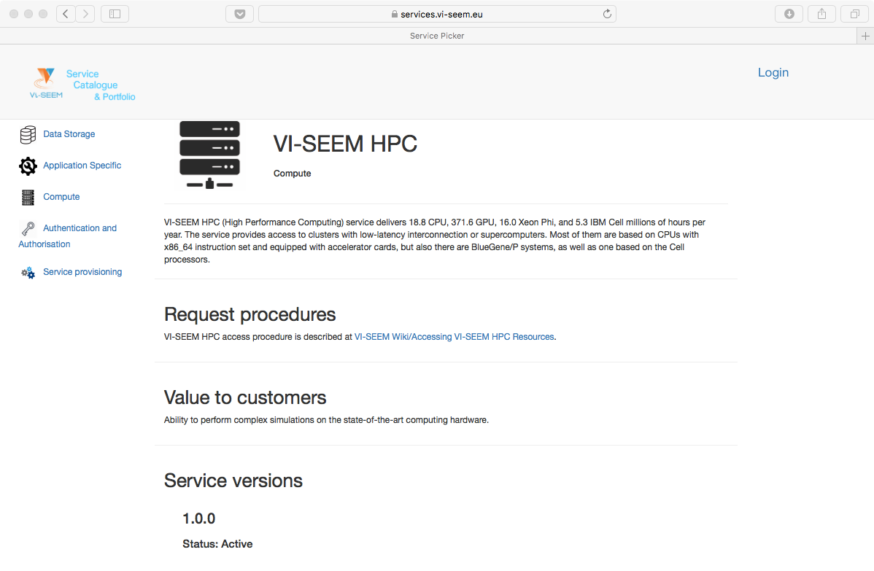
Example services: HPC and cloud

Slide 15
Service level definitions
Service level definitions ensure quality of service
VI-SEEM operational level monitoring procedure describes step-by-step processes for
Service validation (performed by VI-SEEM operational team)
Service registration (GOCDB registration by service enabler)
Service certification (ARGO monitoring by service enabler)
Service monitoring (ARGO monitoring by Operator-On-Duty)
Service level targets (reliability and reliability)
Service level targets for customer created requests
Service level targets for incident handling

Slide 16
Thank you for your attention
Questions?

