Slide 1
Source Code Repository
Petar Jovanovic
Institute of Physics Belgrade
The VI-SEEM project initiative is co-funded by the European Commission under the H2020 Research Infrastructures contract no. 675121

Slide 2
Agenda
Introduction to version control
VI-SEEM repository
Introduction to git
starting a project
making changes
synchronising
GUI Clients
VI-SEEM REG CL, 11-13 Oct 2017 2

Slide 3
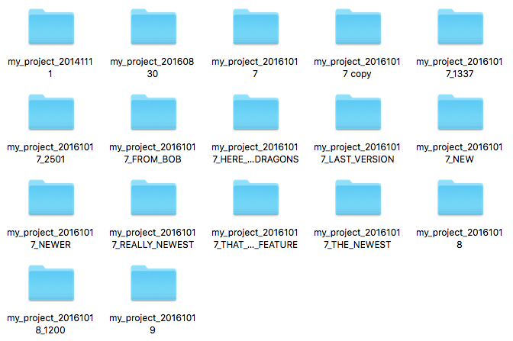
Introduction to Version Control
The problem it tackles:
VI-SEEM REG CL, 11-13 Oct 2017 3

Slide 4
Introduction to Version Control
Organizes your file versions.
Keeps track of changes.
Enables sharing and collaboration with others.
VI-SEEM REG CL, 11-13 Oct 2017 4

Slide 5
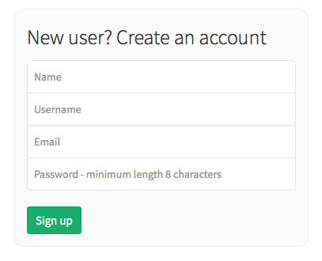
VI-SEEM Repository
Repository url: https://code.vi-seem.eu
Requesting a new user account:
VI-SEEM REG CL, 11-13 Oct 2017 5

Slide 6
Introduction to git - starting a project
Starting a project
git init
Checkout an existing project from a repository
git clone /path/to/repository
git clone username@host:/path/to/repository
Key terms:
Repository
Working dir
Stage (Index)
Head
VI-SEEM REG CL, 11-13 Oct 2017 6

Slide 7
Introduction to git - making changes
Inspecting changes
git status
Saving changes
git add .
git commit -m ‘commit message’
Pushing changes
git push origin master
if the origin repository is not set: git remote add origin <repository_url>
VI-SEEM REG CL, 11-13 Oct 2017 7

Slide 8
Introduction to git - making changes
Updating
git pull
or: git fetch & git update
Merging
git merge <branch>
VI-SEEM REG CL, 11-13 Oct 2017 8

Slide 9
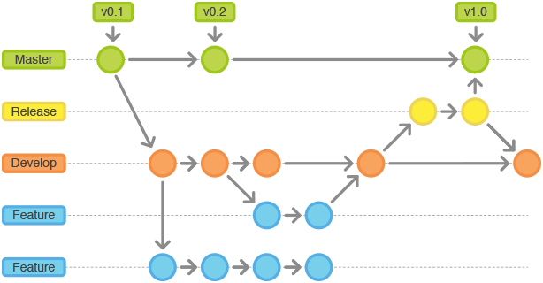
Introduction to git
Branching
git checkout -b new_branch
Switching branch
git checkout the_branch
Deleting a branch
git branch -d the_branch
To push the branch to remote repository:
git push origin <branch>
VI-SEEM REG CL, 11-13 Oct 2017 9

Slide 10
GUI Clients
There are graphical interfaces for GIT and other SCMs.
Most IDEs have some integrated support.
Some recommendations:
TortoiseGIT (for Windows): https://tortoisegit.org/
Git’s official list: https://git-scm.com/downloads/guis
VI-SEEM REG CL, 11-13 Oct 2017 10

Slide 11
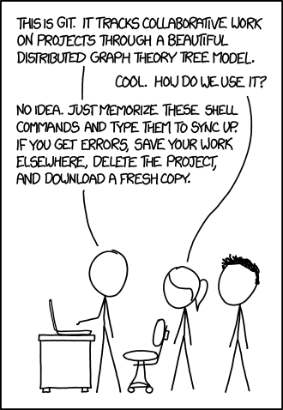
Relevant XKCD
VI-SEEM REG CL, 11-13 Oct 2017 11

Slide 12
Questions
Thank you for your attention.
VI-SEEM REG CL, 11-13 Oct 2017 12

