Slide 1
Introduction to Google Earth Engine (GEE) and Remote Sensing and Climate Applications
https://vi-seem.eu/
Zivan Yoash
Inter University Computation Center

Slide 2
IUCC - Backround
Established 1984
Funded by Israel’s eight universities
Headquarters on Tel Aviv University campus
Operates ILAN Network - Israel’s National Research & Education Network (NREN)
Operating Units:
MALMAD Israel Center for Digital Information Services
IUCEL (MEITAL) The Inter-University Center for E-Learning
Cloud Service Unit
Cyber Unit

Slide 3
IUCC - Areas of Activity
National Research & Education Network (NREN) operator
High Performance (Supercomputing) - PRACE
Cloud Services ( Vatat’s Initiative)
Centralized Digital Research and Learning Technologies
Joint Procurement

Slide 4
Administrative details
VI-SEEM: Virtual Research Environment for regional interdisciplinary communities in Southeast Europe and the Eastern Mediterranean
Start date 01/10/2015
Duration 36 months
Total funded effort: 715 PMs
EC contribution: 3.3m euro

Slide 5
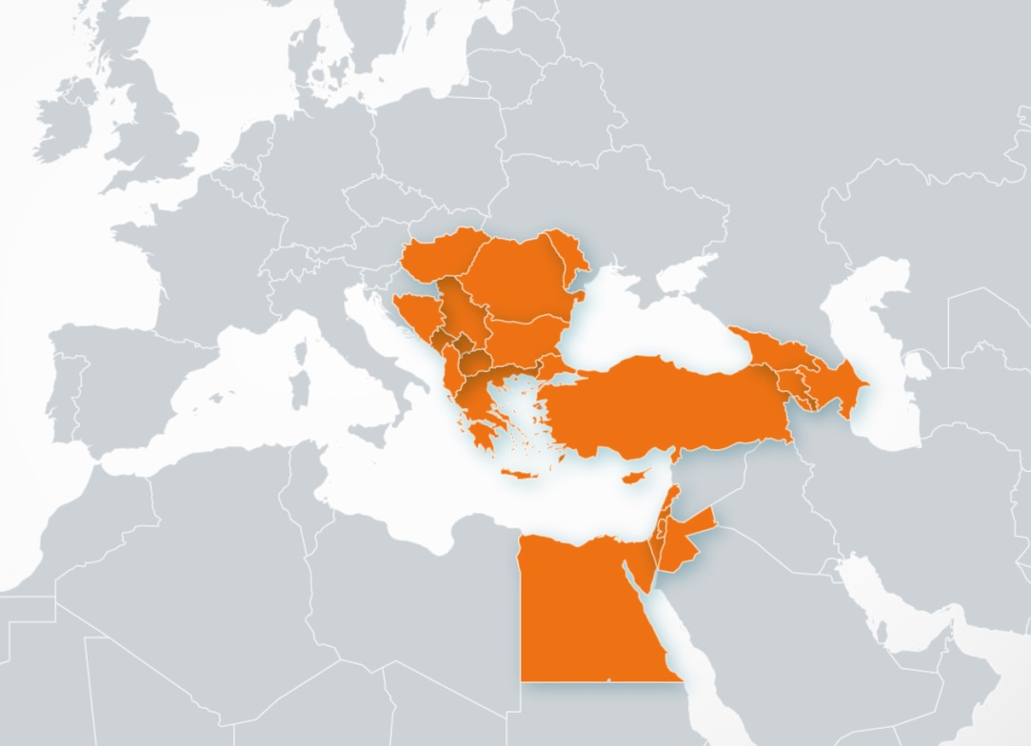
VRE for regional interdisciplinary communities in SEE and EM
e-Infrastructure built over last decade
Merging of SEE and EM regions
SEE: network SEEREN1-2, Grid SEE-GRID-1/2/SCI, HPC HP-SEE
EM: HPC LinkSCEEM1-2
Participant no. | Participant organisation name | Part. short name | Country
1 (Coord) | GREEK RESEARCH AND TECHNOLOGY NETWORK S.A. | GRNET | Greece
2 | THE CYPRUS INSTITUTE | CyI | Cyprus
3 | INSTITUTE OF INFORMATION AND COMMUNICATION TECHNOLOGIES – BULGARIAN ACADEMY OF SCIENCES | IICT-BAS | Bulgaria
4 | INSTITUTE OF PHYSICS BELGRADE | IPB | Serbia
5 | NATIONAL INFORMATION INFRASTRUCTURE DEVELOPMENT INSTITUTE | NIIF | Hungary
6 | WEST UNIVERSITY OF TIMISOARA | UVT | Romania
7 | POLYTECHNIC UNIVERSITY OF TIRANA | UPT | Albania
8 | UNIVERSITY OF BANJA LUKA | UNI BL | Bosnia and Herzegovina
9 | SS CYRIL AND METHODIUS UNIVERSITY OF SKOPJE | UKIM | FYR of Macedonia
10 | UNIVERSITY OF MONTENEGRO | UOM | Montenegro
11 | RESEARCH AND EDUCATIONAL NETWORKING ASSOCIATION OF MOLDOVA | RENAM | Moldova
12 | INSTITUTE FOR INFORMATICS AND AUTOMATION PROBLEMS OF THE NATIONAL ACADEMY OF SCIENCES OF THE REPUBLIC OF ARMENIA | IIAP-NAS-RA | Armenia
13 | GEORGIAN RESEARCH AND EDUCATIONAL NETWORKING ASSOCIATION | GRENA | Georgia
14 | BIBLIOTHECA ALEXANDRINA | BA | Egypt
15 | INTER UNIVERSITY COMPUTATION CENTER | IUCC | Israel
16 | SYNCHROTRON-LIGHT FOR EXPERIMENTAL SCIENCE AND APPLICATIONS IN THE MIDDLE EAST | SESAME | Jordan

Slide 6
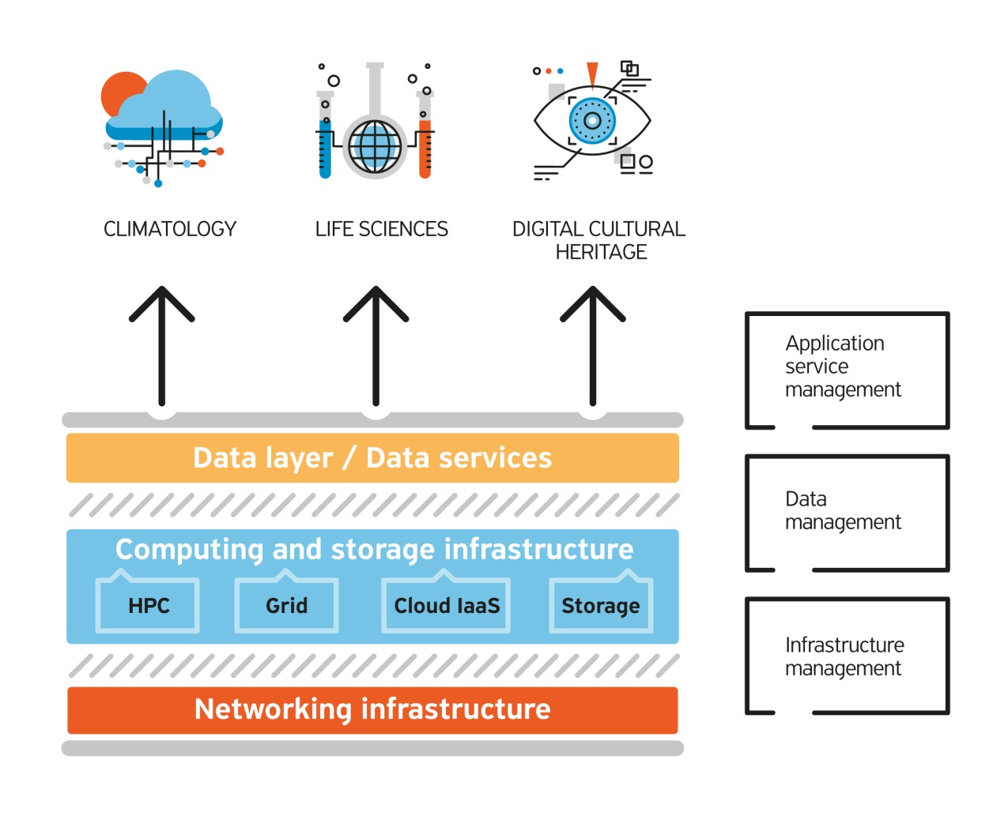
Overall objective
Provide user-friendly integrated e-Infrastructure platform for Scientific Communities in Climatology, Life Sciences, and Digital Cultural Heritage for the SEEM region; by linking compute, data, and visualization resources, as well as services, software and tools.
Diverse computing technologies
Advent of big data / data services
Service orientation

Slide 7
Specific objectives
Notes:
Services: storage, compute, filesharing, code repository, sso
Research: collaboration and sharing data

Slide 8
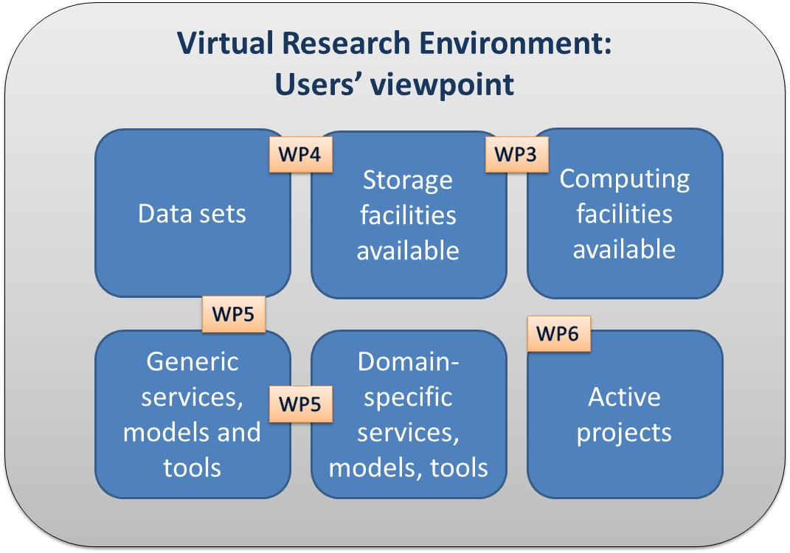
User-centric approach

Slide 9
Key Performance Indicator targets
e-Infrastructure: 21500 CPU cores, 325000 GP-GPU cores and 18500 Intel Xeon Phi cores of HPC, 2900 grid cores, 10500 cloud VM cores, 11 PBytes of storage (of which dedicated 5-15% , 10-15%, 5% and 10% respectively)
> 10 specific services, 30 data sets and 25 codes
39 applications, 45 research teams taking part. 100 publications, 50 presentations
17 dissemination events, 12 training events

Slide 10
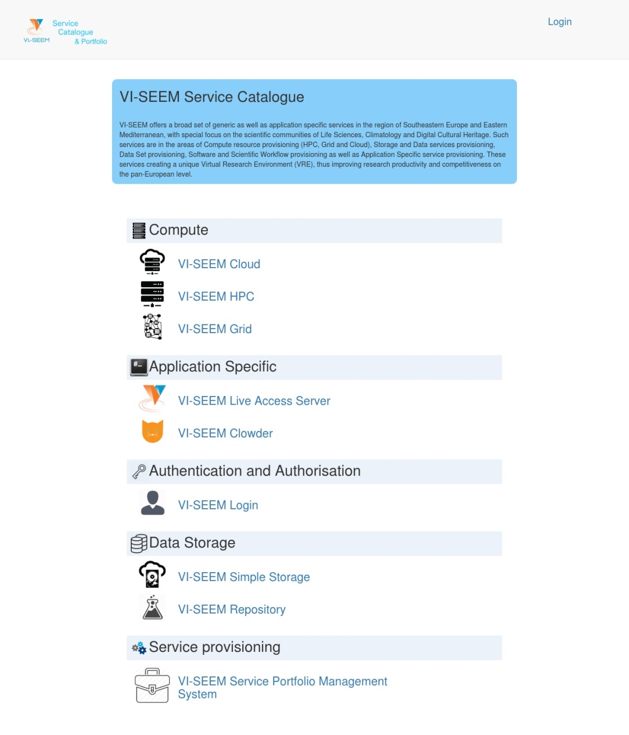
Access to services: the service catalogue
1. e-Infrastructure services: HPC, Grid, Cloud, Code repository
2. Data management services
3. Generic services, models and tools
4. Domain specific services, models and tools
5. Scientific applications and data sets

Slide 11
e-Infrastructure services
Resource Type | Number of countries contributing | Number of sites | Total amount of resources | Total amount of resources dedicated for the project
HPC x86 Compute | 8 | 11 | ~21500 cores | ~17.5 Million core hours per year
HPC GPU | 3 | 3 | ~325000 GP-GPU cores | ~ 18000 GPU cores
HPC Intel Phi Accelerators | 1 | 1 | ~18500 co-processor cores | ~8Μ co processor core hours per year
Grid Compute | 12 | 25 | ~ 2900 cores | 10-15% of the resources
Cloud Compute | 8 | 9 | ~ 10500 VM cores | 5% of VM cores
HPC Test/Train Cluster | 3 | 4 | ~300 cores | ~50000 cores hours per year
Storage (Disk) | 13 | 18 | 3.1 PB | 515 TB
Storage (Tape) | 2 | 2 | 8 PB | 550 TB

Slide 12
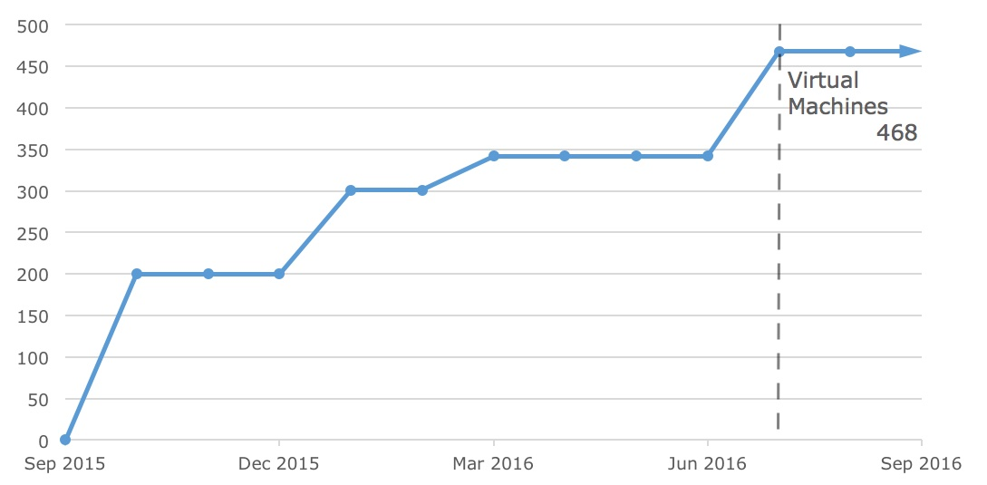
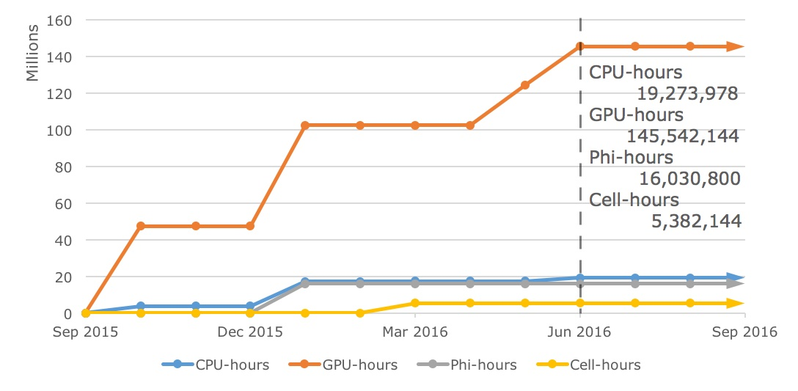
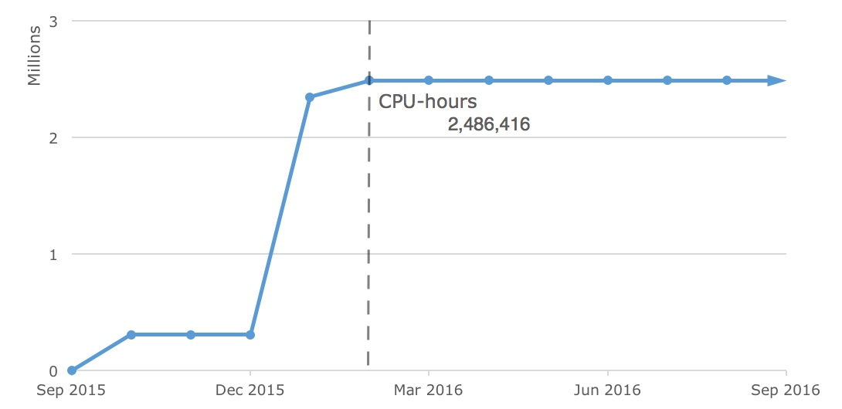
e-Infrastructure: available resources

Slide 13
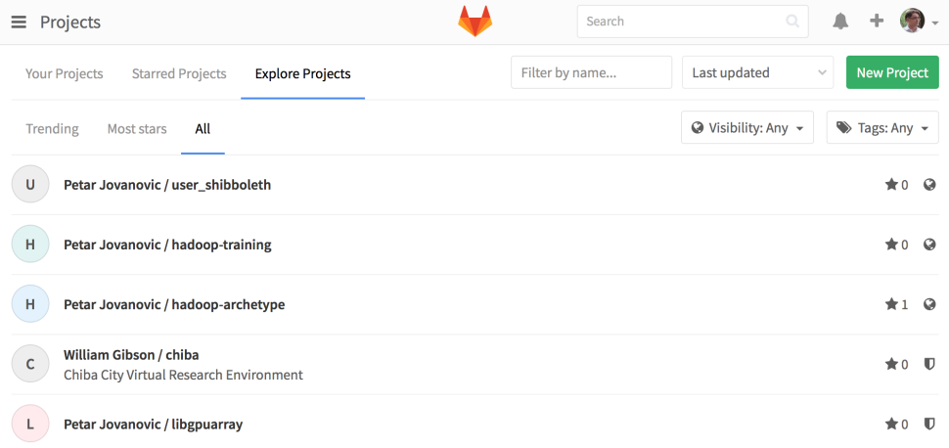
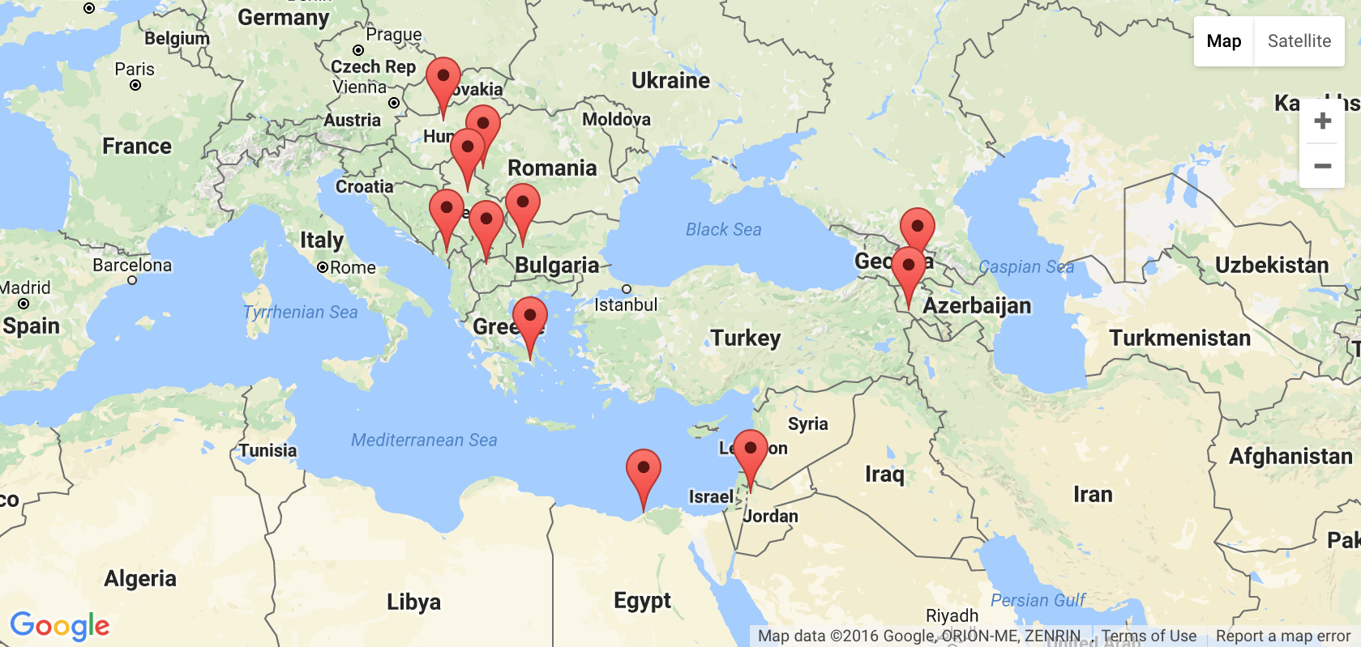
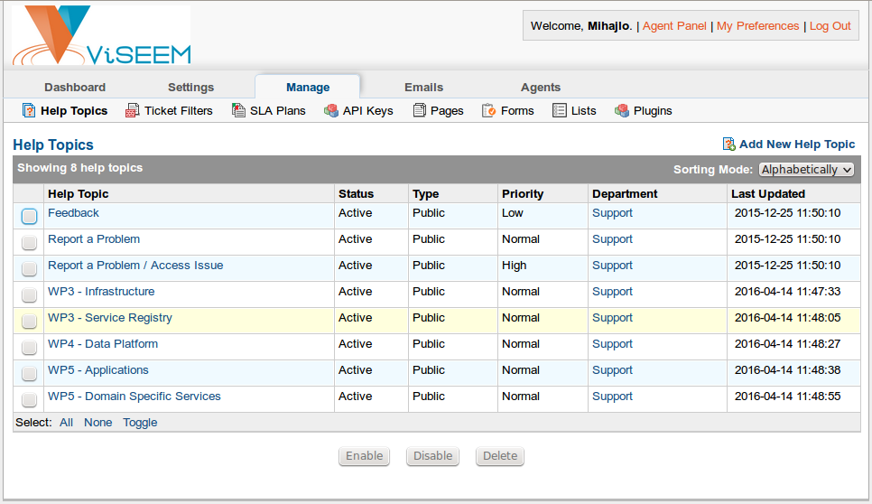
e-Infrastructure: operational services
Service registry https://gocdb.vi-seem.eu/portal/
Source Code Repository https://code.vi-seem.eu/
Helpdesk https://support.vi-seem.eu/

Slide 14
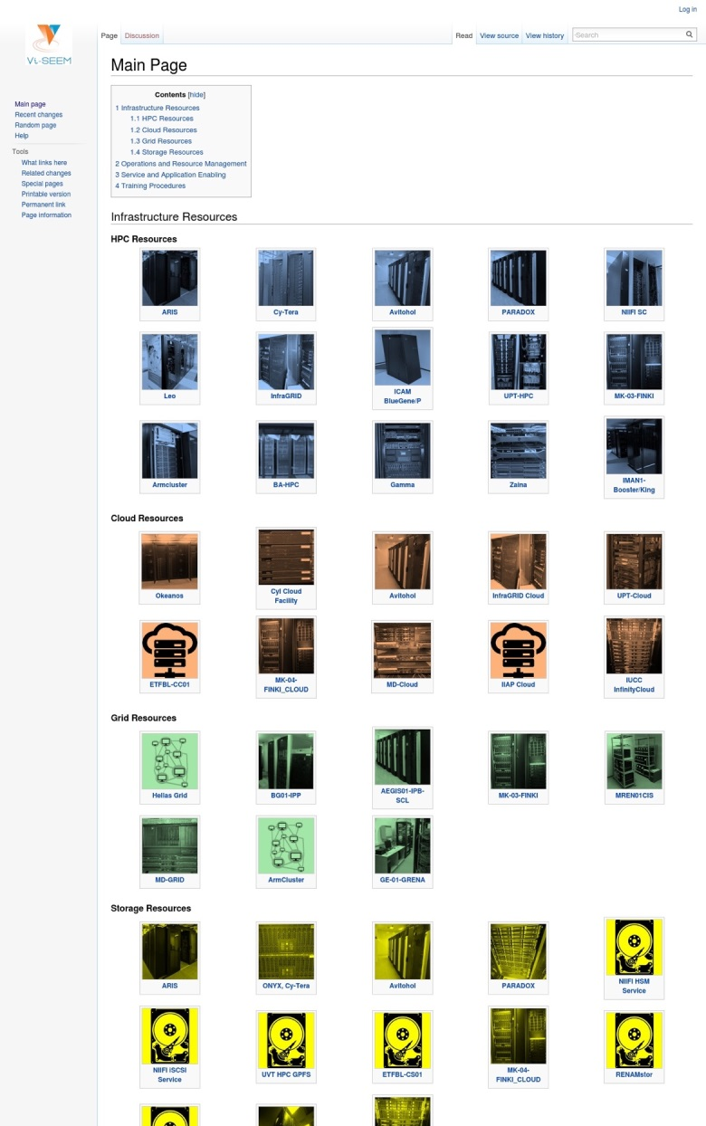
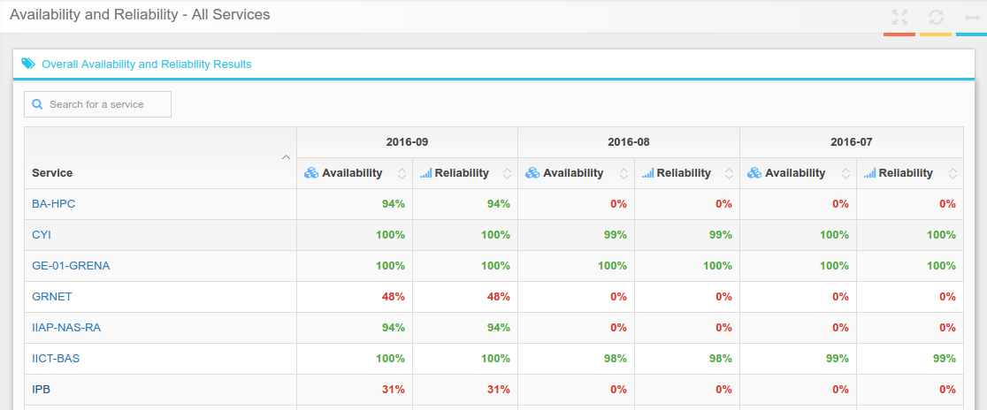
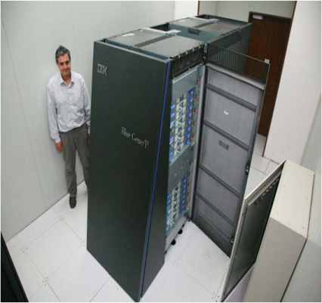
e-Infrastructure: operational services
Tech wiki https://wiki.vi-seem.eu/
Monitoring https://mon.vi-seem.eu/
VI-SEEM login
Accounting in development

Slide 15
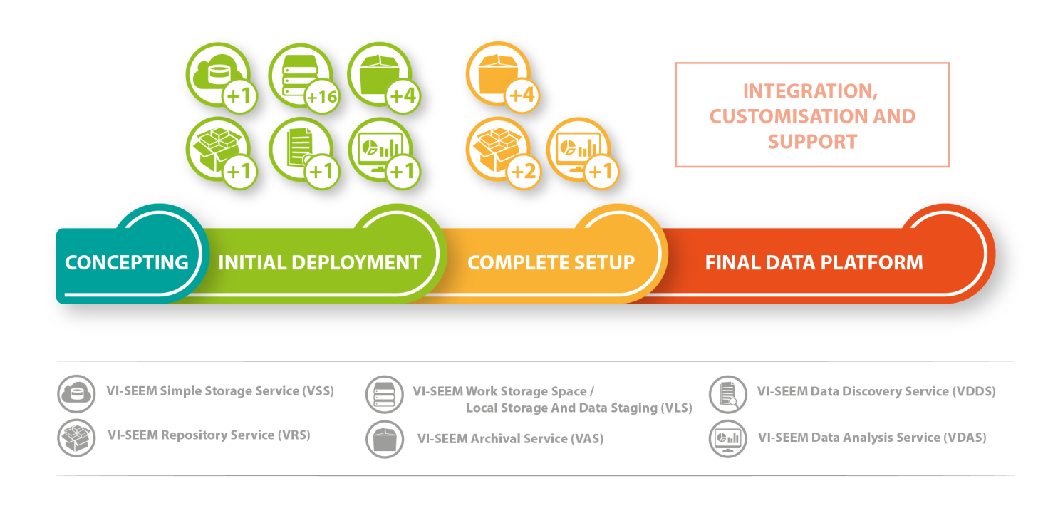
Data management services (types)
Functions allowing for data management for selected Scientific Communities, engage the full data management lifecycle:
VSS – Simple Storage Service (simplestorage.vi-seem.eu)
VRS – Repository Service (repo.vi-seem.eu)
VAS – Archival Service (deployed at 4 sites – GRNET, IPB, IICT-BAS, NIIF)
VLS – work storage space / local storage and data staging (at 12 sites)
VDDS – Data Discovery Service (dds.avitohol.acad.bg)
VDAS – Data Analysis Service (hadoop.ipb.ac.rs)
PIDs

Slide 16
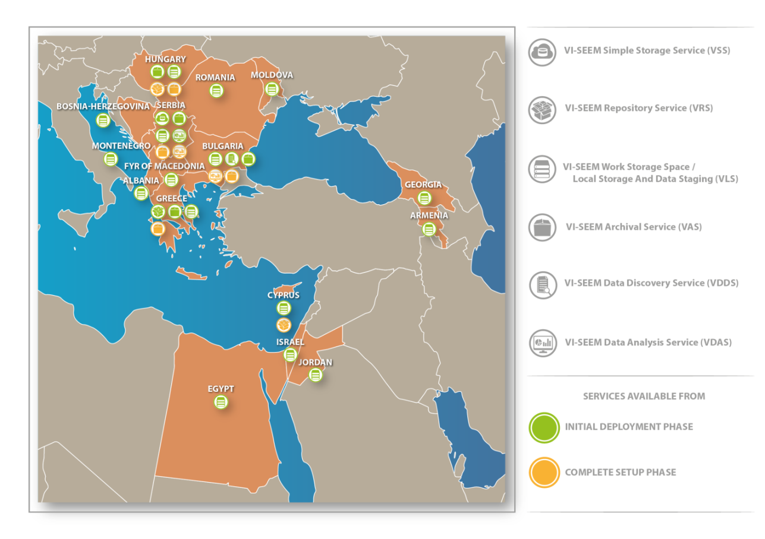
Data management services (spread)

Slide 17
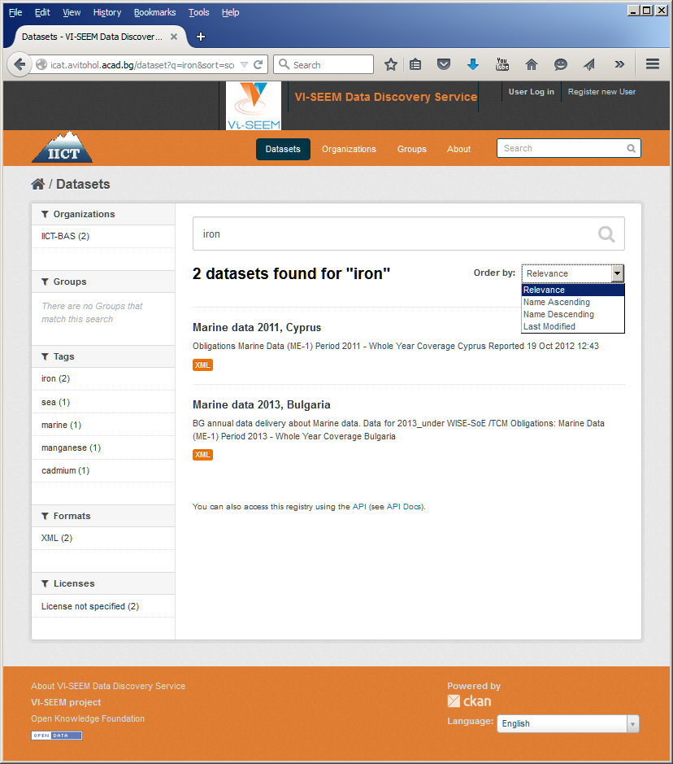
Data management services (ex: search)

Slide 18
Generic services, models and tools
Generic services
VRE platform as entry point http://vre.vi-seem.eu/
Application environment (optimized applications, codes, libraries), preinstalled in compute resources or provided as VM images. (Climate models, production programs for Life Sciences applications, data management tools for Digital Culture Heritage)
Workflow and software tools repository
Regional community datasets

Slide 19
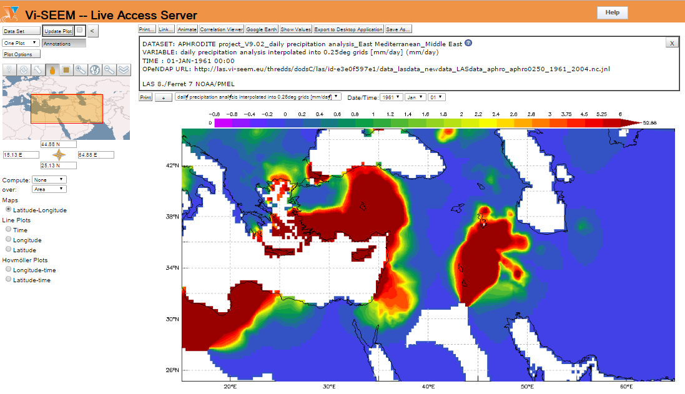
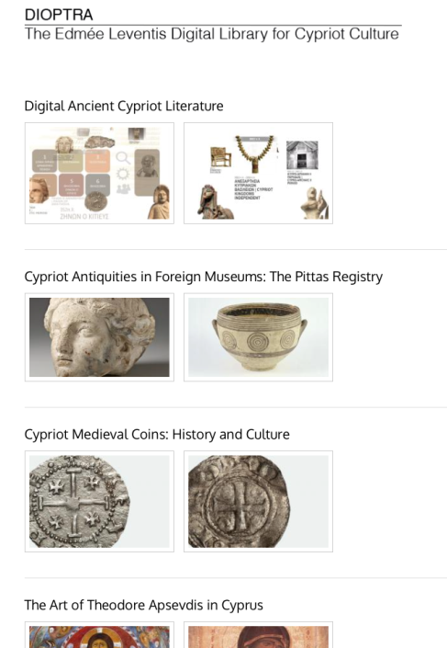
Domain-specific services, models and tools
Domain specific services flagships
ChemBioServer: a web-based pipeline for filtering, clustering and visualization of chemical compounds used in drug discovery
Live Access Server: a web server providing flexible access to geo-referenced scientific data, offering visualization & post-processing capabilities for climate data
Clowder: a Digital Culture Heritage repository which also offers integrated interactive visualization tools

Slide 20
Scientific applications
Climate | Life Sciences | Cultural Heritage
Regional Climate Modelling | Modeling and Molecular Dynamics (MD) study of important drug targets | Digital Libraries
Global Climate Modelling | Computer-aided drug design | Interactive Visualization Tools
Weather Forecasting | Analysis of Next Generation DNA sequencing data and RNA profiling data | Semantic Referencing
Air Pollution/Quality | Data mining to identify prevalent diseases/mutations in the SEEM region | Image Classification
Model Development | Image processing for biological applications | Modelling of Built Environments and Advanced Representation Techniques
Visualization, Datasets, etc. | Computational simulation of DNA and RNA | Scientific simulation of materiality and systems' properties
Other | Synchrotron data analysis | Geo-referencing Tools
 | Other | Bioarchaeology

Slide 21
Data sets: climate
Simulation and observation data; global and local sets
Source | Description | URL
Earth System Grid Federation | Data portal for downloading CORDEX and other data (i.e. CMIP5) | http://pcmdi9.llnl.gov/esgf-web-fe/
Climatic Research Unit (CRU) | gridded observations of surface meteorological data and climatic indices | http://www.cru.uea.ac.uk/data
E-OBS | gridded observations of surface meteorological parameters for Europe | http://eca.knmi.nl/download/ensembles/download.php
ECA&D | meteorological station observations for Europe and part of MENA | http://eca.knmi.nl/dailydata/index.php
APHRODITE | Gridded precipitation data for Asia and Middle East | http://www.chikyu.ac.jp/precip/index.html
Global Precipitation Climatology Centre (GPCC) | Gridded global precipitation observations | ftp://ftp-anon.dwd.de/pub/data/gpcc/html/gpcc_normals_download.html
European Centre of Medium-Range Weather Forecasts Data Portal (ECMWF) | Mainly for downloading reanalysis products such as the ERA-Interim | http://apps.ecmwf.int/datasets/
AERONET | federation of ground-based remote sensing aerosol networks | http://aeronet.gsfc.nasa.gov
MODIS | MODIS (or Moderate Resolution Imaging Spectroradiometer) is a key instrument aboard the Terra (EOS AM) and Aqua (EOS PM) satellites | http://modis.gsfc.nasa.gov
ISA-MEIDA | collection and archiving of Israeli Earth Science data sets | http://nasa.proj.ac.il/
TOMS aerosol index | index that detects the presence of uv-absorbing aerosols such as dust and soot | http://disc.sci.gsfc.nasa.gov/data-holdings/PIP/aerosol_index.shtml
Source | Description
TAU, Israel | Meteorological and hydrological data for Israel, environmental data, such as PM10 and PM2.5 measurements in various locations in Israel
METEO-RO, Romania | a gridded dataset from observations consisting of 9 essential climate variables with daily values (1961-2013) on a spatial resolution of 10 km for the Romanian territory (ROCADA)
IEG, Moldova | data recorded by meteorological stations and posts of the State Hydro-meteorological Service
NIGGG, Bulgaria | NCEP Global Analysis Data with 1º resolution, available since 2000 TNO high resolution emission inventory for Europe Data of the pollution levels, measured by the Bulgarian National Network for Air Quality Control, available since 2000
IGEWE, Albania | data collected from the Hydrological, Meteorological and Seismological networks (such as water flow, temperature, humidity, precipitation etc., and a range of seismic data)

Slide 22
Data sets: life sciences
Simulation and observation data; global and local sets
Country | Available data | Access Policy (Private, Regional, Public)
Greece | Virtual screening results | Data that is published is public and can be shared
Serbia | SNP database of variations in genes involved in Cystic Fibrosis, Thrombosis, Alpha-1-Antitripsine deficiency, Colorectal cancer, Thyroid cancer, Lung cancer, Endometrium. The database contains data on Serbian population. | Data that is published is public and can be shared
Moldova | Investigation Analytics, Research Results, Pathologies case studies | Investigation Analytics and Research Results are shared information. Pathologies case studies (no personal patient info) – available for research community by creating agreement with institution.

Slide 23
Data sets: cultural heritage
Source | Description | URL
Ancient Cypriot Literature Digital Corpus (AKGDC) | Searchable digital library of Ancient Cypriot Literature. Covers the ancient Cypriot literary production from 7th century BC to 5th-6th century AD and examines it through its wide range of literary genres. | Not public yet.
STARC repository | Repository for digital CH objects created over the last 5 years at CyI. Including novel interactive methods for accessing and exploring information. | http://public.cyi.ac.cy/starcRepo/
Electronic Corpus of Karamanlidika | Digitalization and transcription into Latin characters of a corpus of Karamanlidika printed material from different periods and genres with access to graphic, phonetic and morphemic varieties search. | Not public yet.
The digital collection of Bibliotheca Alexandrina | As a library of the 21st Century, the Bibliotheca Alexandrina (BA), along with its affiliated academic and cultural centres, is committed to digitization as a means of preserving, managing, and disseminating information and knowledge. The BA sets out to share them with a worldwide audience via the internet, thus promoting greater understanding and tolerance between cultures. To achieve this goal, the BA has formed partnerships with various cultural, academic, governmental, and corporate organizations for the creation of many significant and compelling digital projects. These projects cover a wide array of cultural and educational themes. | http://www.bibalex.org/Libraries/Presentation/Static/12600.aspx?d=0

Slide 24
Access to VRE
http://vre.vi-seem.eu/

Slide 25
Access to VRE
Through 3 distinct calls
Pre-selected candidates M12
1st open call M18 ongoing, 21 applications supported
2nd open call M28

Slide 26
Training and dissemination
Extensive training portal
1 regional-level training event (Life Sciences)
1 online regional training event (hadoop)
4 country-level training events
4 country-level dissemination events
~20 external events
~ 25 publications

Slide 27
Conclusion
VI-SEEM provides a Virtual Research Environment to be provided to the scientific user communities in Climatology, Life Sciences, and Cultural Heritage
VI-SEEM unifies networking, computing, data management and application-specific service management
Support the full lifecycle of scientific research
Services provided through a service catalogue
User-centric view
Wide outreach campaign
Sharing value-added services for R&E communities

Slide 28
Thanks!
VI-SEEM Project Management Office
e-mail: vi-seem-pmo@vi-seem.eu
W: https://vi-seem.eu
T: @vi_seem
L: https://www.linkedin.com/groups/VISEEM-7018941/about

