Slide 1
VI-SEEM Virtual Research Environment and Services
Antun Balaz
Head of Scientific Computing Laboratory
Deputy Director of Institute of Physics Belgrade

Slide 2
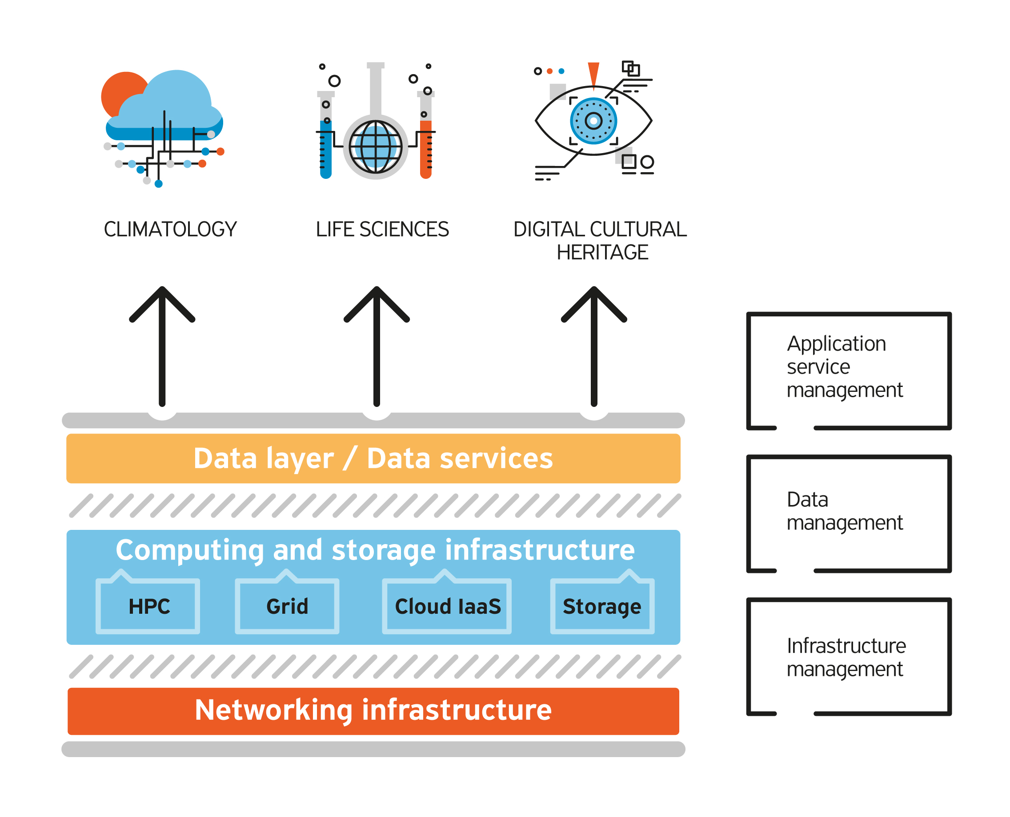
VI-SEEM VRE and Services
Builds on the success of its predecessor e-Infrastructure projects
Unifies existing e-Infrastructures into an integrated platform
Improved service provision within a unified VRE in South East Europe and Eastern Mediterranean
Facilitate regional interdisciplinary collaboration
Ensure continuity and expansion of the available resources and services
Horizon 2020 GA No 675121

Slide 3
VI-SEEM VRE and Services
Overall objective: Provide user- friendly integrated e-Infrastructure platform for Scientific Communities in Climatology, Life Sciences, and Digital Cultural Heritage for the SEEM region; by linking compute, data, and visualization resources, as well as services, software and tools
Diverse computing technologies
Advent of big data
Service orientation

Slide 4
VI-SEEM VRE and Services

Slide 5
VI-SEEM Computing Services
VI-SEEM HPC service delivers 18.8 million CPU hours, 371.6 million GPU hours, 16.0 million Xeon Phi hours, and 5.3 million IBM Cell CPU hours per year
VI-SEEM Cloud service provides the ability to launch VMs with public/private IPs; In total 500 VMs or 4 million of VM-hours per year are made available
VI-SEEM Grid service provides access to smaller, geographically distributed clusters integrated via Grid middleware
VI-SEEM Storage services deliver 1 PT of storage space.

Slide 6
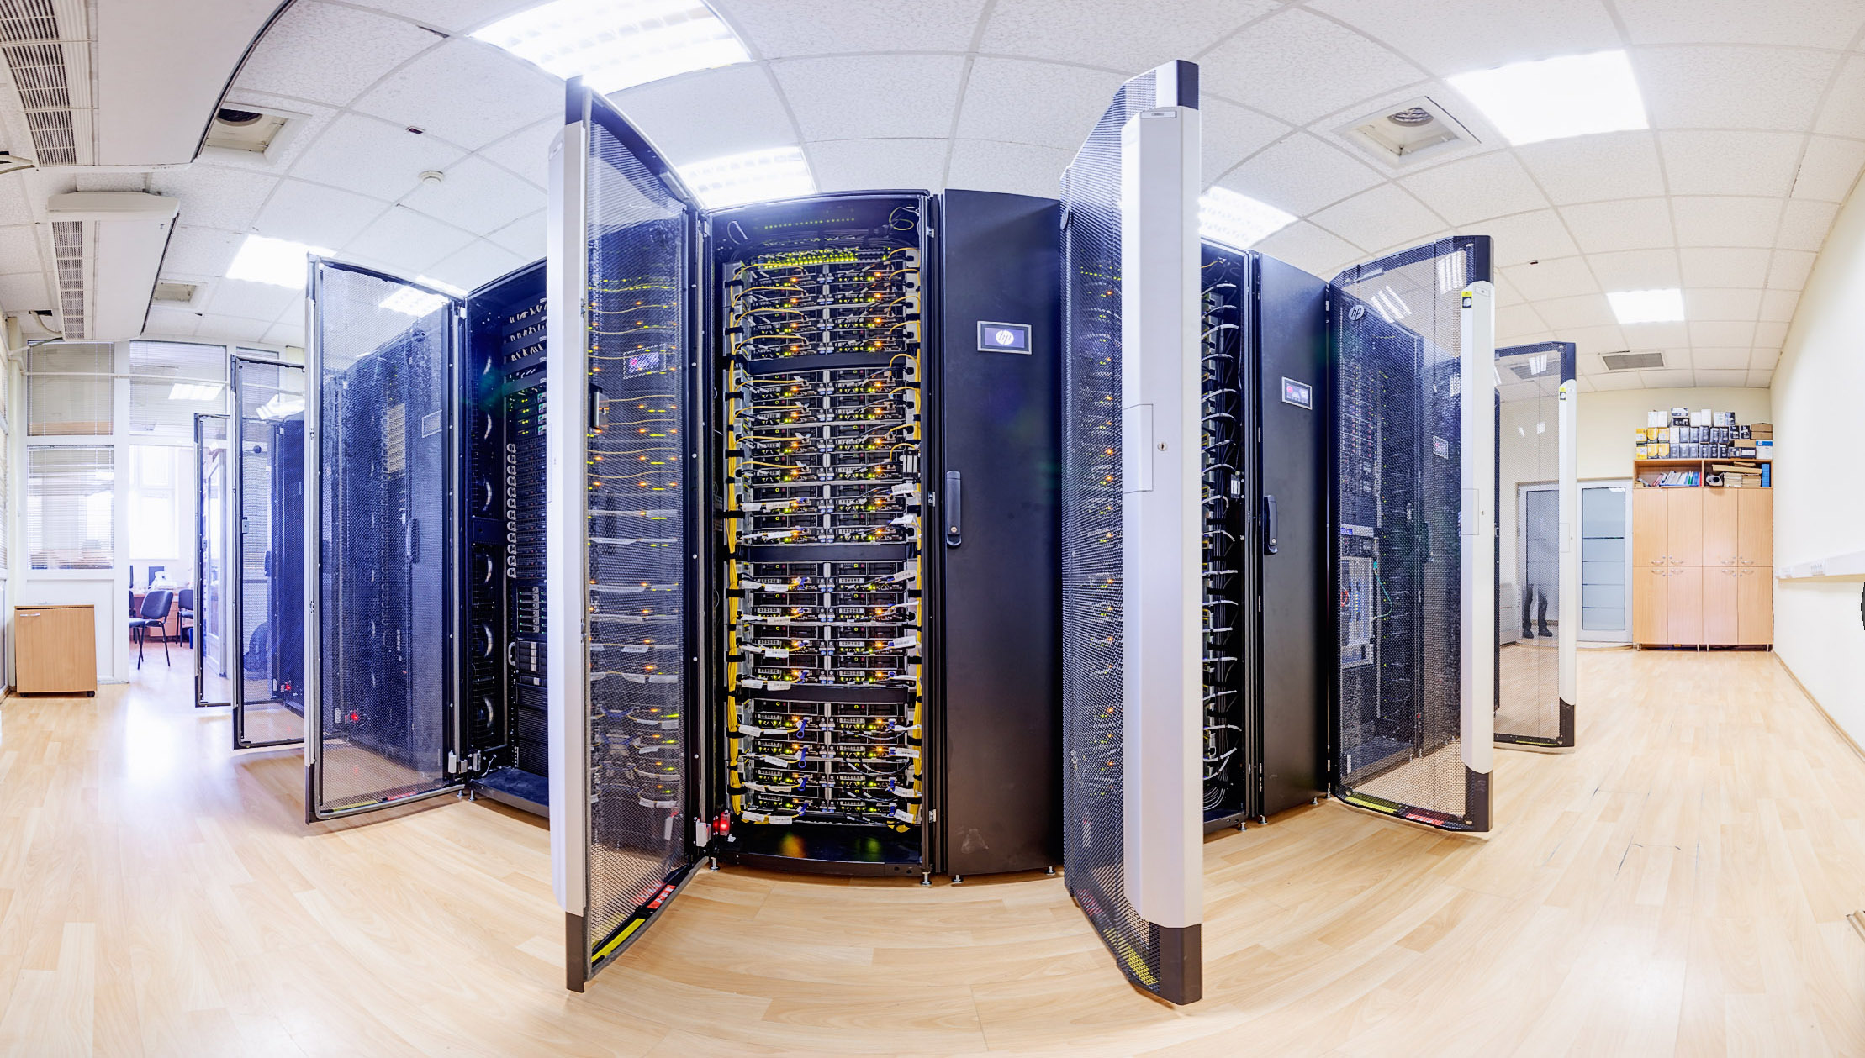
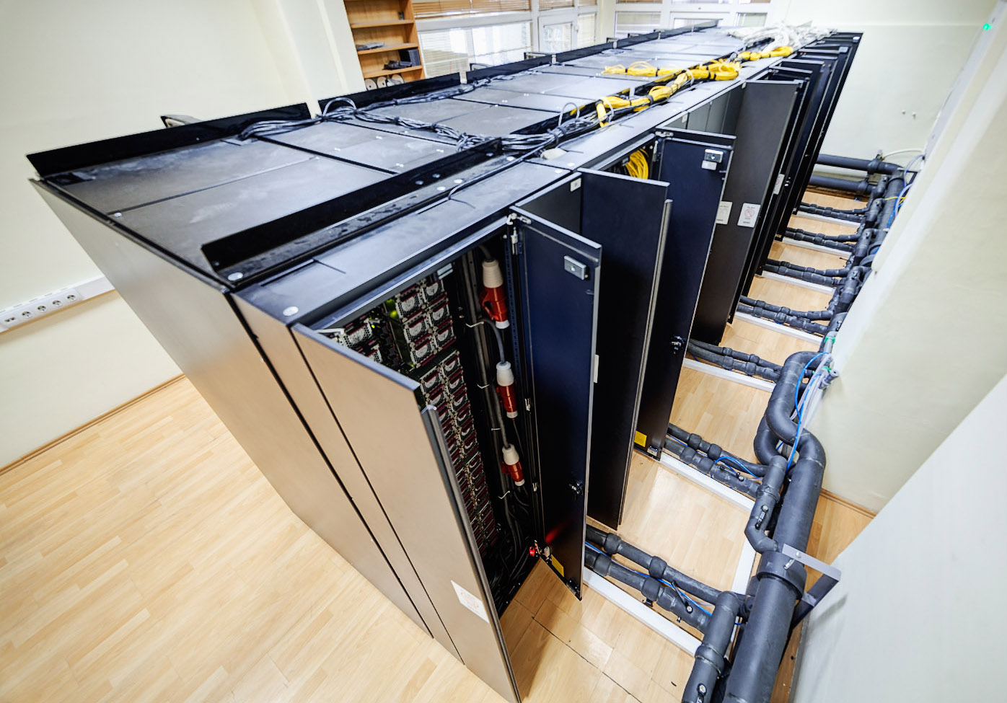
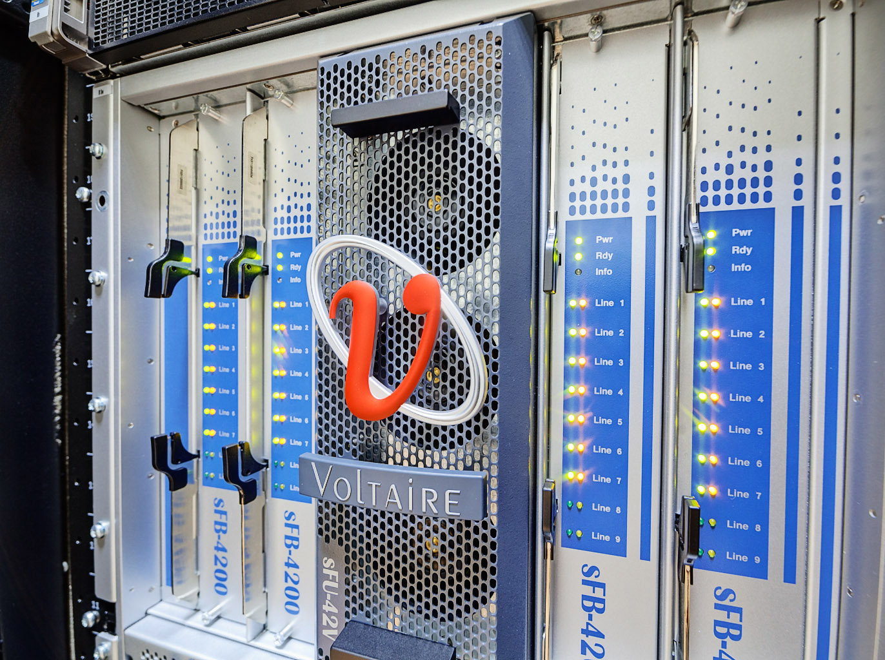
PARADOX installation
PARADOX-III
88 computing nodes (2x4-core Xeon E5345@2.33 GHz)
704 CPU cores (1 GB/core of RAM)
50 TB of disk space
Gigabit full duplex interconnection
Internet connection (10 Gbps ready)
PARADOX-IV
106 computing nodes (2x8-core Sandy Bridge E5-2670@2.6 GHz)
1,696 CPU cores (2 GB/core of RAM)
106 GPU NVIDIA Tesla M2090
96 TB of disk space (Lustre parallel file system)
QDR Infiniband (40 Gbps non-blocking all-to-all)

