Slide 1
Accessing the VI-SEEM infrastructure
Boro Jakimovski
FCSE, UKIM

Slide 2
Open Science Commons

Slide 3
Open Science Commons
The Open Science Commons (OSC) relies on four pillars, representing a wide range of groups, providers and community types:
Data. The data that is the subject matter for research. It should be dealt with according to the principles of open access and open science, while maintaining trust and privacy for researchers.
e-Infrastructures. The technology and technical services supporting researchers, building towards integrated services and interoperable infrastructures across Europe and the world.
Scientific instruments. The equipment and collaborations which generate scientific data, from small-scale lab machines to global collaborations around massive facilities.
Knowledge. The human networks, understanding and material capturing skills and experience required to carry out open science using the three other pillars.

Slide 4
Vi-SEEM services and eInfrastructure
Access to eInfrastctures present a key element of accomplishing the Open Science Commons
Vi-SEEM has a lot of activities on enabling OSC
Organization and coordination of Virtual Research Communities (VRC)
Enabling services for VRCs
Repository of VRC
Training portal
Support researchers using a Help-desk system
Enabling access to research eInfrastructure
Computing
HPC
Grid
Cloud
Data storage

Slide 5
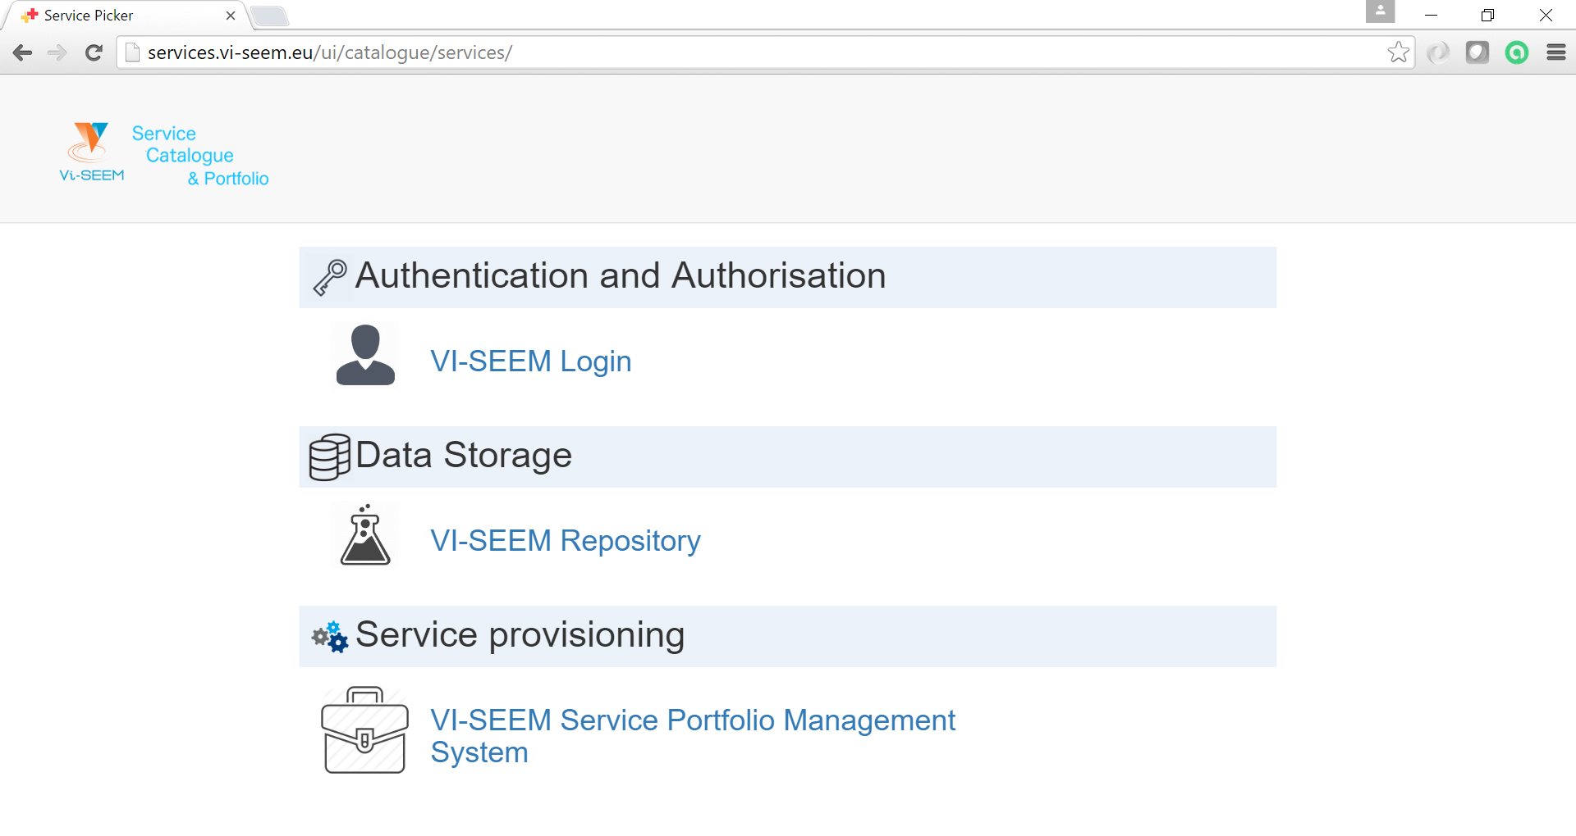
Vi-SEEM VRC services (1)
Vi-SEEM maintains a service catalog with currently available services
http://services.vi-seem.eu/ui/catalogue/services/
Services will be published to the service catalog as soon as they become production ready

Slide 6
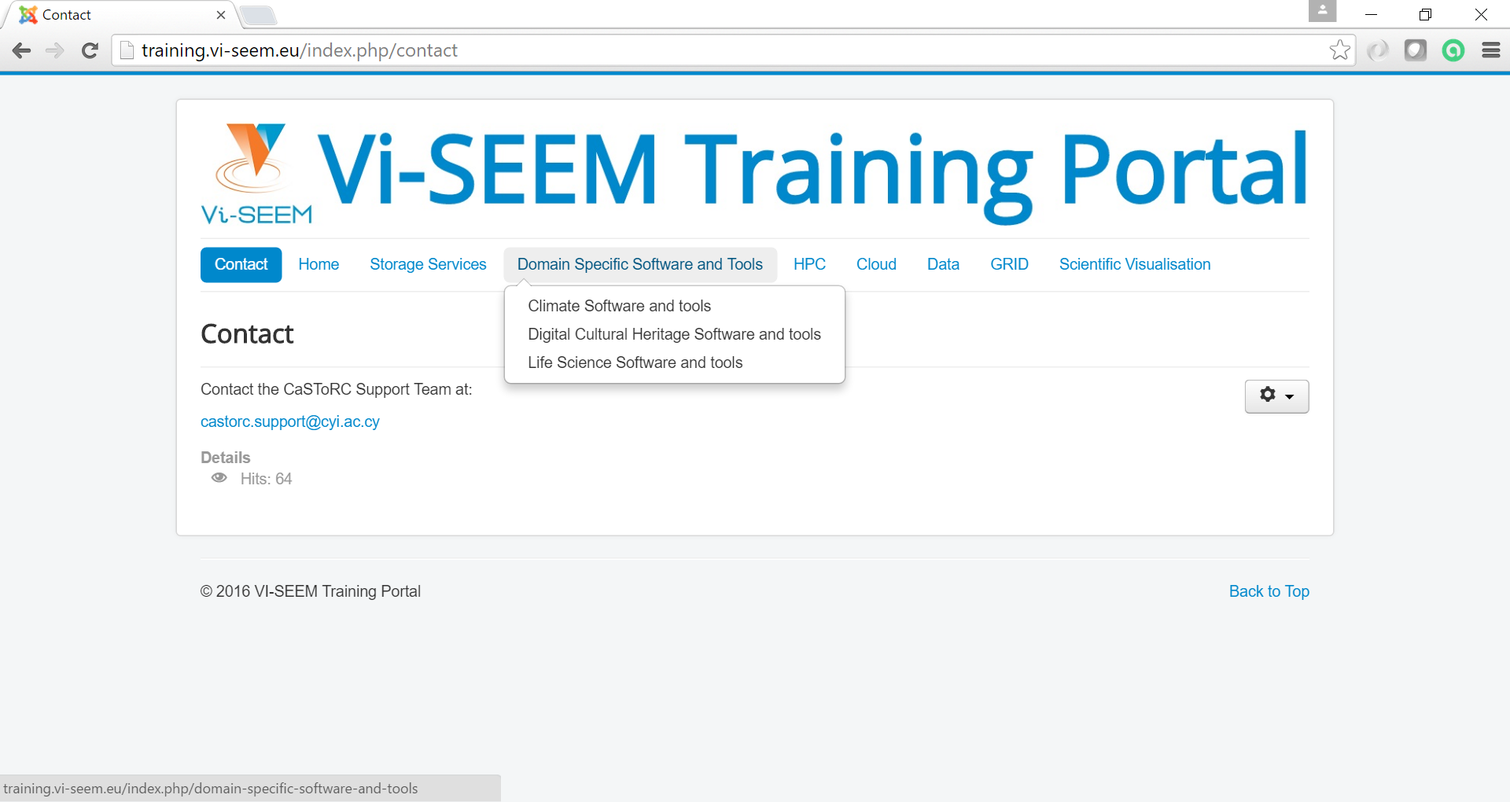
Vi-SEEM VRC services (2)
Vi-SEEM training portal
http://training.vi-seem.eu/
Contains training materials (tutorials, presentations, papers) connected with HPC/Grid/Cloud computing/Storage as well as Domain Specific tools

Slide 7
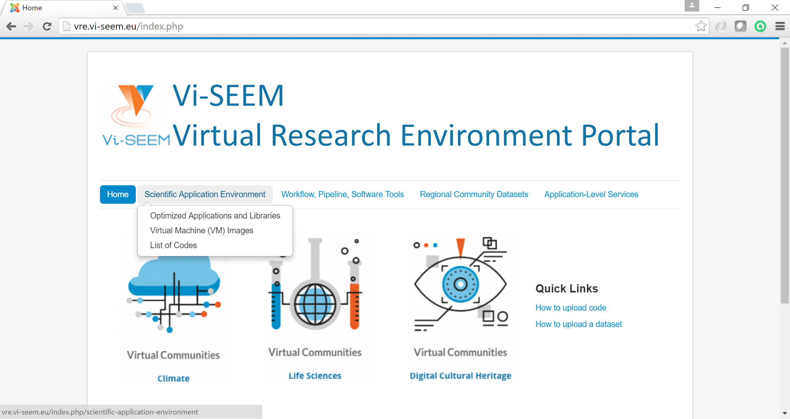
Vi-SEEM VRC services (3)
Vi-SEEM virtual research environment portal
http://vre.vi-seem.eu/
Optimized applications and libraries
Virtual Machine (VM) images
List of codes
Scientific workflows
Datasets
Application level services

Slide 8
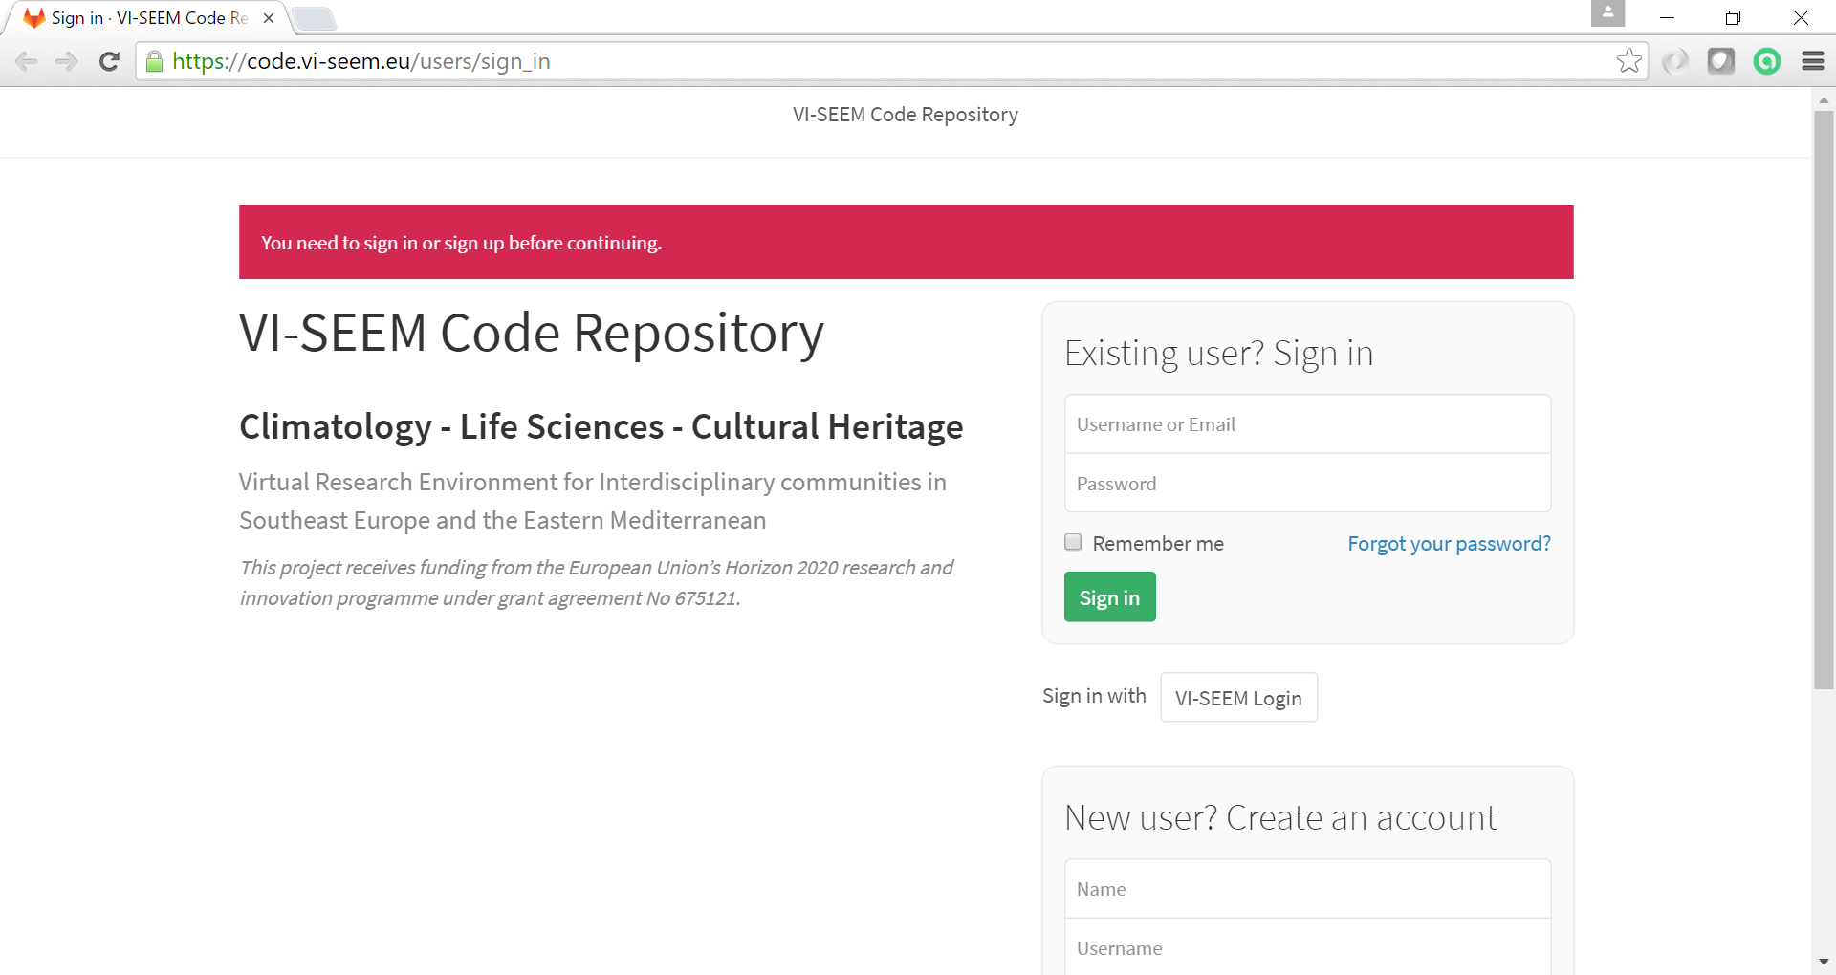
Vi-SEEM VRC services (4)
Vi-SEEM code repository
https://code.vi-seem.eu/
Service for hosting project developed codes

Slide 9
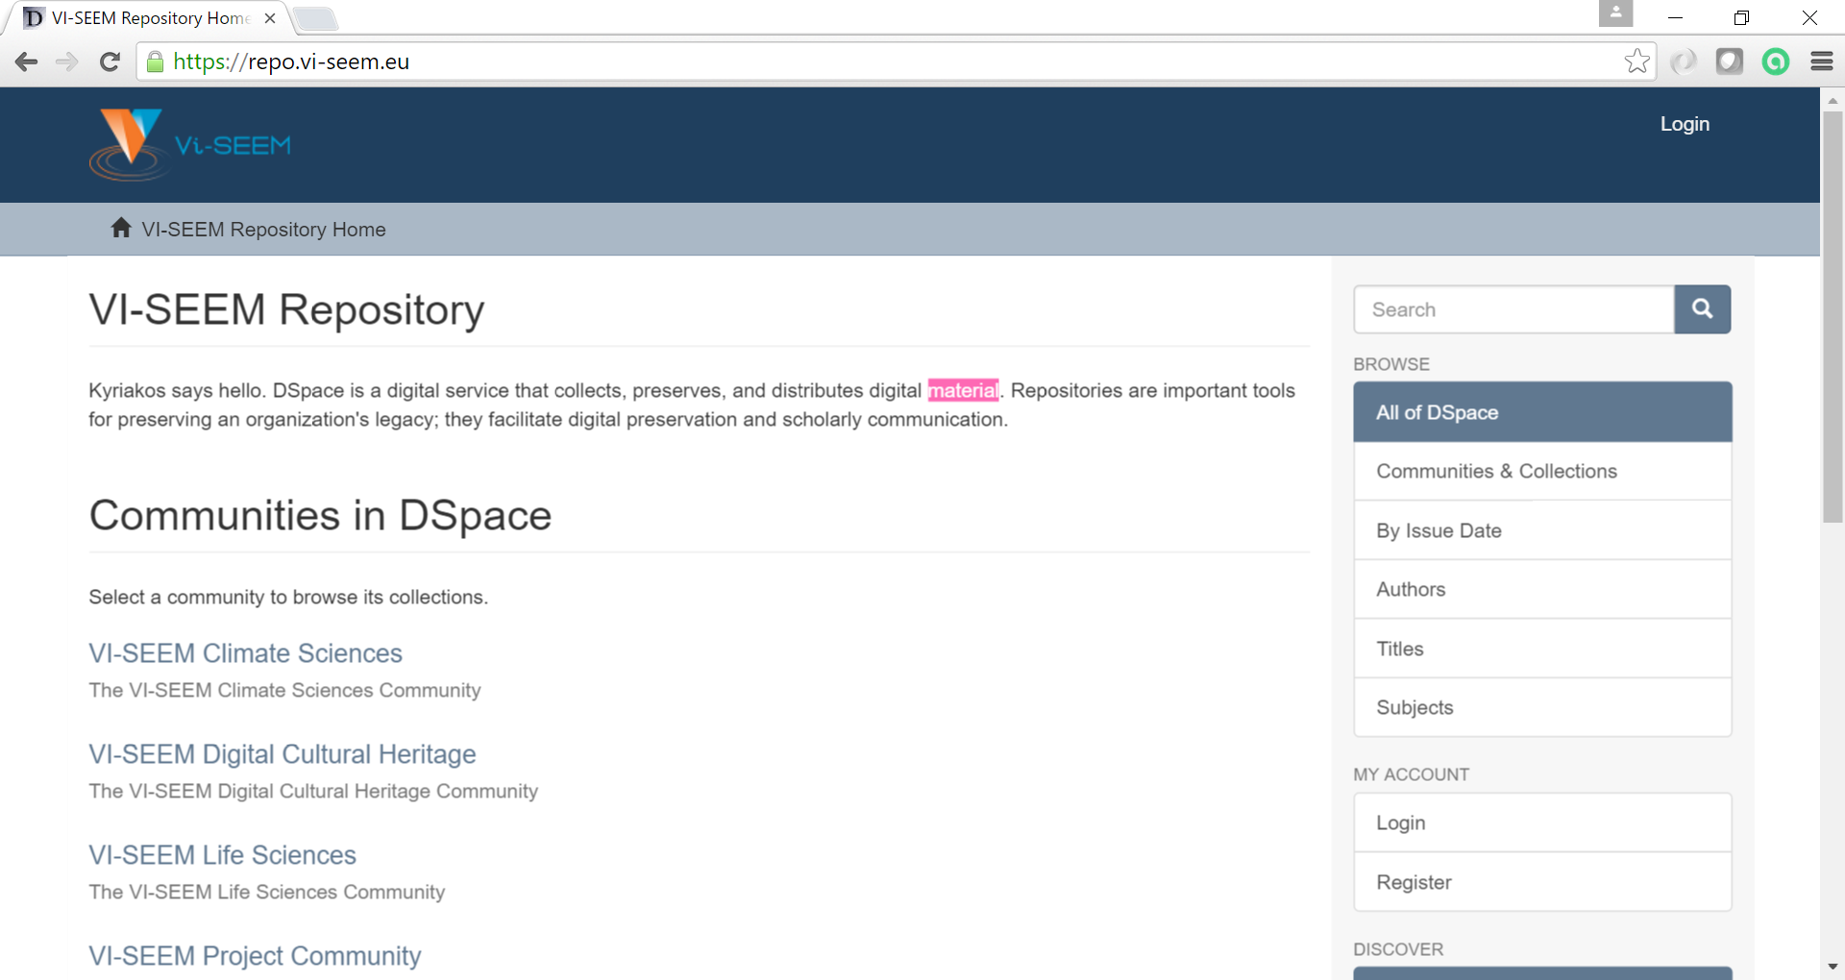
Vi-SEEM VRC services (5)
Vi-SEEM repository of digital material
https://repo.vi-seem.eu/
A digital service that collects, preserves, and distributes digital material.

Slide 10
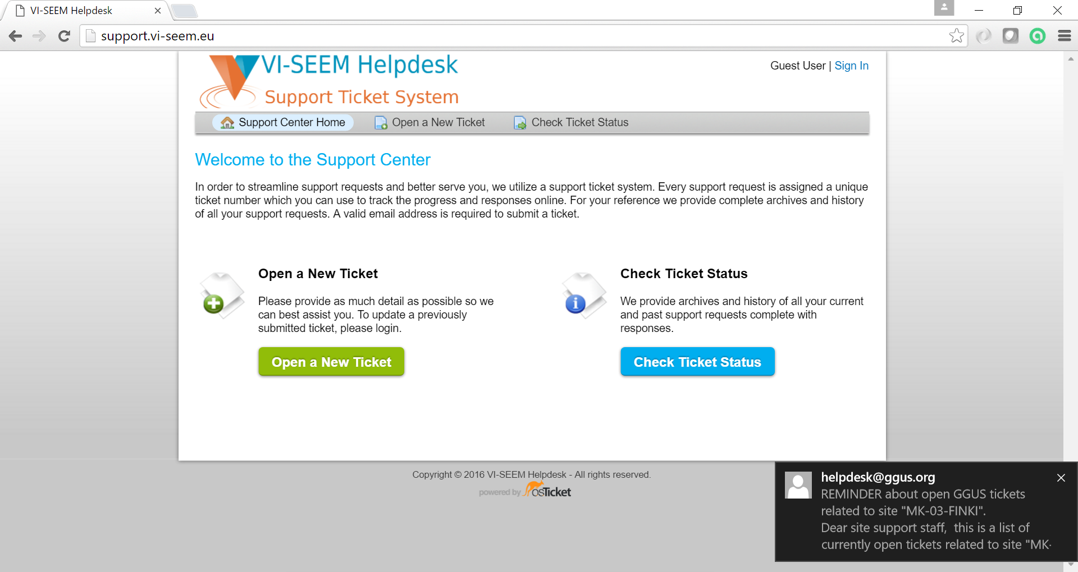
Vi-SEEM VRC services (6)
Vi-SEEM Helpdesk
http://support.vi-seem.eu/
User support for access/usage/application porting

Slide 11
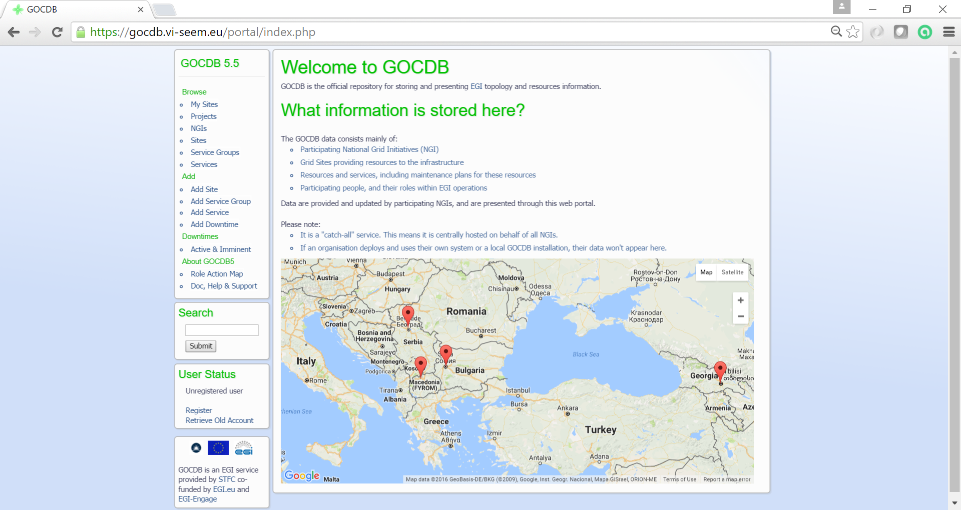
Vi-SEEM VRC services (7)
Vi-SEEM configuration database
https://gocdb.vi-seem.eu/portal/index.php
List of all eInfrastructure components

Slide 12
Access to the eInfrastructure
eInfrastructures have different access policies and procedures
Vi-SEEM will deploy services to ease and unify the access to the computing and data resources

Slide 13
Authetication and Authorization Infrastructure
Accessing any requires user authentication and authorization
Authentication establishes the User identity
Vi-SEEM Single Sign On (SSO) will enable users to access some of the resources using web
Portals (VRE portal, code repository, …)
Data stores (datasets, repositories, …)
Cloud computing providers
SSO relies on user home institution identity provider or via Social networks (Google or Facebook)
X.509 digital certificates
The Grid uses X.509 digital certificates. Users can obtain them using the MARGI CA operated by FCSE (FINKI). http://www.margi.marnet.net.mk/

Slide 14
High Perfomance Computing (HPC)
High Performance Computing allows users to utilize big volume of computing and memory resources of specialized large systems
Up to 8520 CPU cores
Up to 40Gbps interconnect
Utilizing large number of CPU presents a challenge that requires support from the HPC community
Vi-SEEM community has a long history of collaboration on supporting researchers in scaling their programs, or utilize community available software on HPC platforms
Many research software solutions and software libraries already implement the support for HPC, just need proper configuration in order to use the system

Slide 15
HPC resouces
Access to the HPC resources will be based on Linux terminal access (SSH)
Since HPC resources are very diverse in technology/software stack, every HPC center will provide a list of supported software libraries, user access documentation on how a user can:
Log-in to the front node
Upload code
Compile code
Submit jobs
Retrieve results

Slide 16
Grid Computing
Flexible, secure, coordinated resource sharing among dynamic collections of individuals, institutions, and resource
From “The Anatomy of the Grid: Enabling Scalable Virtual Organizations”
Enable communities (“virtual organizations” or VO) to share geographically distributed resources as they pursue common goals
European Grid Initiative (EGI) https://www.egi.eu
Access to Grid computing resources is based on VO membership
https://operations-portal.egi.eu/vo/search
Obtain X.509 digital certificate
Find the research community VO, apply for access, ask for support on National Grid resources if requested by VO
Browse available tools/software related to Grid on https://appdb.egi.eu/
Vi-SEEM has established a regional project VO that includes resources of 8 Grid clusters

Slide 17
Grid Computing Resources
Being a member of a Grid VO gives you access to the computing and storage resources
Resources support only Linux CentOS/SL 6
Software must be compiled under Linux
Distributed in jobs if less than 20MB or preinstalled on VO resources
Data should be uploaded to Grid Storage Nodes
gridFTP and srm

Slide 18
Grid Access
Command line tools under Linux
Requires Linux knowledge
Steps:
User creates proxy certificate and loges into the VO
User creates the Grid job specification file
input files specification
job start script and parameters
output files specificaion
User submits the job using command line tools and monitors execution
Science portals (search at https://appdb.egi.eu/)
Easier access
Different access policy and scenarios
Uses workflows to automate the execution of scientific computing processes
EGI Platform for Long Tail of Science https://access.egi.eu

Slide 19
Cloud

Slide 20
Storage

