Slide 1

Life Science and Climatology national training
FCSE, UKIM
Anastas Mishev
FCSE, UKIM
The VI-SEEM project initiative is co-funded by the European Commission under the H2020 Research Infrastructures contract no. 675121

Slide 2

Administrative details
VRE for regional Interdisciplinary communities in Southeast Europe and the Eastern Mediterranean
Start date 01/10/2015
Duration 36 months
Total funded effort: 715 PMs
EC contribution: 3.3m euro

Slide 3
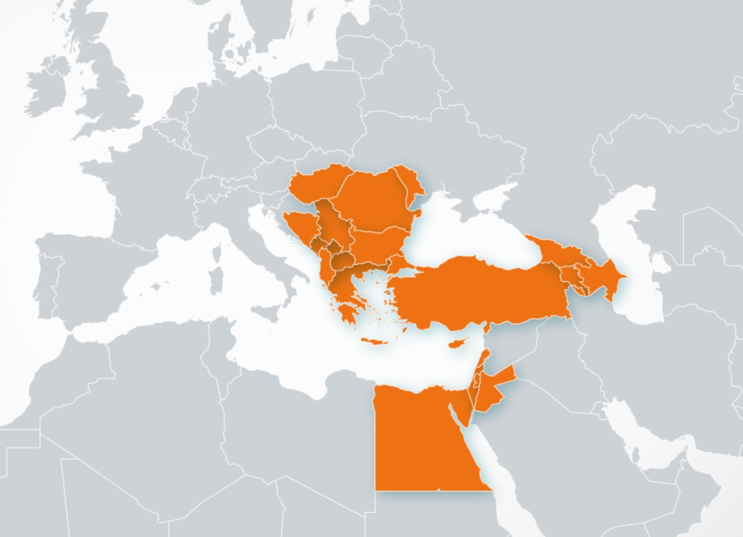
Geographical and historical context
VRE for regional Interdisciplinary communities in SEE and EM
Merging of SEE and EM regions
SEE: network SEEREN1-2, Grid SEE-GRID-1/2/SCI, HPC HP-SEE
EM: HPC LinkSCEEM1-2
Participant no. | Participant organisation name | Part. short name | Country
1 (Coord) | GREEK RESEARCH AND TECHNOLOGY NETWORK S.A. | GRNET | Greece
2 | THE CYPRUS INSTITUTE | CyI | Cyprus
3 | INSTITUTE OF INFORMATION AND COMMUNICATION TECHNOLOGIES – BULGARIAN ACADEMY OF SCIENCES | IICT-BAS | Bulgaria
4 | INSTITUTE OF PHYSICS BELGRADE | IPB | Serbia
5 | NATIONAL INFORMATION INFRASTRUCTURE DEVELOPMENT INSTITUTE | NIIF | Hungary
6 | WEST UNIVERSITY OF TIMISOARA | UVT | Romania
7 | POLYTECHNIC UNIVERSITY OF TIRANA | UPT | Albania
8 | UNIVERSITY OF BANJA LUKA | UNI BL | Bosnia and Herzegovina
9 | SS CYRIL AND METHODIUS UNIVERSITY OF SKOPJE | UKIM | FYR of Macedonia
10 | UNIVERSITY OF MONTENEGRO | UOM | Montenegro
11 | RESEARCH AND EDUCATIONAL NETWORKING ASSOCIATION OF MOLDOVA | RENAM | Moldova
12 | INSTITUTE FOR INFORMATICS AND AUTOMATION PROBLEMS OF THE NATIONAL ACADEMY OF SCIENCES OF THE REPUBLIC OF ARMENIA | IIAP-NAS-RA | Armenia
13 | GEORGIAN RESEARCH AND EDUCATIONAL NETWORKING ASSOCIATION | GRENA | Georgia
14 | BIBLIOTHECA ALEXANDRINA | BA | Egypt
15 | INTER UNIVERSITY COMPUTATION CENTER | IUCC | Israel
16 | SYNCHROTRON-LIGHT FOR EXPERIMENTAL SCIENCE AND APPLICATIONS IN THE MIDDLE EAST | SESAME | Jordan

Slide 4
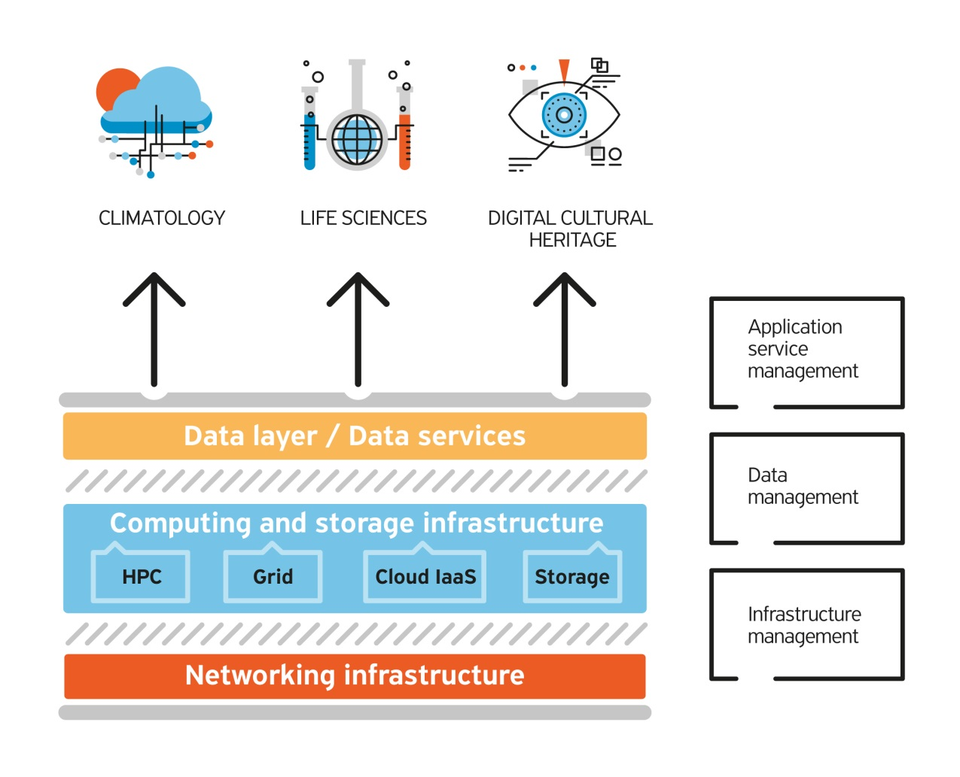
Technology context
Overall objective: Provide user-friendly integrated e-Infrastructure platform for Scientific Communities in Climatology, Life Sciences, and Digital Cultural Heritage for the SEEM region; by linking compute, data, and visualization resources, as well as services, software and tools.
Diverse computing technologies
Advent of big data
Service orientation

Slide 5
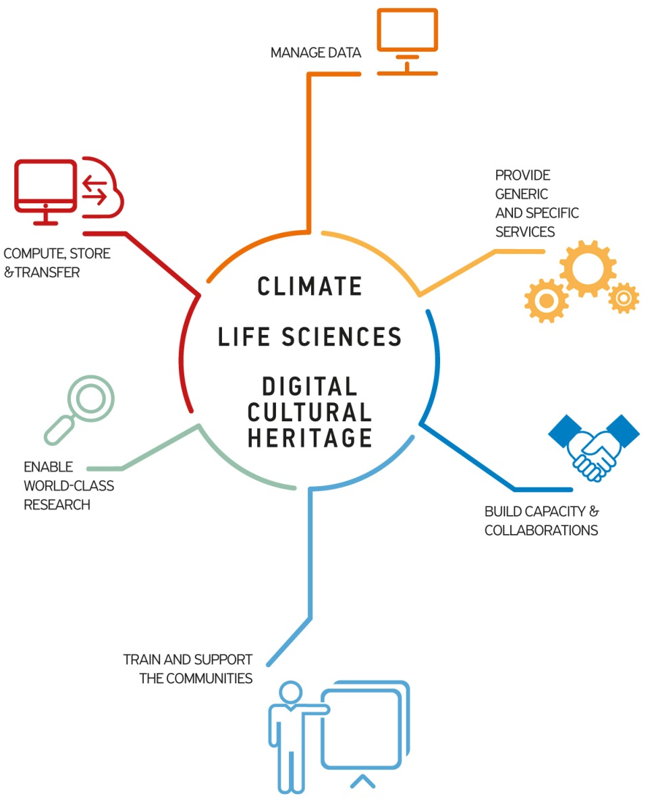
Detailed objectives

Slide 6
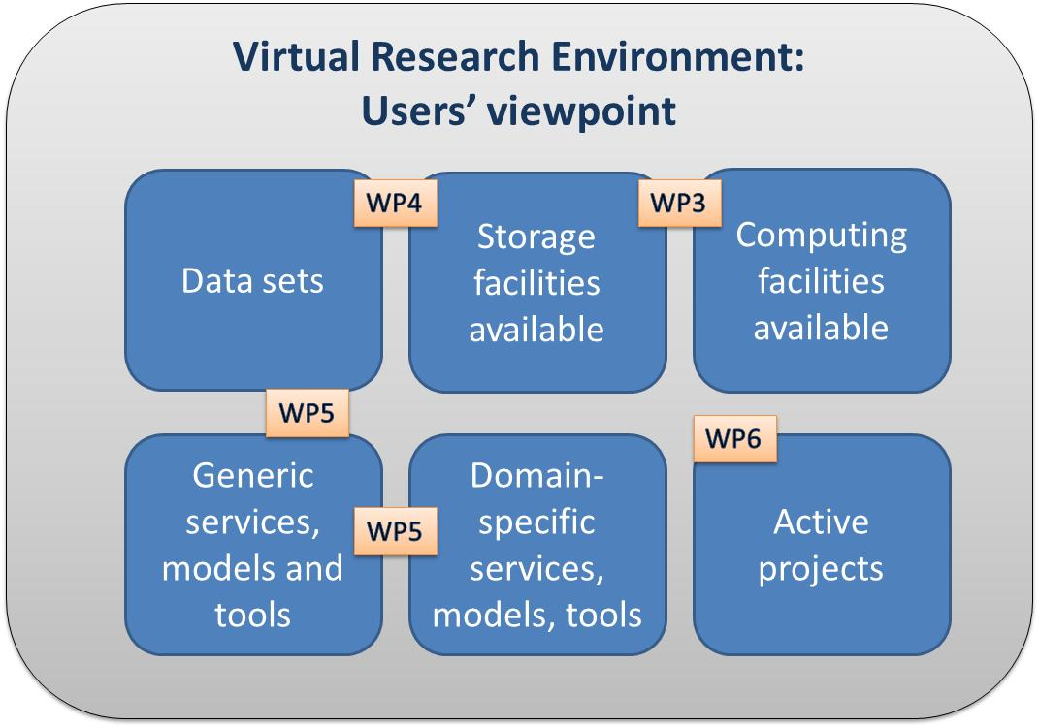
User-centric approach

Slide 7
Key Performance Indicators
e-Infrastructure: 21500 CPU cores, 325000 GP-GPU cores and 18500 Intel Xeon Phi cores of HPC, 2900 grid cores, 10500 cloud VM cores, 11 PBytes of storage (of which dedicated 5-15% , 10-15%, 5% and 10% respectively)
> 10 specific services, 30 data sets and 25 codes
39 applications, 45 research teams taking part. 100 publications, 50 presentations
17 dissemination events,12 training events

Slide 8
Work organisation

Slide 9
e-Infrastructures (WP3)
Resource Type | Number of countries contributing | Number of sites | Total amount of resources | Total amount of resources dedicated for the project
HPC x86 Compute | 8 | 11 | ~21500 cores | ~17.5 Million core hours per year
HPC GPU | 3 | 3 | ~325000 GP-GPU cores | ~ 18000 GPU cores
HPC Intel Phi Accelerators | 1 | 1 | ~18500 co-processor cores | ~8Μ co processor core hours per year
Grid Compute | 12 | 25 | ~ 2900 cores | 10-15% of the resources
Cloud Compute | 8 | 9 | ~ 10500 VM cores | 5% of VM cores
HPC Test/Train Cluster | 3 | 4 | ~300 cores | ~50000 cores hours per year
Storage (Disk) | 13 | 18 | 3.1 PB | 515 TB
Storage (Tape) | 2 | 2 | 8 PB | 550 TB

Slide 10
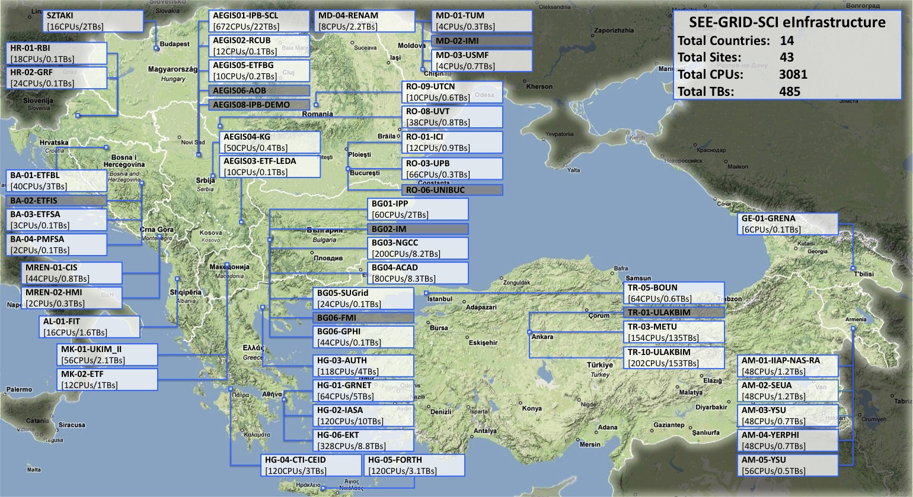
e-Infrastructures: Grid (WP3)
At end of SEE-GRID projects series: 55 sites in production
<Event Name> 10

Slide 11
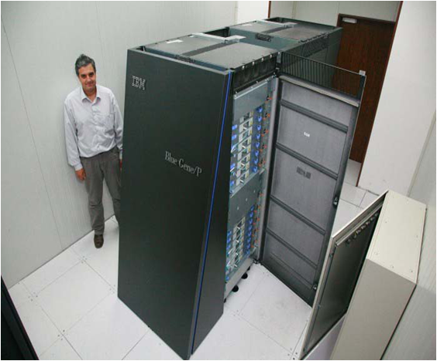
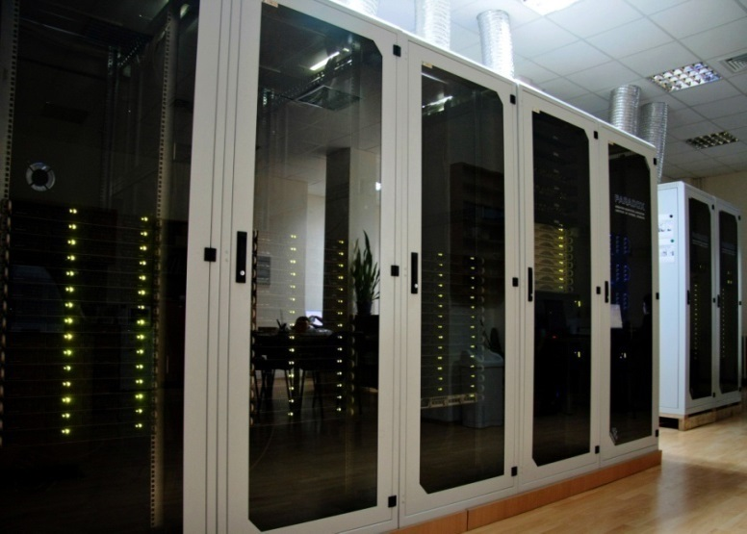
e-Infrastructures: HPC (WP3)
3 top 500 supercomputers in June 2015 (Bulgaria, Greece, Hungary)
Heterogeneous infrastructure - Blue Gene/P SCs, large HPC clusters with advanced interconnects. Advantage to users
To support a substantial number of libraries, toolkits, codes and application software

Slide 12
Data management (WP4)
Functions allowing for data management for selected Scientific Communities, engage the full data management lifecycle
Select and integrate data management services tailored to the project’s Scientific Communities
Deploy and operate data management services that address the full data lifecycle
Collect the actual VRE-specific data sets and make them available via common interfaces and services
Data storage (live, dropbox-like), data archiving, data manipulation, collaborative access, domain specific interfaces to storage, data annotation and citation, metadata, PIDs, etc.

Slide 13
Types of applications (WP5)
Climate | Life Sciences | Cultural Heritage
Regional Climate Modelling | Modeling and Molecular Dynamics (MD) study of important drug targets | Digital Libraries
Global Climate Modelling | Computer-aided drug design | Interactive Visualization Tools
Weather Forecasting | Analysis of Next Generation DNA sequencing data and RNA profiling data | Semantic Referencing
Air Pollution/Quality | Data mining to identify prevalent diseases/mutations in the SEEM region | Image Classification
Model Development | Image processing for biological applications | Modelling of Built Environments and Advanced Representation Techniques
Visualization, Datasets, etc. | Computational simulation of DNA and RNA | Scientific simulation of materiality and systems' properties
Other | Synchrotron data analysis | Geo-referencing Tools
 | Other | Bioarchaeology

Slide 14
Data sets: climate (WP4, WP5)
Simulation and observation data; global and local sets
Source | Description | URL
Earth System Grid Federation | Data portal for downloading CORDEX and other data (i.e. CMIP5) | http://pcmdi9.llnl.gov/esgf-web-fe/
Climatic Research Unit (CRU) | gridded observations of surface meteorological data and climatic indices | http://www.cru.uea.ac.uk/data
E-OBS | gridded observations of surface meteorological parameters for Europe | http://eca.knmi.nl/download/ensembles/download.php
ECA&D | meteorological station observations for Europe and part of MENA | http://eca.knmi.nl/dailydata/index.php
APHRODITE | Gridded precipitation data for Asia and Middle East | http://www.chikyu.ac.jp/precip/index.html
Global Precipitation Climatology Centre (GPCC) | Gridded global precipitation observations | ftp://ftp-anon.dwd.de/pub/data/gpcc/html/gpcc_normals_download.html
European Centre of Medium-Range Weather Forecasts Data Portal (ECMWF) | Mainly for downloading reanalysis products such as the ERA-Interim | http://apps.ecmwf.int/datasets/
AERONET | federation of ground-based remote sensing aerosol networks | http://aeronet.gsfc.nasa.gov
MODIS | MODIS (or Moderate Resolution Imaging Spectroradiometer) is a key instrument aboard the Terra (EOS AM) and Aqua (EOS PM) satellites | http://modis.gsfc.nasa.gov
ISA-MEIDA | collection and archiving of Israeli Earth Science data sets | http://nasa.proj.ac.il/
TOMS aerosol index | index that detects the presence of uv-absorbing aerosols such as dust and soot | http://disc.sci.gsfc.nasa.gov/data-holdings/PIP/aerosol_index.shtml
Source | Description
TAU, Israel | Meteorological and hydrological data for Israel, environmental data, such as PM10 and PM2.5 measurements in various locations in Israel
METEO-RO, Romania | a gridded dataset from observations consisting of 9 essential climate variables with daily values (1961-2013) on a spatial resolution of 10 km for the Romanian territory (ROCADA)
IEG, Moldova | data recorded by meteorological stations and posts of the State Hydro-meteorological Service
NIGGG, Bulgaria | NCEP Global Analysis Data with 1º resolution, available since 2000 TNO high resolution emission inventory for Europe Data of the pollution levels, measured by the Bulgarian National Network for Air Quality Control, available since 2000
IGEWE, Albania | data collected from the Hydrological, Meteorological and Seismological networks (such as water flow, temperature, humidity, precipitation etc., and a range of seismic data)

Slide 15
Data sets: life sciences (WP4, WP5)
Simulation and observation data; global and local sets
Country | Available data | Access Policy (Private, Regional, Public)
Greece | Virtual screening results | Data that is published is public and can be shared
Serbia | SNP database of variations in genes involved in Cystic Fibrosis, Thrombosis, Alpha-1-Antitripsine deficiency, Colorectal cancer, Thyroid cancer, Lung cancer, Endometrium. The database contains data on Serbian population. | Data that is published is public and can be shared
Moldova | Investigation Analytics, Research Results, Pathologies case studies | Investigation Analytics and Research Results are shared information. Pathologies case studies (no personal patient info) – available for research community by creating agreement with institution.

Slide 16
Data sets: CH (WP4, WP5)
Source | Description | URL
Ancient Cypriot Literature Digital Corpus (AKGDC) | Searchable digital library of Ancient Cypriot Literature. Covers the ancient Cypriot literary production from 7th century BC to 5th-6th century AD and examines it through its wide range of literary genres. | Not public yet.
STARC repository | Repository for digital CH objects created over the last 5 years at CyI. Including novel interactive methods for accessing and exploring information. | http://public.cyi.ac.cy/starcRepo/
Electronic Corpus of Karamanlidika | Digitalization and transcription into Latin characters of a corpus of Karamanlidika printed material from different periods and genres with access to graphic, phonetic and morphemic varieties search. | Not public yet.
The digital collection of Bibliotheca Alexandrina | As a library of the 21st Century, the Bibliotheca Alexandrina (BA), along with its affiliated academic and cultural centres, is committed to digitization as a means of preserving, managing, and disseminating information and knowledge. The BA sets out to share them with a worldwide audience via the internet, thus promoting greater understanding and tolerance between cultures. To achieve this goal, the BA has formed partnerships with various cultural, academic, governmental, and corporate organizations for the creation of many significant and compelling digital projects. These projects cover a wide array of cultural and educational themes. | http://www.bibalex.org/Libraries/Presentation/Static/12600.aspx?d=0

Slide 17
Access to VRE (WP6)
Through 3 distinct calls
Pre-selected candidates project M12
Open calls project M18 and M28

Slide 18
Conclusion
SouthEast European initiatives built up the regional (and national) NRENs, NGI and HPC models
LinkSCEEM project series linked the Eastern Mediterranean HPC facilities
VI-SEEM unifies SEE and EM for the benefit of 3 large regional communities
Virtual Research Environment to be provided to the scientific user communities in Climatology, Life Sciences, and Cultural Heritage
VI-SEEM unifies networking, computing and data management
Support in the full lifecycle of scientific research
Services will be provided through a service catalogue

Slide 19
Thanks!
VI-SEEM Project Management Office
e-mail: vi-seem-pmo@vi-seem.eu
W: https://vi-seem.eu
T: @vi_seem
L: https://www.linkedin.com/groups/VISEEM-7018941/about

