Slide 1
National ESFRI Roadmap

Slide 2
Why Research Infrastructures?
Research Infrastructures in the ERA
catalyze the knowledge creation process
facilitate the networking of researchers
stimulate knowledge flows
enhance the prospects for downstream impacts
have important accelerator effects on
local economies

Slide 3
Characteristics of a PanEU Research Infrastructure
Offers cutting-edge, essential service to research, on a non-economic basis, within an ERA outlook
Awards free open access through international peer-review competition at world level
Results published/shared in the public domain
Proprietary and/or training access is marginal
Clear pan-European added value: e.g. at least 30% of selected users coming from non-host countries

Slide 4
Research Infrastructures Today
Today the economic contingency and the globalization of the challenges may jeopardize the efforts for a new European renaissance.
A concentrated effort on common, internationally shared research infrastructures that will keep producing new knowledge, could be a cheaper solution than the fully distributed effort.
We should therefore elaborate the concept that investing in large RI is the best strategy in time of crisis.

Slide 5
Research Infrastructures Tomorrow
EUROPE 2020 Vision
Innovation Union commitments
5. By 2015, Member States together with the Commission should have completed or launched the construction of 60% of the priority European research infrastructures currently identified by the European Strategy Forum for Research Infrastructures (ESFRI). The potential for innovation of these (and ICT and other) infrastructures should be increased. The Member States are invited to review their Operational Programmes to facilitate the use of cohesion policy money for this purpose.
Research Infrastructures contribute to implementation of the Europe 2020 strategy and “Innovation Union”

Slide 6
What is ESFRI?
ESFRI is a strategic instrument created in 2002 by the Member States and the European Commission to develop the scientific integration of Europe and to strengthen its international outreach.
ESFRI gives national authorities the opportunity to explore common and integrated activities for the best development and use of Research Infrastructures of pan-European relevance.
In this way, ESFRI contributes to the implementation of a critical, strategic part of the Lisbon agenda by integrating national policies and bringing together national and EU resources to develop the European Research Area.
The ESFRI delegates are nominated by the Research Ministers of the Member States and Associated Countries, and include a representative of the Commission.

Slide 7
        Mission of ESFRI
To support a coherent and strategy-led approach to policy-making on new and existing pan-European and global RIs
To facilitate multilateral initiatives leading to the better use and development of Research Infrastructures, at EU and international level

Slide 8
        The Roadmap Mandate
The Competitiveness Council of the EU mandated ESFRI on November 2004 to develop a strategic roadmap in the field of RI for Europe
The ESFRI roadmap identifies new pan-European Research Infrastructures (RIs) or major up-grades to existing ones, corresponding to the needs of European research communities in the next 10 to 20 years, regardless of possible location

Slide 9



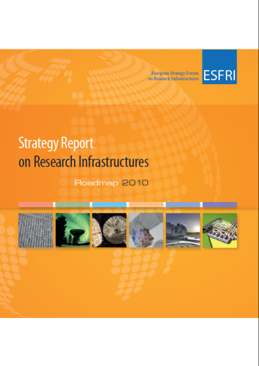

ESFRI Roadmap
  Roadmap identifies new pan-European Research Infrastructures or major up-grades to existing ones, corresponding to the needs of European research communities in the next 10 to 20 years, in all fields of Research, regardless of possible location
  ESFRI to provide help and best practice, but MS and AC must be the major source of funding
    First Roadmap published in 2006
      Followed by two updates in 2008 and 2010: Now contains 48 projects
        Requires major financial investment (~20 b€) and long term commitment for operation (~2 b€/year)
          New ESFRI Roadmap in 2016

Slide 10
ROADMAP 2016
What is the ESFRI Roadmap
Mandate of Competitiveness Council
ESFRI definition of Research Infrastructure
The role of Research Infrastructures in European Competitiveness
Impact on innovation
Impact on socio-economic aspects
Impact on advanced education and attractiveness of Europe for young scientists
Structuring Effect of ESFRI RIs on the European Research Area
Global dimension
Big Data and Big Data Analysis issues
What is new in the Roadmap 2016 *e-book*
LANDSCAPE ANALYSIS: the ensemble of RIs offering access to European researchers in all domains
ESFRI LANDMARKS: ESFRI contribution in shaping the European landscape
ESFRI PROJECTS: Fewer, more mature projects for a dynamical strategy on RIs for European competitiveness
Time window of opportunity for ESFRI projects
New Method of evaluation and selection
Periodic assessments ESFRI LANDMARK and PROJECTS

Slide 11
ROADMAP 2016
EVALUATION PROCESS
PROPOSAL SUBMISSION by National Delegations on behalf of MS(s) and AS (s) or EIROFORUM
ESFRI Executive Board
UNELIGIBLE PROPOSALS
ELIGIBLE PROPOSALS
ATTRIBUTION TO SWG
SCIENTIFIC ANALYSIS
peer-review
internal experts
+
3 external referees
SWG
ENE
IMPLEMENTATION ANALYSIS
internal experts
IG
SWG
ENV
SWG
H&F
SWG
PSE
SWG
SCI

Slide 12
ROADMAP 2016
EVALUATION PROCESS
SCIENTIFIC ANALYSIS
PRE-HEARING
SWG
ENE
IMPLEMENTATION ANALYSIS
PRE-HEARING
IG
SWG
ENV
SWG
H&F
SWG
PSE
SWG
SCI
INTELLIGENT QUESTIONS
HEARINGS
SCIENTIFIC ANALYSIS
POST-HEARING
SWG
ENE
IMPLEMENTATION ANALYSIS
POST-HEARING
IG
SWG
ENV
SWG
H&F
SWG
PSE
SWG
SCI
HARMONISATION BETWEEN SWGs+IG
RECOMMENDATIONS TO ESFRI EB and FORUM

Slide 13
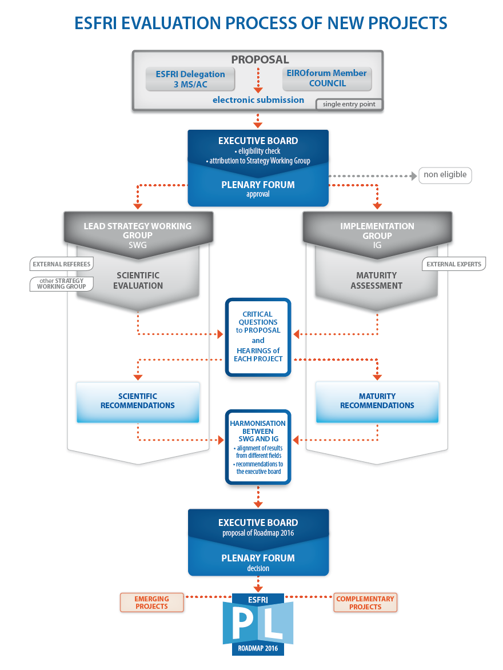
ROADMAP 2016
ESFRI EVALUATION PROCESS
OF NEW PROJECTS

Slide 14


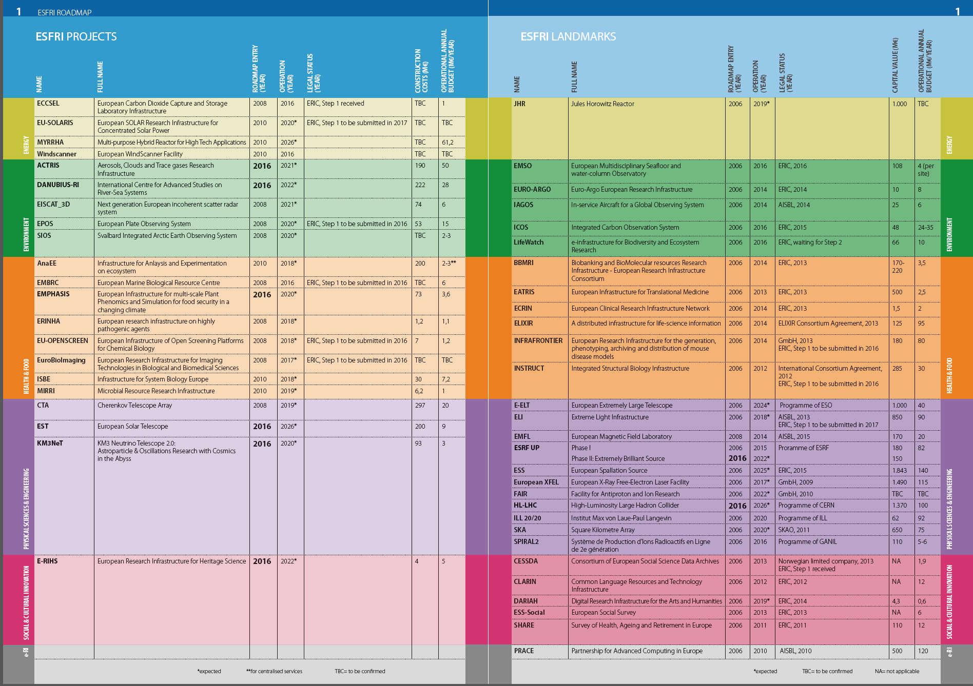

Slide 15

ROADMAP 2016
THE PROJECTS

Slide 16
ROADMAP 2016 Part 2 project-descriptions
ESFRI PROJECTS, 15 ongoing + 6 new
ENE
ENV
H&F
PSE
SCI
e-RI
ECCSEL
EISCAT_3D
EMBRC
CTA
2008
EPOS
ERINHA
SIOS
EU-OPENSCREEN
Euro-BioImaging
EU-SOLARIS
ANAEE
2010
MYRRHA
ISBE
WindScanner
MIRRI
2016
ACTRIS
EST
DANUBIUS-RI
EMPHASIS
KM3NeT 2.0
E-RIHS

Slide 17

ROADMAP 2016
THE LANDMARKS

Slide 18
ROADMAP 2016
ESFRI LANDMARKS, 27+2 proposed
ENE
ENV
H&F
PSE
SCI
e-RI
JHR
EMSO
BBMRI ERIC
E-ELT
CESSDA
PRACE
EURO-ARGO ERIC
EATRIS ERIC
ELI
CLARIN ERIC
IAGOS
ECRIN ERIC
EUROPEAN SPALLATION SOURCE ERIC
DARIAH ERIC
ICOS ERIC
INFRAFRONTIER
Eu-XFEL
ESS ERIC
LifeWatch
INSTRUCT
FAIR
SHARE ERIC
ELIXIR
ILL
SKA
SPIRAL2
2006
EMFL
2008
ESRF-EBS
HL-LHC
2016

Slide 19
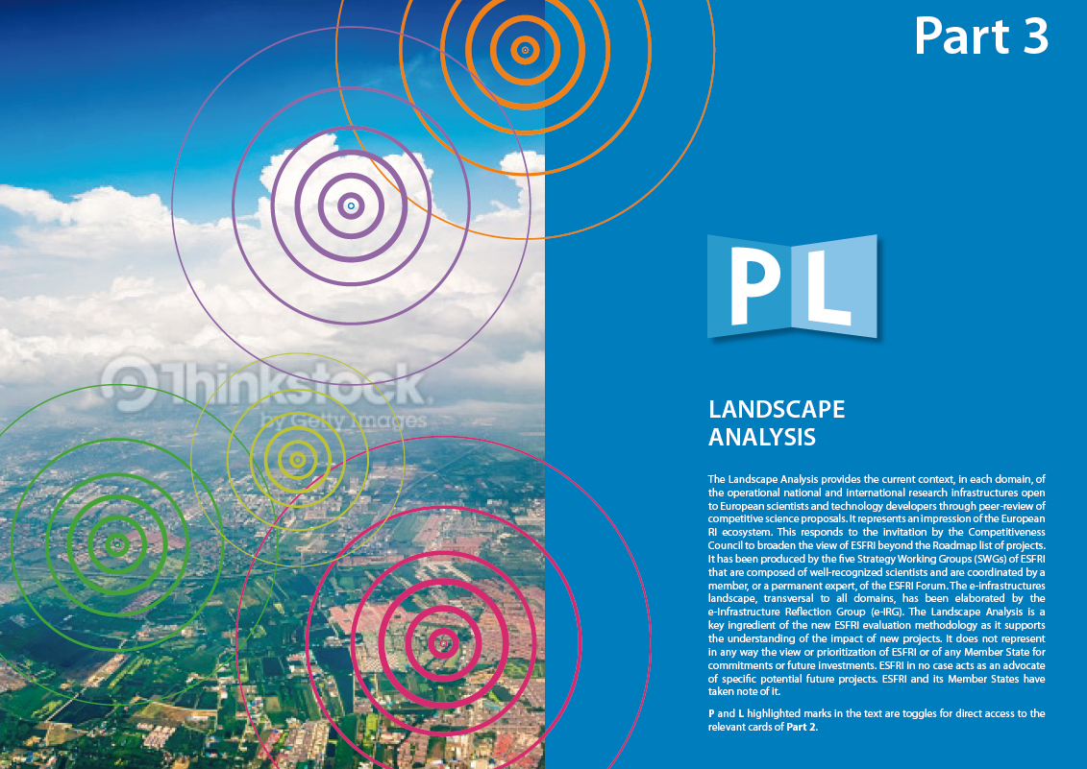
ROADMAP 2016
LANDSCAPE ANALYSIS

Slide 20

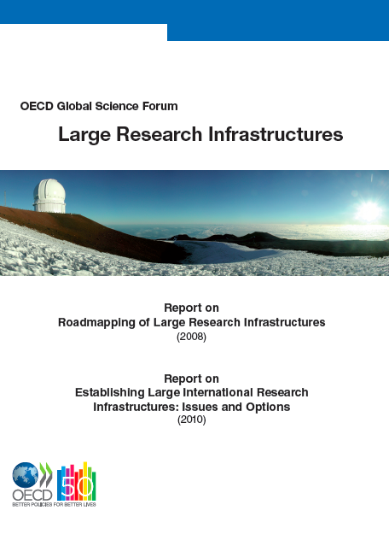



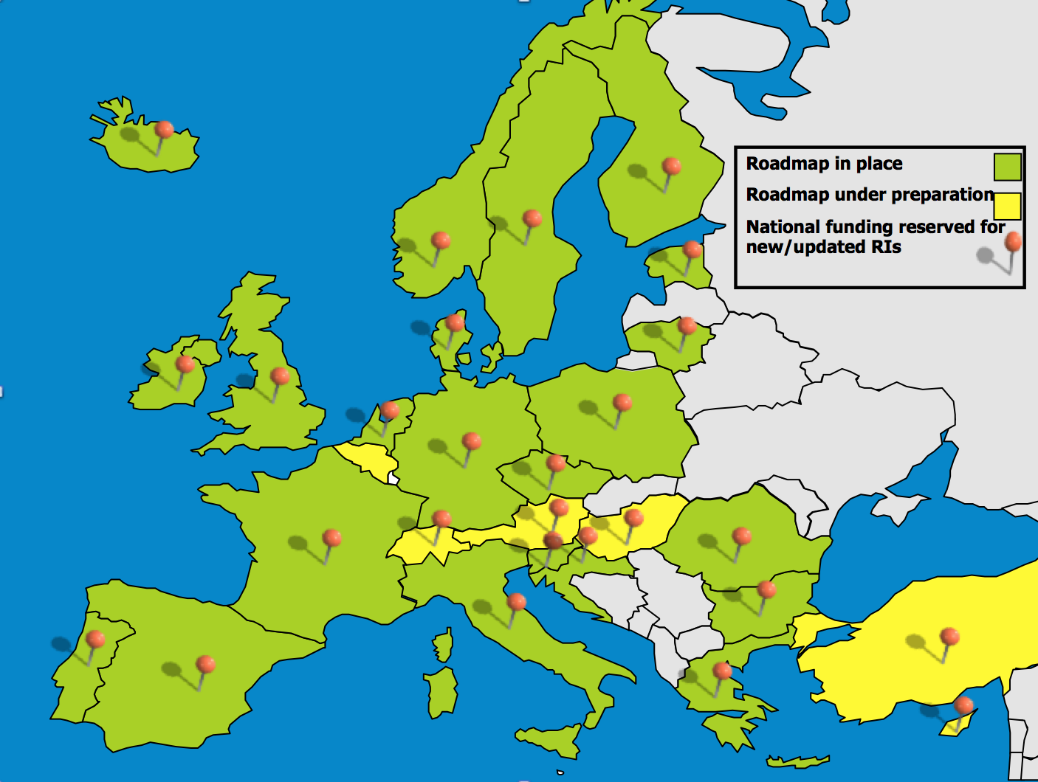

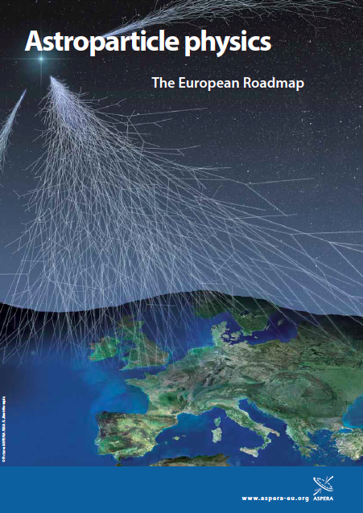


PSE
Part 3 e-book
LANDSCAPE ANALYSIS

Slide 21

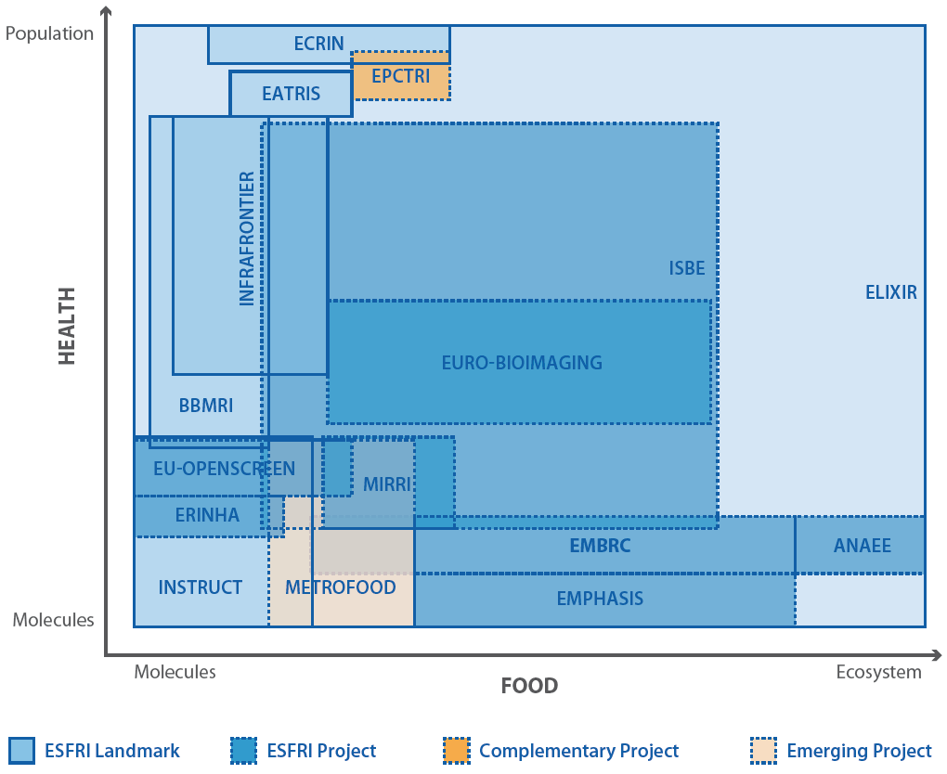
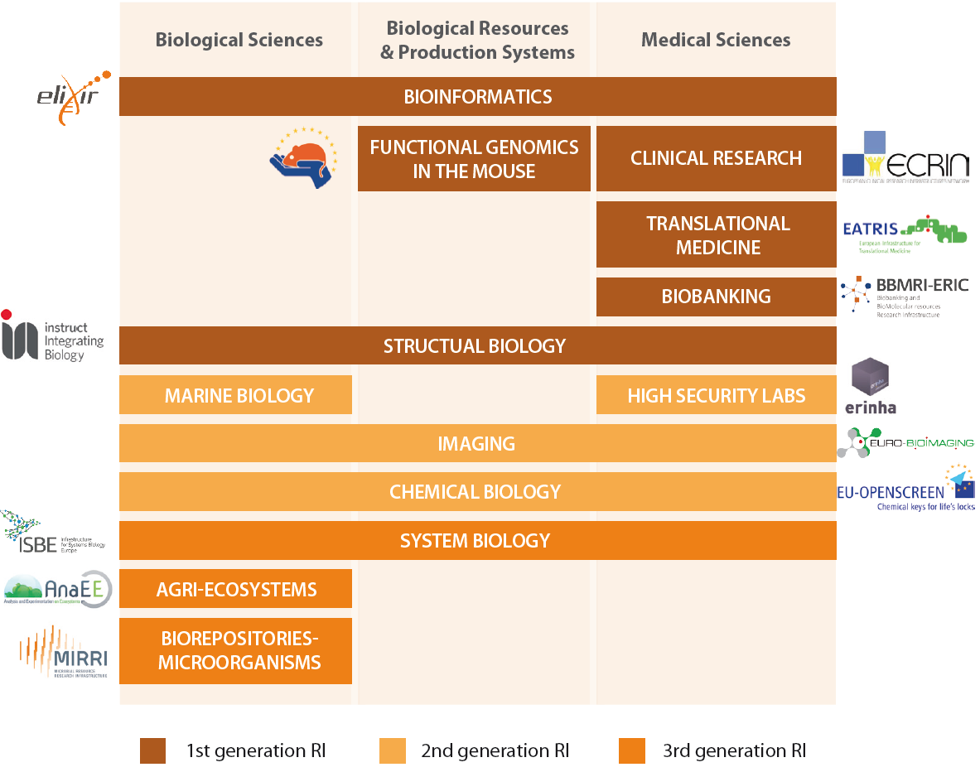
Health & Food

Slide 22
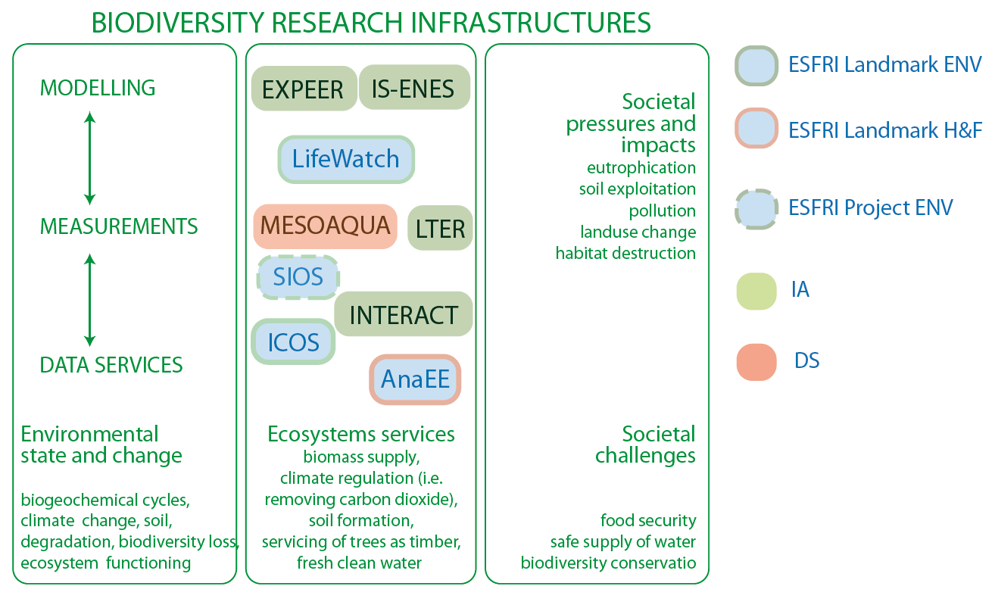
ENVIRONMENT

Slide 23
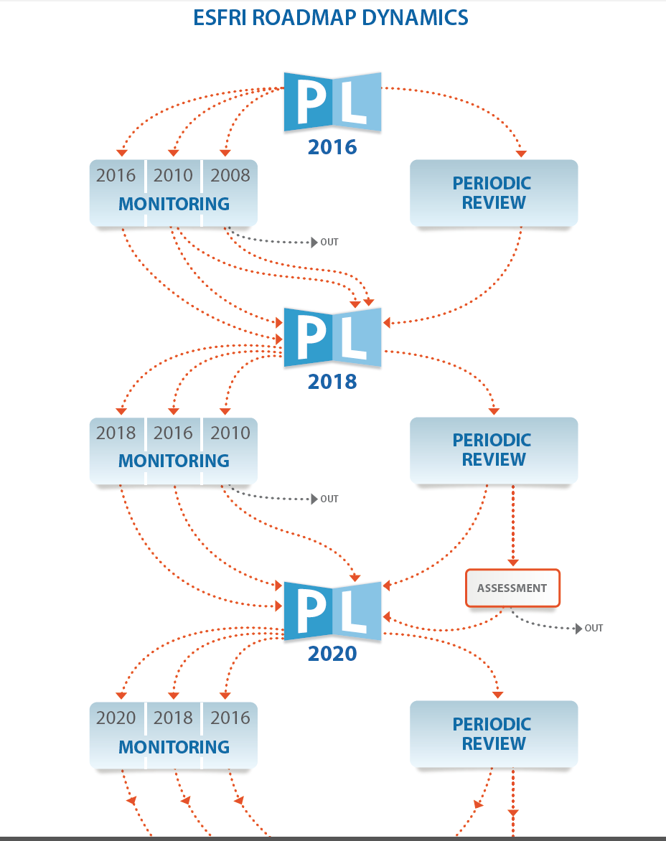
ESFRI ROADMAP DYNAMICS

Slide 24
Activities in Macedonia
Macedonia has not yet established an ESFRI Roadmap
We should join forces and push

